Slide 1


Slide 2
Hazards of Radiation

Slide 3
CONTENTS:
INTRODUCTION
WHAT ARE RADIATION HAZARDS??
HOW DOES IT OCCUR?
EFFECTS OF RADIATION ON BIOLOGICAL TISSUES
CONCLUSION
REFERENCES

Slide 4
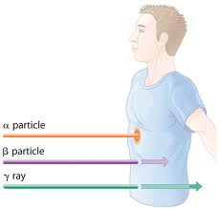
INTRODUCTION:
Radiation is the emission or transmission of energy in the form of waves or particles through space or through a material medium.
Spontaneous decay of radioactive materials produces radiation.
Radiation may be ionizing and non-ionizing.
Notes:
alpha particles densely ionize matter through which they pass. Accordingly, they quickly give up their energy and penetrate only a few microns of body tissue. (An ordinary sheet of paper absorbs them.)
beta particles are hydrogen-3 (tritium) ionize matter much less densely than alpha particles. Beta particles
are used in radiation therapy for treatment of skin lesions.
gamma rays are technetium-99m (the most commonly used radioactive material in nuclear medicine),

Slide 5
Ionizing Versus Non-ionizing Radiation
Ionizing Radiation
  Higher energy electromagnetic waves (gamma) or heavy particles (beta and alpha).
  High enough energy to free an electron from its orbit.
Non-ionizing Radiation
  Lower energy electromagnetic waves.
  Not enough energy to pull electron from orbit, but can excite the electron.

Slide 6
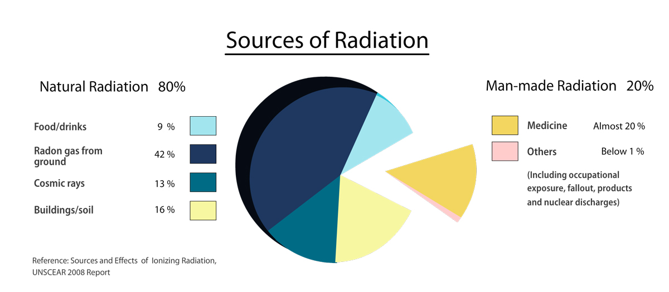
Notes:
Medicine : Although sources in this group include radiation therapy and diagnosis, diagnostic x-ray exposure is the largest contributor, with an average annual E of about 0.39 mSv. The contribution made by oral radiography has been excluded from this calculated total because dental examinations are responsible for a average annual E of less than the negligible individual dose (0.01 mSv)

Slide 7
Dosimetry:
Determination of the quantity of radiation exposure or dose.
Radiation dosimetry: deals with the absorbed dose or dose rate resulting from the interaction of ionizing radiation with matter & particularly in different tissues of the body.
Dose : Amt of radiation at a given point or the amt of energy absorbed/unit mass at the site of interest.
Erythema dose : Dose which produces in 1 sitting a reversible reddening of the skin (3-4 Gy)

Slide 8
RADIATION QUANTITIES AND UNITS:
Roentgen (R)
Gray (Gy)
Rad
Rem
Sievert
1 Gy = 100rad (traditional) = 1 joule/kg
1 Sv = 1 Gy
1 Sv = 100 rem (roentgen equivalent man, traditional)

Slide 9
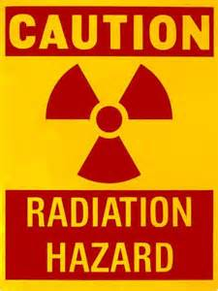
What are radiation Hazards???
The danger to health arising from exposure to ionizing radiation either due to external irradiation or to radiation from radioactive materials within the body.
Initial interaction b/w radiation and matter occurs at the level of electrons.
These molecular changes may result in alteration in the cells and organs.
Notes:
These changes may persist for hours , decades or possibly for generations, or the changes may be so drastic that they may result in the death of the cell or organism.

Slide 10
Effect of radiation on Biological Tissues:
Radiation Effects Deterministic Direct Biological Stochastic Indirect Cellular levels
Acute Chronic
Somatic Genetic
changes changes

Slide 11
Deterministic Effect :
It is an effect in which the severity of the response is proportional to the dose.
These effects have a dose threshold below which the response is not seen.
Ex: Oral changes after the radiation therapy
Effects usually in cell killing and may occur in all people when the dose is large enough.

Slide 12
STOCHASTIC Effect:
Stochastic effects are those that may develop.
Their development is random and depends on the laws of chance or probability.
Eg : Leukaemia, genetic effects and certain other tumours.
These damaging effects may be induced when the body is exposed to any dose of radiation.
It is therefore assumed that there is no threshold dose.
The lower the radiation dose, the lower the probability of cell damage. However, the severity of the damage is not related to the size of the inducing dose.

Slide 13
Direct action theory:
X ray photon
Interacts with a Molecule Chemical changes Biological changes
Free radical production:
RH + x-radiation ----- RO + H+ + e⁻
Free radical fates:
Dissociation:
R ---- X + Y‘
Cross-linking:
R + S ---- RS
The subsequent effect includes :
Abnormal replication
Inability to pass on information & Cell death
Notes:
Direct alteration of biologic molecules by ionizing radiation begins with absorption of energy by the biologic molecule and formation of unstable free radicals.
They are extremely reactive and have very short lives, quickly reforming into stable configurations by dissociation
(breaking apart) or cross-linking (joining of two molecules). Free radicals play a dominant role in producing
molecular changes in biologic molecules. Because the altered molecules differ structurally and
functionally from the original molecules, the consequence is a biologic change in the irradiated organism.
Approximately one third of the biologic effects of x-ray exposure
result from direct effects.

Slide 14
INDirect action theory:
Water is a predominant molecule of the biological system.
Two mechanisms:
Ionization.
Free radical formation
Notes:
About two thirds of radiation-induced biologic
damage results from indirect effects.

Slide 15
H2O -------------> H2O⁺ + e⁻
The positive ion immediately breaks up:-
H2O⁺ —> H⁺ + OH⁻
The electron (e-) attaches to a neutral water molecule:-
H20 + e⁻ —> H2O ⁻
The resulting negatively charged molecule dissociates:-
H20⁻ —> H + OH
The electrically neutral H and OH are unstable and highly reactive and called free radicals. They can combine with other free radicals, e.g. :-
H + H —> H2 (hydrogen gas)
OH + OH —> H202 (hydrogen peroxide)
Radiation
Notes:
The hydrogen peroxide can then DAMAGE the cell by breaking down large molecules like proteins or DNA.

Slide 16
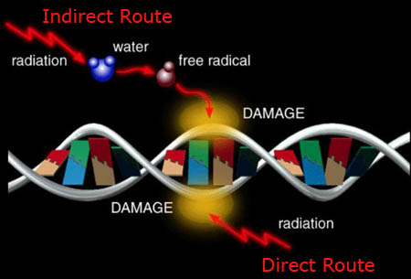

Slide 17
WHAT FOLLOWS???
Changes in:
Biologic molecules:
Proteins
Nucleic acid
At cellular level:
Nucleus
Cytoplasm

Slide 18
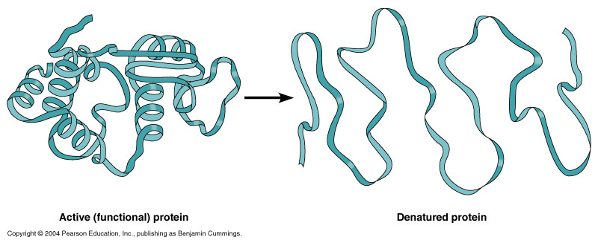
PROTEINS :
Denaturation.
Intermolecular and intramolecular cross linking.
When an enzyme is irradiated, inactivation of an enzyme molecule results in its failure to convert many substrate molecules to their products.
Notes:
Irradiation of proteins in solution usually leads to
changes in their secondary and tertiary structures
through disruption of side chains or the breakage of
hydrogen or disulfide bonds. Such changes lead to
denaturation.

Slide 19
NUCLEIC ACIDS :
Damage to a DNA molecule is the primary mechanism for radiation-induced cell death and mutation.
Breakage of one or both DNA strands
Cross-linking of DNA strands within the helix, to
other DNA strands, or to proteins.
Disruption of hydrogen bonds between DNA strands

Slide 20
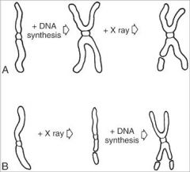
NUCLEUS :
Inhibition of cell division
Chromosomes :
Single or double armed
chromosomal aberrations.
CYTOPLASM:
Increased permeability of plasma membrane to Na and K ions
Swelling and disorganization of mitochondria.
Focal cytoplasmic necrosis.
Notes:
If radiation exposure occurs after DNA synthesis, only one arm of the affected chromosome
is broken (chromatid aberration). If
the radiation-induced break occurs before the
DNA has replicated, the damage
manifests as a break in both arms (chromosome aberration)
at the next mitosis

Slide 21
SOMATIC DAMAGE AND GENETIC CHANGES:
Somatic Damage : occurs in living cells/organisms and are not carried forward once the cell/ organism dies.
Genetic changes : rearrangement of genetic material leading to genetic mutation.

Slide 22
Somatic Damage :
An individual suffers somatic radiation damage when significant amounts of tissue are affected.
A short-term dose of 200 to 300 rads can result in sunburn-like injuries to the skin with accompanying hair loss.
At doses over 1,000 rads, the gastrointestinal system suffers upset, including nausea, electrolyte imbalance and other symptoms.
In excess of 5,000 rads, the nervous system undergoes shock, leading to confusion, loss of coordination or coma due to internal bleeding and pressure in the brain.
Delayed, longer-term somatic effects include the possible development of tumors, cancer and cataracts.

Slide 23
GENETIC Damage :
Genetic cells are the germ cells found in the reproductive organs.
Any damage will lead to loss or rearrangement of the genetic material , which results in genetic mutations.
Genetic mutations may show up in the next and subsequent generations.
Doubling dose for mutations – 2 Sv
Notes:
However, if a pregnant woman is exposed to radiation, the developing tissues in the fetus are vulnerable, particularly in the brain and nervous system; exposure may lead to mental retardation and other serious conditions. For this reason, the Food and Drug Administration recommends limiting medical X-rays and nuclear medicines for pregnant women.
One way to measure the risk from genetic exposure is by determining the doubling dose. Which is the amount of radiation a population requires to produce in the next generation as many additional mutations as arise spontaneously.

Slide 24
Short & long term effects:
 | Short term effects | Long term effects
Seen in | 1st day/ weeks after exposure | Months & years after exposure
Cells | Are lost by apoptosis | Loss of parenchymal cells & replacement with fibrous C.T
 | Effects are Quick | Effects are late
Examples | Bone marrow, oral mucous membrane | Damage to capillaries

Slide 25
Sequence of radiation injury:
Latent period :
The time that elapses between exposure to ionizing radiation and the appearance of observable clinical signs.
Period of injury :
Changes in cell function, breaking of chromosomes, cessation of mitotic activity or abnormal mitotic activity, cell death.
Recovery period :
Repair of radiation damage.
Notes:
Latent period :
More the radiation received-shorter is the latent period.
Period of injury:
Changes in cell function, breaking of chromosomes, cessation of mitotic activity or abnormal mitotic activity, cell death.
Recovery period:
Repair of radiation damage.
Lower dose of radiation more capacity to repair.
Damage due to high dose of radiation- not completely repaired- residual injury in DNA / cytoplasm

Slide 26
Characteristics in radiosensitive cells:
Bergone & Tribondeau observed:
High mitotic rate
Undergo many future mitoses
Are most primitive in differentiation

Slide 27
categories by Casarett
(based on histologic observation)
Vegetative intermitotic cells
Differentiating intermitotic cells
Reverting post mitotic cells
Fixed post mitotic cells

Slide 28
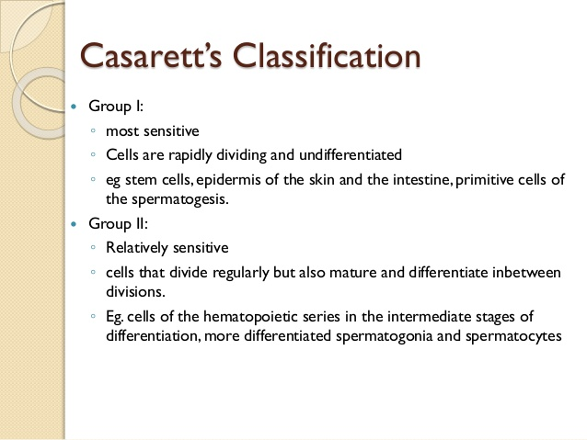

Notes:
Vegetative intermitotic cells:
Differentiating intermitotic cells

Slide 29
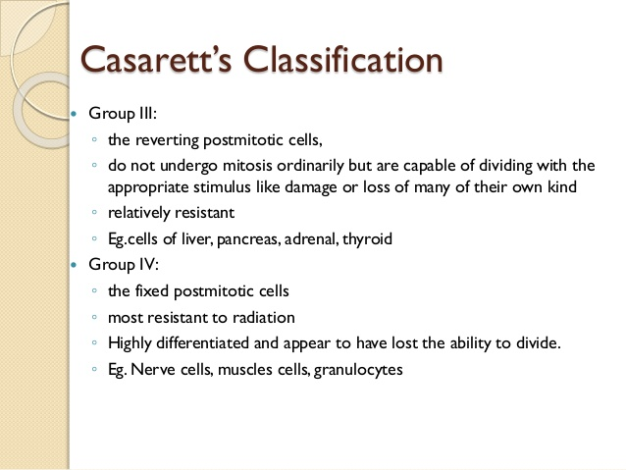
Notes:
Reverting post mitotic cells are least radioresistant, long lived and die without dividing. Dividing under special conditions.
Fixed postmitotic cells are most radioresistant becos they do not divide.1s matured are incapable of division.
Cells that are rapidly dividing spend more time in radiosensitive phase of the cell cylce

Slide 30
Radio sensitivity of organs:
High sensitivity | Bone marrow, lymphoid organs, mucous membrane, testes , Intestine.
Intermediate | Fine vasculature, growing cartilage, growing bone, salivary glands, lungs, liver, kidneys.
Low sensitivity | Optic lens, muscle, neurons

Slide 31
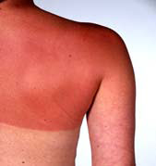
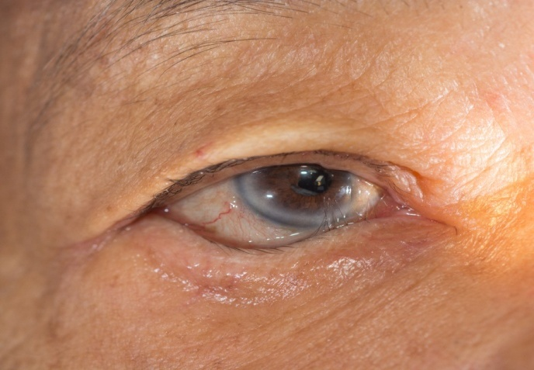
General effects of radiation :
SKIN: erythema,
dryness,
increased susceptibility to chapping.
loosening of hair,
keratosis, ulcerations.
Brittleness and ridging of finger nails.

Slide 32
EYES: epilation of eyelashes, dryness, inflammation , fibrosis and decreased flexibility of the eyelids, corneal ulceration, cataract formation.
EARS: radiation otitis media

Slide 33
HAEMATOPOIETIC
INJURY: leukopenia, anemia, lymphopenia
TESTICLES: alteration in fertility
functional changes in the offsprings may be seen.
OVARY: increase in frequency of hemangioma in children
receiving dose of radiation in uterus
The allowed exposures from specific radioactive sources to the public are limited to 100 mrem.
Medical X-rays generally deliver less than 10 mrem.

Slide 34
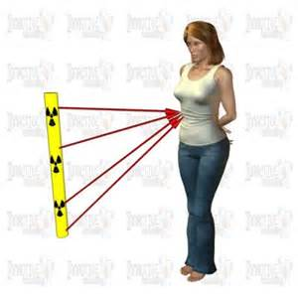
EFFECTS ON EMBRYO & FOETUS :
Embryo/fetus is rapidly developing so is more sensitive to a possible radiation effect than an adult because most embryonic cells are relatively undifferentiated and rapidly mitotic
Most sensitive period 18-45 days of gestation.
Effects vary with amount of radiation and stage of development of the embryo/fetus.
Increased risk for childhood cancer (leukemia)
Notes:
Irradiation during the fetal period (more than 50 days after conception) does not cause gross malformations. However general retardation of growth may persist through life.

Slide 35
Whole body irradiation:
Acute Radiation Sickness :
When the whole body is exposed to low or moderate doses of radiation there are characteristic changes seen.
Prodromal Syndrome:
Nausea , vomiting, diarrhea , anorexia.
Latent Period :
Period of apparent well being, extent of which is dose related.
Symptoms follow latent period when the individuals are exposed in lethal doses (approx 2-5 Gy) or suptralethal range (>5 Gy)

Slide 36
High doses to the whole body (>100 rem) intestinal lining is damaged to the point that it cannot perform its functions of intake of water and nutrients, and protecting the body against infection. This leads to nausea, diarrhea and general weakness.
Higher whole body doses (>300 rem) the body's immune system is damaged and cannot fight off infection and disease.
At whole body doses near 400 rem if no medical attention is given, about 50% of the people are expected to die within 60 days of the exposure, due mostly from infections.
Whole body dose more than 1,000 rem vascular damage of vital blood providing systems for nervous tissue, such as the brain. It is likely at doses this high, 100% of the people will die, from a combination of all the reasons associated with lower doses and the vascular damage.
Notes:
Absorbed 1gy=100rad(traditional)
1Sv=1gy
1Sv=100 rem(roentgen equivalent man, traditional)
1 rem = 1 rad

Slide 37
Three categories (E. Hall, 1994)
  Hemopoietic syndrome: 3-8 Gy
  Damage to circulatory system
  Fall in number of granulocytes, platelets, erythrocytes.
  Hemorrhage due to thrombocytopoenia
  Anemia due to depletion of erythrocytes
  Gastrointestinal syndrome : >10 Gy
  Radiation depopulates GI epithelial cells. (crypt cells)
  Abdominal pain/fever, diarrhea, dehydration
  Death 3 to 10 days (no record of human survivors above 10 Gy)
  CNS and CVS syndrome : > 50 Gy
  Stupor, incordination , disorientation, convulsions.
  Death within 1 – 2 days

Slide 38
COMMONLY ENCOUNTERED RADIATION DOSES
Effective Dose Radiation Source
<= 0.01 rem annual dose living at nuclear power plant perimeter; bitewing, panoramic, or full-mouth dental x rays; skull or chest x ray
<=0.1 rem single spine x ray; abdominal or pelvic x ray; hip x ray; mammogram
<=0.5 rem kidney series of x rays; most barium-related x rays; head CT; spine x-ray series; annual ; most nuclear medicine brain, liver, kidney, bone, or lung scans
<=1.0 rem barium x rays of the large intestine;
chest, abdomen, or pelvic CT
<=5.0 rem cardiac x rays; most nuclear medicine heart scans
Notes:
Absorbed 1gy=100rad(traditional)
1Sv=1gy
1Sv=100 rem(roentgen equivalent dose, traditional)

Slide 39
Critical organs receiving scattered radiation include :
BONE MARROW max dose for damage is 2 Gy
13mR - Full mouth IOPA
THYROID 10R - thyroid cancer
40mR - full mouth IOPA
GONADAL Male gonads - 0.3mR
female – 0.03mR
EYE cataract > 500R
Notes:
Radiosensitive target organs commonly reported include bone marrow, thyroid gland, and gonads. The mean active bone marrow dose is an important measurement because bone marrow is the target organ believed responsible for radiation-induced leukemia. Particular concern has been expressed over exposure of the thyroid because this gland has one of the highest radiation-induced cancer rates. The gonad dose is important because of suspected genetic responses to diagnostic x-ray exposure.

Slide 40
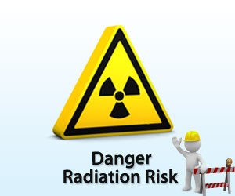
EFFECTS ON DENTAL TISSUES:
ORAL MUCOUS MEMBRANE
SALIVARY GLANDS
TASTE BUDS
TEETH
BONE

Slide 41
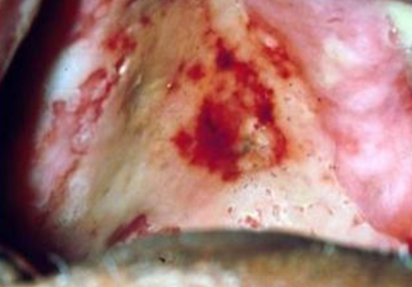
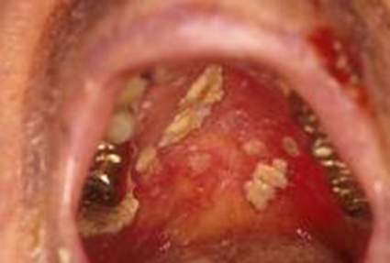
Oral mucositis:
Oral mucous membrane:
Inﬂammation of oral mucosa resulting from chemotherapeutic drugs or ionising radiation.
Radiation mucositis is defined as the reactive inflammation of the oral and oropharyngeal mucous membranes during radiotherapy in the head and neck region.
Basal layer – most radiosensitive.
By the end of second week of therapy-areas of redness and inflammation are visible(mucositis).
On continuation of therapy- formation of white to yellow pseudomembrane.
At the end of therapy- severe mucositis, discomfort, difficulty in food intake.

Slide 42
PATHOGENESIS:
Acute mucositis results from the loss of squamous epithelial cells
linear decrease in the number of epithelial cells
resulting in some or complete denudation of the mucosa.
Signs of radiation Induced mucositis : erythema, ulceration, necrosis, and bleeding.
Notes:
PATHOGENESIS:
Acute mucositis results from the loss of squamous epithelial cells because of radiation-induced mitotic death of basal keratinocytes. This process leads to a gradual linear decrease in the number of epithelial cells. As radiotherapy continues, a steady state between death and regeneration of mucosal cells could occur because surviving cells are produced at an increased rate. However, cell regeneration often cannot keep up with the rate of cell death, resulting in some or complete denudation of the mucosa.
In addition to direct tissue injury, the oral microbial ﬂora is thought to contribute to radiotherapy-induced Mucositis.
Viral infections differ clinically from mucositis, because they are typically cropped and localised and affect keratinised mucosa, and often coincide with fever at onset.

Slide 43
World Health Organization (WHO) scale for oral mucositis
Grade 0 = No oral mucositis
Grade 1 = Erythema and Soreness
Grade 2 = Erythema / Ulcers, able to eat solids
Grade 3 = Ulcers, requires liquid diet
Grade 4 = Ulcers, alimentation not possible (due to mucositis)
Notes:
In patients who have received radiotherapy, some data suggest that chlorhexidine worsens the condition.
Prophylactic rinsing with saline or chlorhexidine might provide indirect beneﬁts, by controlling plaque amounts, gingivitis, and oropharyngeal candidiasis.
Scully C, Epstein J, Sonis S. Oral mucositis: a challenging complication of radiotherapy, chemotherapy, and radiochemotherapy. Part 2: diagnosis and management ofmucositis. Head Neck 2004; 26: 77–84
The use of topical drugs pertain to the use of sucralfate and chlorhexidine, also with conﬂicting results.
(Konturek SJ, Brozozowski T, Bielanski W, et al. Epidermal growth factor in the gastroprotective and ulcer-healing actions of sucralfatein rats. Am J Med 1989; 86: 32–37)

Slide 44
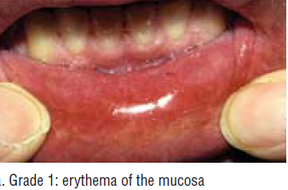
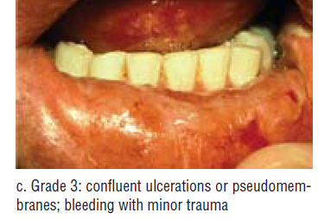
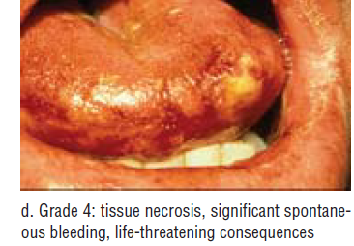


Slide 45
Management of oral mucositis:
  Pain control :
  Topical mouth rinse - 2% viscous lidocaine to reduce pain mixed with equal volume of diphenhydramine to prevent infection.
  Sucralfate forms a protective coating over ulcerated mucosa there by reducing pain.
  Nutrition support :
  A soft diet and liquid diet supplements are more easily tolerated than a normal diet.
Notes:
Sucralfate is thus a direct cytoprotectant, which was initially thought to prevent or control radiation-induced mucositis, but double-blinded studies have not conﬁrmed its efﬁcacy. However, even though sucralfate does not prevent mucositis, reduced overall oropharyngeal pain has been recorded .

Slide 46
  In patients expected to develop severe mucositis , a gastrostomy tube is sometimes placed prophylactically .
Oral decontamination :
Microbial colonization of oral mucositis lesion increase the severity of oral mucositis and septicemia.
Achieved by using soft toothbrush, flossing and use of non medicated rinses like saline or sodium bicarbonate.
Management of Oral Mucositis in Patients with Cancer.
Dent Clin North Am. Author manuscript; PMC 2009 Jan1
Notes:
Multiple studies have examined the role of chlorhexidine
mouthrinse in oral mucositis but have not demonstrated significant efficacy in reducing severity
of mucositis.
,. Therefore, the MASCC/ISOO - Multinational Association of Supportive Care in Cancer. guidelines recommend against the use of
chlorhexidine mouthrinse for prevention or treatment of oral mucositis.

Slide 47
SALIVARY GLANDS :
Marked decrease in the salivary flow
Composition of saliva is affected.
Saliva loses its lubricating properties.
Mouth becomes dry and tender due to xerostomia
pH of saliva is decreased which may initiate decalcification of enamel.
A compensatory hypertrophy of the salivary gland may take place and xerostomia may subside after 6 - 12 months after therapy.

Slide 48
Salivary glands are exquisitely sensitive to radiation and display acute and chronic responses to radiotherapy.
Significant reductions in flow rate
Loss of glandular weight,
Loss of acinar area or cells.
Maximum cumulative exposure to the parotid and submandibular glands in affected individuals has been set at 24-26 Gy & 39 Gy, respectively, to limit side effects.
O. Grundmann, 2009 Oct
J Dent Res. 2009 Oct; 88(10): 894–903.
Sensitivity of Salivary Glands to Radiation from Animal Models to Therapies
Notes:
Cumulative exposure is the total exposure resulting from repeated exposures of ionizing radiation to an occupationally exposed worker to the same portion of the body, or to the whole body, over a period of time.

Slide 49
Treatment :
Palliative Therapies
Use of artificial saliva and mouth moisturizers.
Pilocarpine, had been approved by the FDA.
Cevimeline, which is already approved for Sjögren’s syndrome, has undergone open-label studies for use in affected individuals following radiotherapy (Chambers et al., 2007).
Restorative Therapies
Gene Transfer
Stem Cell Transplantation
Artificial salivary gland.
J Dent Res. 2009 Oct; 88(10): 894–903.
Sensitivity of Salivary Glands to Radiation from Animal Models to Therapies
Notes:
Pilocarpine – 5mg tid
Cevimeline – cholinergic agonists – 30mg
These treatments are not well-suited for long-term treatment; thus, an emphasis has been placed on restorative therapies.

Slide 50
Garg AK, Malo M. 1997
Simpson JR, Lee HK , 1998
Tolerance dose for the parotid gland 25–40Gy. Cumulative tumoricidal doses of 60–70 Gy. Serous acini are considered more sensitive and immediately degenerate after radiation.
The severity of xerostomia is related to the radiation dose, dose rate and amount of salivary tissue irradiated. During radiotherapy of a salivary gland tumor, if the salivary glands of the opposite side are not in the direct field of the radiation beam, the xerostomia will not be severe.
Notes:
Garg AK, Malo M. Manifestaions and treatment of xerostomia and associated oral effects secondary to head and neck radiation therapy. . J Am Dent Assoc 1997; 128:1128-33
Simpson JR, Lee HK. Salivary glands. In: Perez CA, Brady LW, eds. Principles and Practice of
Radiation Oncology. 3rd ed. Philadelphia: Lippincott-Raven; 1998:961-80
The parotid glands are composed primarily of serous acini and produce a watery like secretion, whereas the sublingual and submandibular glands are composed of both serous and mucous acini.

Slide 51
Taste buds:
Sensitive to radiation.
Taste sensation decreases exponentially with a cumulative dose of about 30 Gy
Loss of taste during second week of therapy.
Bitter & acid taste affected- post. 2/3rd irradiated, salt & sweet – ant 1/3rd.
Mucositis and taste loss are reversible consequences

Slide 52
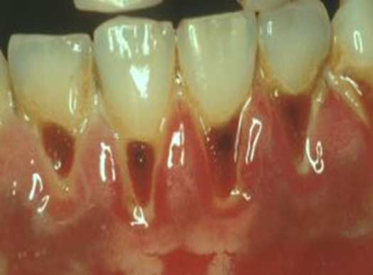
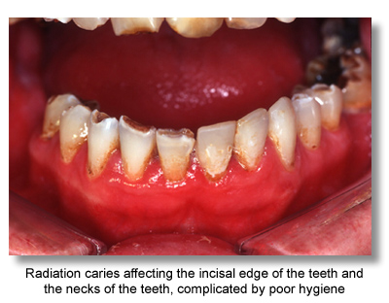
TEETH :
Prior to calcification, the tooth buds get
destroyed.
Pulp shows decreased vascularity, reduced
cellularity and tooth becomes more prone to
pulpitis.
RADIATION CARIES:
Rampant form of caries.
These lesions occur secondary to changes in
the salivary gland.
Radiation-induced hyposalivation is the main factor
for dental caries
Decreased pH of saliva
Increased viscosity.
The average post-irradiation pH falls from about 7·0 to 5·0 - cariogenic
Notes:
One of the accepted side effects of megavoltage radiotherapy to neoplasms of the mouth and pharynx is a diminution of salivary flow. This is at its greatest when two opposed fields are used for lesions of the nasopharynx and oropharynx. Secretions from both parotids and both submandibular salivary glands as well as some of the many small mucosal glands, are then grossly diminished. This effect would seem to be at its greatest in those patients treated with hyperbaric oxygen. The reduction begins at the end of the first week of treatment, when about 1,000 rads have been given. The quantity of saliva is not only reduced but its nature becomes more viscid and adhesive. Thus the normal movements of the lips and tongue, which enable food to be manipulated and masticated, are reduced. Taste is lost and almost always the patient adopts a semi- solid or fluid diet to mitigate his difficulties and, in order to obtain adequate nourishment, these fluid diets are of high carbohydrate content.
These factors of reduced and altered saliva, reduced lubrication, reduced fibre content and increased carbohydrate content of the food result in stagnation of the secretions and food remnants, together with inflammatory exudates from the lesion itself and the irradiation reaction in the mucous membrane. Much of this debris clings around the teeth and sulci and engenders widespread dental
Early irradiation caries. caries of all teeth whether in the irradiated areas or
not

Slide 53
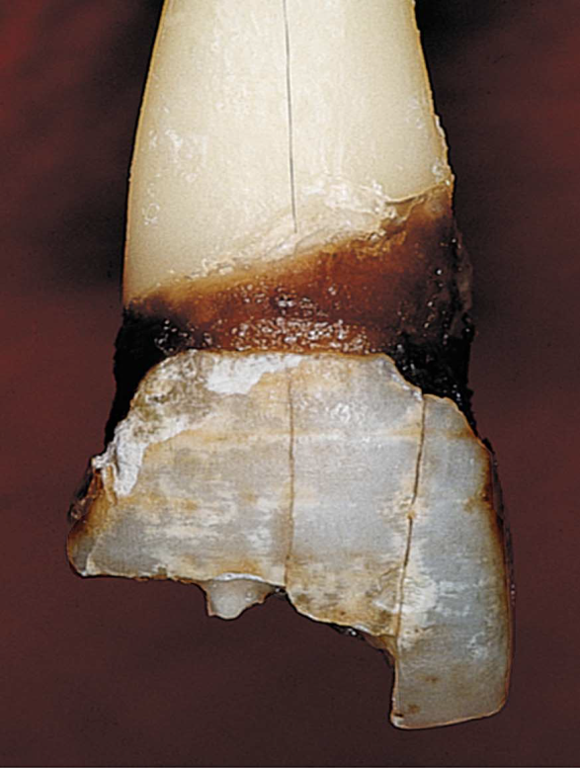
Clinically, it starts on the labial surface at the cervical areas of the teeth,
Affect smooth surfaces including mandibular anterior teeth
Encircle the cervical areas of the tooth
Brown-black discoloration of the entire tooth crowns, leading to increased friability and breakdown(accompanied by wear of the incisal and occlusal surfaces)
Severe cases - Complete amputation of the crown can be seen
NaF gel 1%
Sucrose
Notes:
This effect is thought to be due to mechanical cleansing of these surfaces by the continuous flow of saliva that is severely impeded in radiation-induced hyposalivation

Slide 54
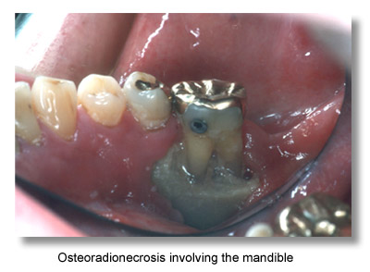
Bone :
Osteoradionecrosis :
Osteoradionecrosis is a possible complication following radiotherapy where an area of bone does not heal from irradiation.
Damage to osteocytes and impairs the blood supply.
Hypovascularity (reduced number of blood vessels),
Hypocellularity (reduced number of cells).
Hypoxia (low levels of oxygen).
Incidence of the disorder varies greatly, ranging from 1% to 37·5%.
Notes:
One study has shown an overall reduction in the incidence of osteoradionecrosis during the past 20 years.
The basis of this tissue alteration resides with radiation
related generation of free radicals and corresponding damage to endothelial cells within the treatment ﬁeld.
Over time, this occurrence leads to hypovascularity, tissue hypoxia, destruction of bone-forming cells, and marrow ﬁbrosis.

Slide 55
Clinical characteristics :
Osteoradionecrosis usually occurs in the mandible, and causes chronic pain and surface ulceration.
Asymptomatic regions of exposed bone that remain stable.
Full-blown osteonecrosis is characterized by severe pain and a foul smelling necrotic jaw bone (of a green-grey colour ) with suppuration.

Slide 56
Management
If osteoradionecrosis is diagnosed early, local debridement, antibiotic treatment can be successful.
In patients with established disease, the use of hyperbaric oxygen coupled with resection of necrotic bone is indicated.
Hyperbaric oxygen stimulates angiogenesis, ﬁbroblast and osteoblast proliferation, and collagen formation in irradiated tissues, and increases cellular oxygen concentrations.
Notes:
All these factors result in hypoxia, a major component of delayed wound healing secondary to decreased ﬁbroblast activity and reduced efﬁciency of collagen production. Finally, secondary infection, injury, and surgery contribute to worsening late morbidity.

Slide 57
Marx protocol for treatment of osteoradionecrosis
Stage I ORN :
Patients with exposed bone who have no serious manifestations, Begin with 30 dives HBO with no debridement or only minor bony debridement. If patient improves, give 10 additional HBO dives.
Stage II ORN:
If no improvement, Stage II patients should receive surgical debridement and 30 HBO dives followed by 10 post-operative dives. Surgery for Stage II patients must maintain mandibular continuity.
Stage III ORN:
If mandibular continuity is not achieved, Stage III patients are entered into a reconstructive protocol where a mandibular resection if followed by a planned reconstruction. All necrotic bone must be surgically eradicated. Stage III patients receive 30 HBO dives prior to resection followed by 10 dives post-resection.
Notes:
*.
The number of treatments may vary according to the severity of the condition.

Slide 58
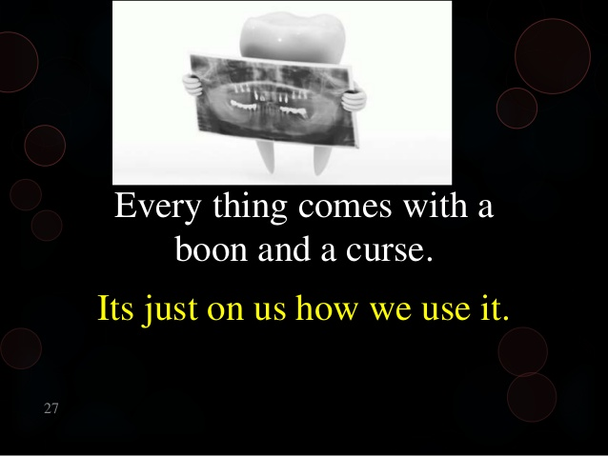
Conclusion
Notes:
Early disasters led to the discoveries of various radiation effects.
Therefore, radiation-induced damage should be anticipated and prevented whenever possible and managed early.

Slide 59
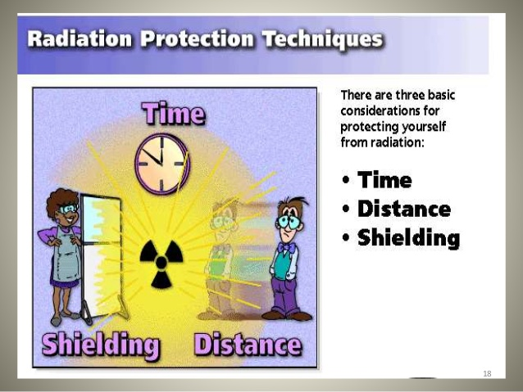



conclusion
Notes:
Adequate radiation protection techniques and radiation monitoring equipments should be employed to minimize or avoid the various hazards of radiation, thus protecting mankind...........

Slide 60
References:
Textbook of Dental and Maxillofacial Radiology – Freny Karjodkar
Oral radiology – principles and interpretation 2 edition, Goaz & White.
Text book of Oral Radiology, White & Pharaoh
Journal Articles
Internet Sources

Slide 61
Thank you

