Slide 1
RECURRENT APHTHOUS ULCER
Presented by
Dr. V. Usha.,
1st yr M.D.S.,
Dept of oral medicine
&
Radiology

Slide 2
ULCER
The complete loss of epithelium accompanied by a variable loss of underlying connective tissue resulting in a crateriform appearance which may be augmented by edema and or a proliferation of the surrounding tissue
Long standing oral ulcers-J Oral Pathol Med (2009) 38:241-53

Slide 3
RECURRENT APHTHOUS ULCER
RAU is common oral mucosal disorder which is characterized by single or multiple recurrent small, round or ovoid ulcers with circumscribed margins, erythematous haloes and yellow or grey floors.
Recurrent aphthous stomatitis.OralDiseases (2006)12, 1-21

Slide 4
Affects 20% of the general population
5-66% in adult population
40% - before 5 years
female–predominance
children in higher socioeconomic status -commonly affected
Decreased with age
Text book of orall&maxillofacial pathology –Neville 3rd Edition

Slide 5
ETIOLOGY
Genetic
Bacterial infection
Immunologic abnormalities
Hematologic deficiency
Text Book of Oral Pathology-Shafer-4th Edition

Slide 6
PRECIPITATING FACTORS
Endocrine conditions
Psychic factors
Allergic factors
Trauma
Text Book of Oral Pathology-Shafer-4th Edition

Slide 7
PATHOGENESIS
A
D
C
C
Aggregation of T cell
TNF-alpha &IL-2 secretion
Recurrent aphthous stomatitis.OralDiseases (2006)12, 1-21
Inflammatory process
MHC I&MHC II antigen expression
Target the epithelial cells
Cell death

Slide 8
CLASSIFICATION
1
Minor
2
Major
3
Herpetiform
4
Associated with Behcet’s syndrome
Text Book of Oral Pathology-Shafer-4th Edition

Slide 9
CLINICAL MANIFESTATIONS
PRODROMAL STAGE
Patient may feel tingling sensation or irritation at the particular area.
PRE ULCERATIVE STAGE
white papules surrounded by erythematous halo.
ULCERATIVE STAGE
Painful ulceration of the papule.
HEALING STAGE
Symptom abutment and progressive healing.
REMISSION
No evidence of lesion

Slide 10
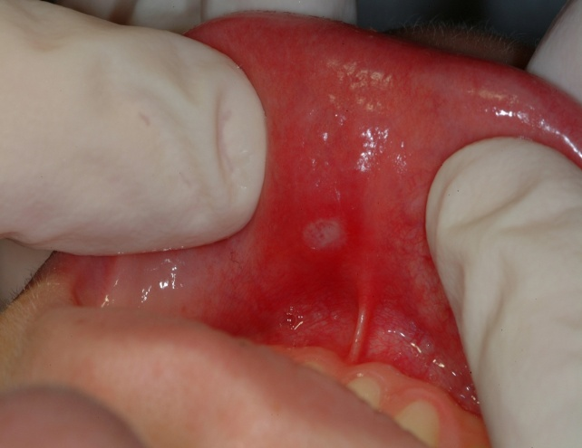
Minor
First episode begin-2nd decade
Prodromal burning-2 to 48 hrs
Within hours-small white papule forms & ulcerates
Text Book of Oral Medicine
-Burkete’s 11th Edition

Slide 11
Ulcers gradually enlarge
Individual lesion- round, symmetric and shallow
Multiple lesion- vary in no, size,& frequency
Buccal and lingual mucosa-commonly affected
Keratinized mucosa-less common
Size-0.3to 1 cm
Self limiting
Begin healing-within a week
Complete without scarring-10-14 days
Text Book of Oral Medicine-Burkete’s 11th Edition

Slide 12
Major/Sutton’s disease
>1 cm in diameter in size
Sever cases-large portions covered
Lips, cheeks, tongue, palate-common
Last for weeks to month
Heals in 4weeks to 6 weeks
Leaves scar
Occur at frequent intervals
Text Book of Oral Medicine-Burkete’s
11th Edition

Slide 13
Herpetiform
Numerous small lesions
Begin as pinhead sized erosions, gradually enlarged and coalesce
More painful
Text Book of Oral Medicine-Burkete’s 11th Edition

Slide 14
Associated with Betchet’s disease
Genital ulcerations
Occular lesions
Skin lesions
Text Book of Oral Pathology-Shafer-4th Edition

Slide 15
DIAGNOSIS
Basis of history and clinical features

Slide 16
DIFFERENTIAL DIAGNOSIS
RIHS
Traumatic ulcers
Immune mediated diseases
Exposure to certain drugs
Squamous cell carcinoma
DD for Oral Maxillofacial Lesions-Wood&Goaz

Slide 17
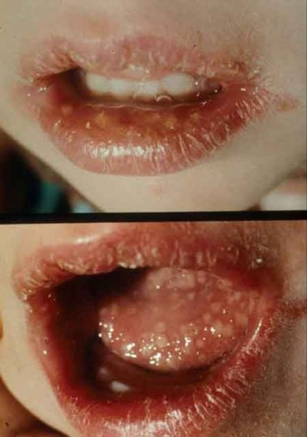
RIHS
Seen in keratinized mucosa
Precede by vesicles
Accompanied by prodromal syndrome
Multiple small ulcers that tend to coalesce as they heal
Lesion often returns to the same location
DD for Oral Maxillofacial Lesions-Wood&Goaz

Slide 18
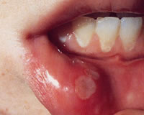
Traumatic ulcers
Almost always history of injury
Variable size
Borders –irregular
Affecting any area
DD for Oral Maxillofacial Lesions-Wood&Goaz

Slide 19
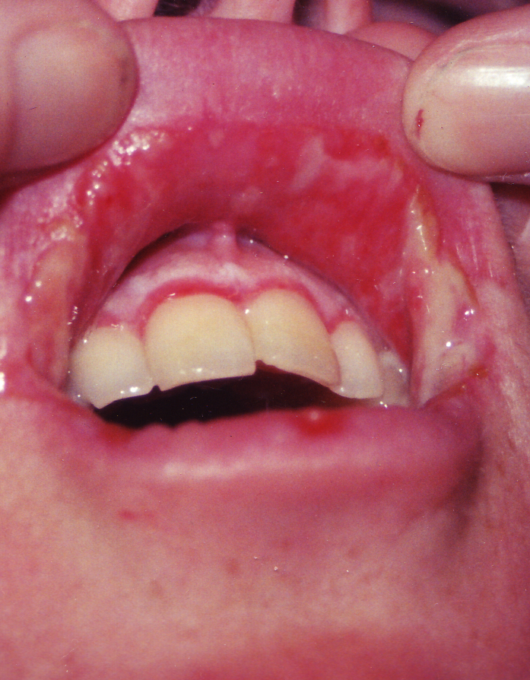
Immune mediated diseases
Present with broad areas of erythema
Bilateral
DD for Oral Maxillofacial Lesions-
Wood&Goaz

Slide 20
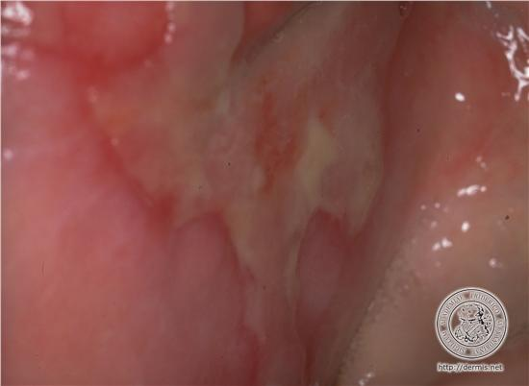
Exposure to certain drugs
eythematous eruptions within
24 hrs
lips and tongue - frequently involved
Recur in the same site each time
The Journal of Contemporary Dental Practice,
Vol 9,No 3, march 1 2008

Slide 21
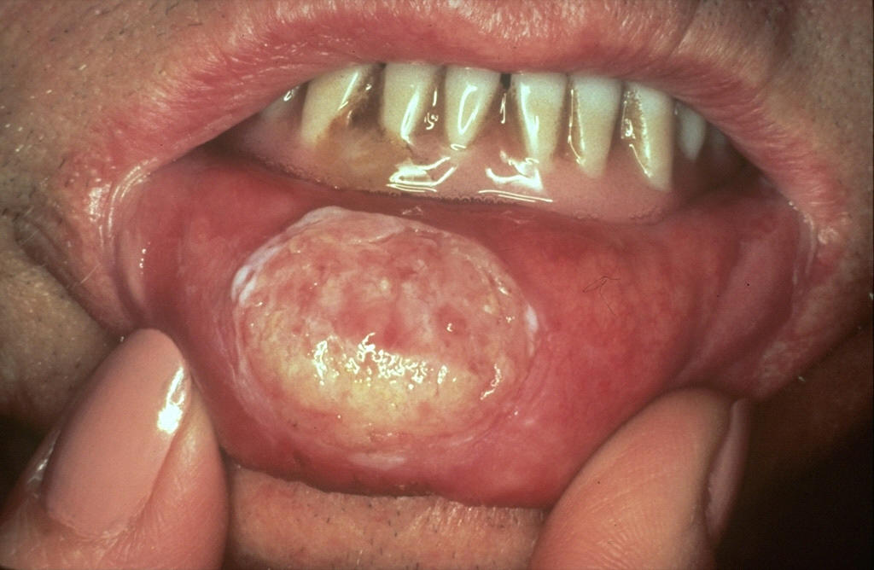
Squamous cell carcinoma
Persistent
Asymptomatic
Firm in consistency
Can present at any location
DD for Oral Maxillofacial Lesions-Wood&Goaz

Slide 22
CONDITIONS MIMIC APHTHAE
Behcet’s syndrome
Crohn’s disease & orofacial granulomatosis
Gastrointestinal diseases
Periodic fever, aphthae, pharyngitis and adenitis syndrome
Sweet’s syndrome
Cyclic neutropenia
HIV.
Oral Ulceration-Aliment pharmacol The 2003:18:949-962

Slide 23
INVESTIGATIONS
Hematologic estimation –iron, folate, vit B12
Biopsy
Text Book of Oral Medicine-Burkete’s 11th Edition

Slide 24
TREATMENT

Slide 25
GOALS OF THERAPY
Relieve discomfort
Reduce secondary infection
Promote healing of existing ulceration
Prevent new ulcers
formation
Oral Ulceration -Aliment Phormocol Ther 2003:18;949-62

Slide 26
Type A
Episodes lasting for only few days
Few times a year
Pain is tolerable
Identify the precipitating factors & eliminate
Medication may not be indicated
The Diagnosis and management of RAS-J Am Dent Assoc,Vol 134 No2,200-207

Slide 27
Type B
monthly episode
lasting for 3-10 days
Painful
Analgesic, antiseptic,mild topical corticosteroids
The Diagnosis and management of RAS-J Am Dent Assoc, Vol 134 No2,200-207

Slide 28
Type C
Chronic course
One ulcer heals, another develops
Painful
Potent topical corticosteroids,systemic Cort, other immunosuppresents
The Diagnosis and management of RAS-J Am Dent Assoc, Vol 134 No2,200-207

Slide 29
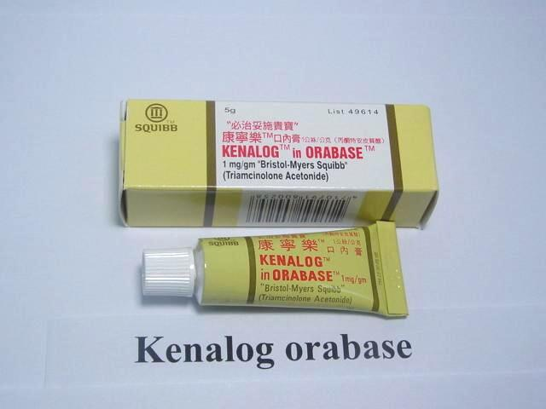
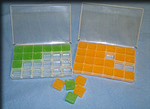
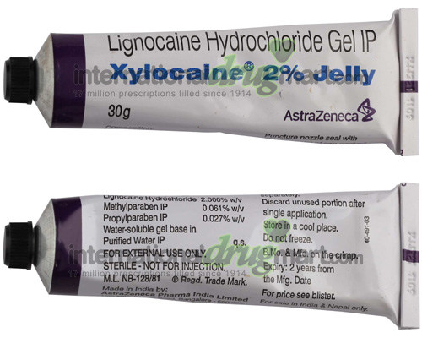
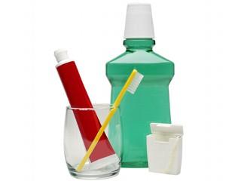

Slide 30
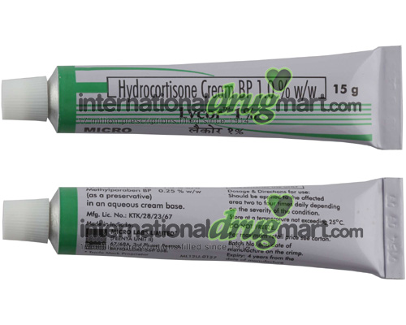
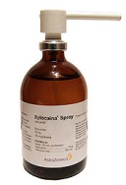
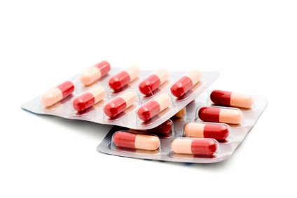

Slide 31
How to select the treatment
TYPE OF TREATMENT | PARTICULARLY SUITABLE FOR
Covering agent e.g. orobase | Sporadic or infrequent ulcers in anteriorly in buccal and labial mucosa ideally in single ulcer
Antiseptic mouth washes | When ulcers affect wide range of oral sites not accessible to covering paste
Low potency topical steroids | Not severe but trouble the patient because they recur frequently
Aerosols | Ulcers in inaccessible site such as soft palate and oropharynx
Steroid mouthwashes | Ulcers affect wide range of site and severe
Systemic steroids | Either severe or refractory to other treatment
Use of proprietary agents to relieve RAS British Dental Journal
182(4):144-46 1997

Slide 32
CURRENT CONCEPTS
Topical therapy
Dietary &general measures
Certain foods
Certain dental products
should be avoided
Local anesthetics
Lidocaine (xylocaine)-2% gel or spray –tid/qid
Benzocaine(Americaine) – 10-20% gel-qid
Current concept in the treatment of RAU-US National Library of Medicine and PubMed sep 2010

Slide 33
Antiseptics
Chlorhexidine gluconate – 12% mouthrinse
Antibacterials
Tetracyclines- (Resteclin)250mg cap in 10ml of water
Chlortetracycline 3% paste
Doxycycline –(Doxt)100mg cap in 100ml water
Current concept in the treatment of RAU-US National Library of Medicine and PubMed sep 2010

Slide 34
Analgesics
Benzydamine hydrochloride –spray& m.rinse(0.15%)
Diclofenac in hyaluronan gel (3%in 2.5% gel)
Topical corticosteroids
Hydrocortisone hemisuccinate(corlan) -2.5mg pellets
Triamcenolone -0.1% in carboxy methylcellulose paste(Adcortyl in orobase)
Flucinonide -0.1%cream
Clobetosol -0.05% cream
Recurrent aphthous stomatitis.OralDiseases (2006)12, 1-21

Slide 35
Contn…,
Dexamethosone elixir-0.5mg/ml
Betamethasone sodium phosphate –mouthrinse
Beclomethasone dipropionate –spray ,8puffs/day
Cyclosporine- mouth rinse
Prostoglandin E2 gel
Comprehensive review of treatment of aphthous stomatitis. (2002-3)

Slide 36
Others
Diphenhydramine elixir-12.5mg/5ml
Diclonine hydrochloride-0.5% or 1%
Sodium cromoglycate –lozenges
Sucralfate-5ml
Amlexenax-5% paste
Management of RAS (ORAS). Annal Dent Univ Malaya 1999; 6: 40-42
Oral surg Oral med Oral path vol83 No2 feb 1997

Slide 37
Local physical treatment
Surgical removal
Debridement
Perilesional infiltration
Laser ablation
Chemical cautery (e.g. silver nitrate sticks)
Physical barriers(e.g. cyanoacrylate adhesives)
Recurrent aphthous stomatitis.OralDiseases (2006)12, 1-21

Slide 38
Systemic therapy
Prednisolone-40mg/day
Systemic zinc sulphate
Immuno suppresents
Colchicine-1.5 mg/day for 2 months
Thalidomide-100mg/day for 2-3 months
Pentoxifyline-4oomg/day ,qid for 6 months
Levamisole-150mg/day for 3 consc days
INF-alpha-6-9×10 units 3 times/week
Current concept in the treatment of RAU-US National Library of Medicine and PubMed sep 2010
6

Slide 39
CONCLUSION

Slide 40
REFERENCES
Comprehensive review of treatment of aphthous stomatitis. (2002-3)
Current concept in the treatment of RAU-US National Library of Medicine and PubMed sep 2010
DD for Oral Maxillofacial Lesions-Wood&Goaz
Long standing oral ulcers-J Oral Pathol Med (2009) 38:241-53
Management of RAS (ORAS). Annal Dent Univ Malaya 1999; 6: 40-42
Oral surg Oral med Oral path vol83 No2 feb 1997
Oral Ulceration -Aliment Phormocol Ther 2003:18; 949-62

Slide 41
Contn…,
Recurrent aphthous stomatitis.OralDiseases (2006)12, 1-21
Text Book of Oral Medicine-Burkete’s 11th Edition
Text Book of Oral Pathology-Shafer-4th Edition
Text book of orall&maxillofacial pathology –Neville 3rd Edition
The Diagnosis and management of RAS-J Am Dent Assoc, Vol 134 No2,200-207
Use of proprietary agents to relieve RAS British Dental Journal 182(4):144-46 1997

