Slide 1
INVESTIGAIONS

Slide 2
Capillary fragility test
INR
Prothrombin time
Schilling’s test
Schrimer’s test
Paul Bunell test
Kveim’s test
Pathergy test
Immunofluorescence

Slide 3
Capillary Fragilitiy test
Tournique test / rumpel leede test
sphygmomanometer cuff to the upper arm and raising the pressure in it between diastolic and systolic for 5 minutes
After deflation, the number of petechiae appearing in the next 5 minute in 3 cm2 area over the cubital fossa are counted.
Presence of more than 20 petechiae is considered a positive

Slide 4
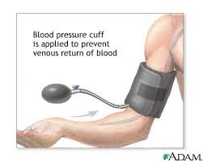
Positive in
increased capillary fragility
thrombocytopenia

Slide 5
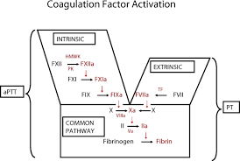
Coagulation pathway

Slide 6
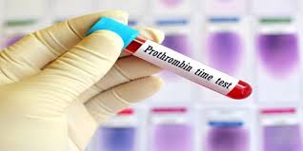
Prothrombin Time
Extrinsic and common pathway
Tissuethromboplastin and calcium are added to platelet poor plasma
Clotting time of mixture is noted
Commercial tissue thromboplastin is prepared from rabbit brain or lung
Normal values depend upon the thromboplastin used
Normal : 11- 16 sec

Slide 7
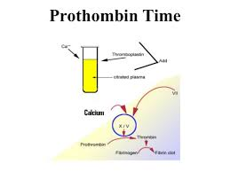

Slide 8
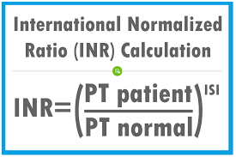
To ensure uniformity of anticoagulation therapy the results should be reported as INR

Slide 10
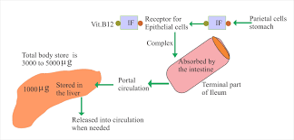
Schilling’s test

Slide 11
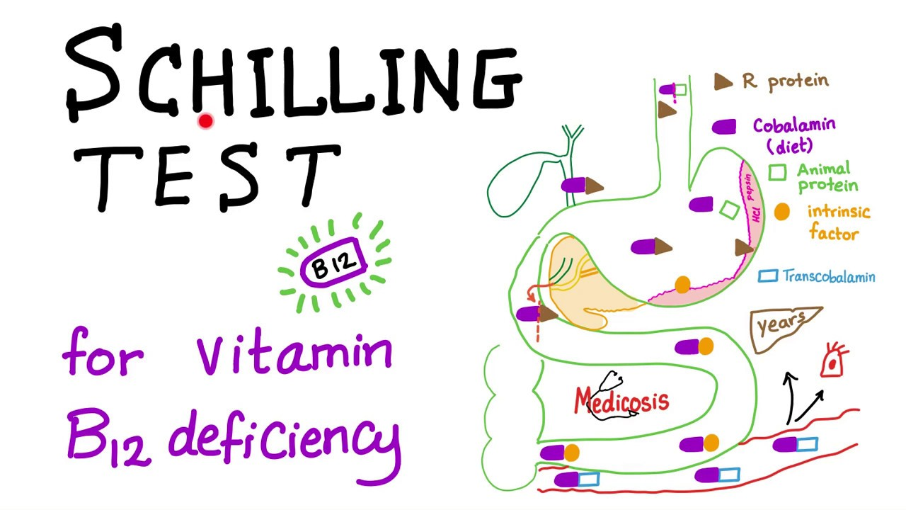
Schilling’s test
Test is done to assess vit B12 malabsorption
Two doses
Small radioactive dose orally
Large non radioactive dose intramuscularly
24 hrs urine collection

Slide 12
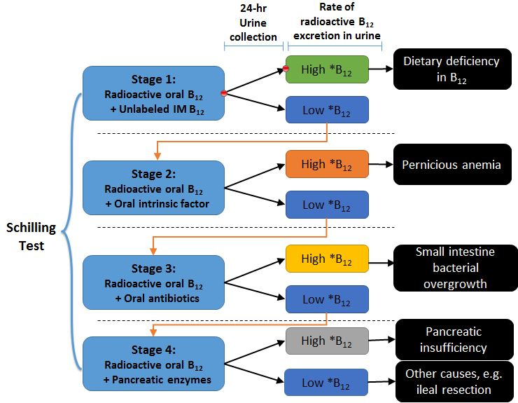

Slide 13
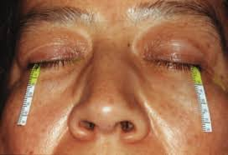
Schrimer’s test

Slide 14
PATHERGY TEST
Intradermal inj of 0.1 ml of isotonic salt solution using 20 G needle without prior disinfection of the injection site
3 – 5 mm intradermally at an angle of 45 degrees
After 24 – 48 hrs
Erythematous papule or pustule ( >2 mm) at prick site

Slide 15
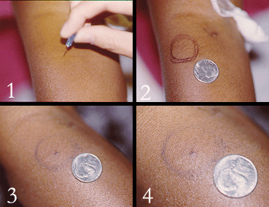

Slide 16
Kveim – Siltzbach testtest
Done to diagnose sacoidosis
It is both sensitive and specific
Intradermal inj of a suspension of granuloma- containing spleen or lymph node from a patient with sarcoidosis
Formation of a papule at the site the injection within 4 -6 wks , on microscopic examination it exhibita non- necrotizing granulomas

Slide 17
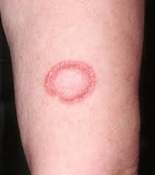

Slide 18
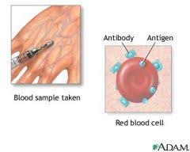
Paul Bunnell test
To diagnose infectious mononucleosis

Slide 19
Testing for heterophile antibodies / Paul bunnell antibody
Causes sheep RBC’s to agglutinate
Antibody appears shortly after the initial symptoms develop and disappears in 6 months after the symptoms resolve

