Slide 1
GUD EVENING
Any doubts in previous class

Slide 2
DR.V.KUMARAN
READER

Slide 3
Objectives of today’s class
Correcting malocclusions: Expansion is used to correct malocclusions, which are problems with the alignment of teeth and jaws. By expanding the arches, orthodontists can create more space for crowded teeth, correct crossbites and overbites, and improve the overall alignment of the teeth and jaws.
Improving breathing: Expansion can also be used to improve breathing by increasing the volume of the nasal cavity and improving the positioning of the tongue and soft palate. This can be particularly helpful for patients with sleep apnea or other breathing disorders.
Enhancing facial aesthetics: Expansion can improve the appearance of the face by widening the upper arch, which can create a more symmetrical and balanced facial profile.
Facilitating other orthodontic treatments: Expansion can be used to create more space in the arches, which can make it easier to perform other orthodontic treatments such as braces or aligners.
Preventing the need for extractions: In some cases, expansion can help prevent the need for extractions by creating more space for the teeth to fit properly in the arches. This can be particularly important for younger patients whose permanent teeth are still developing

Slide 6
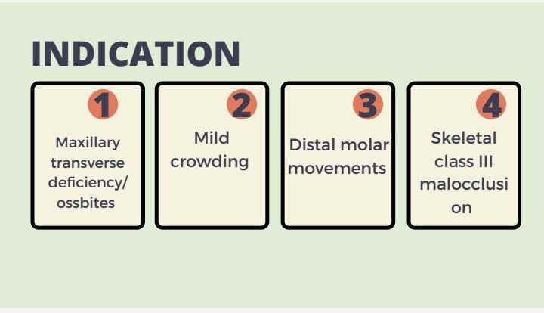

Slide 7
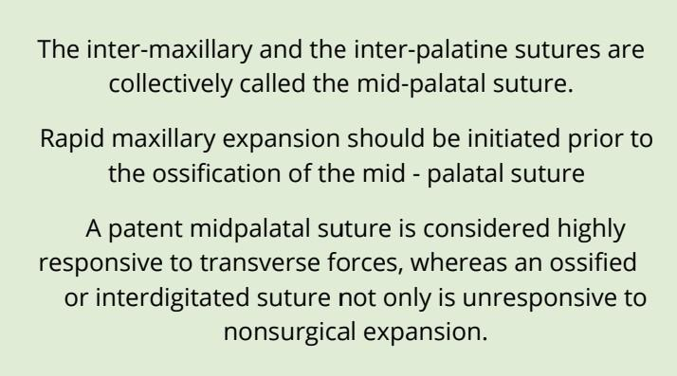

Slide 9
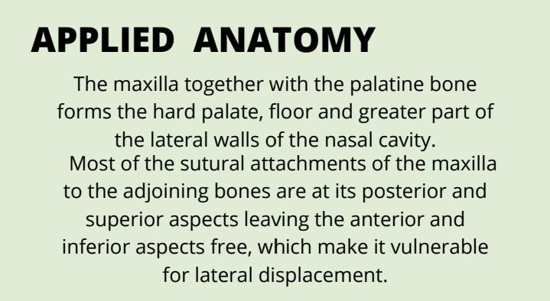

Slide 10
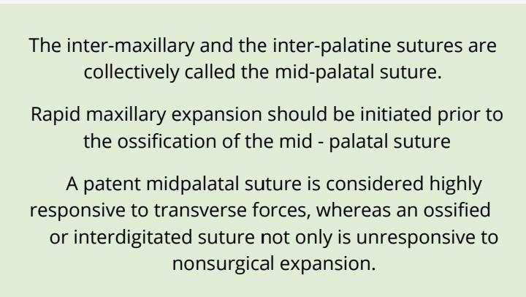

Slide 11
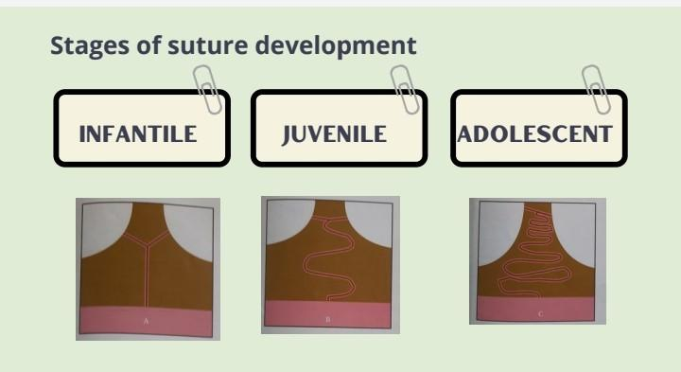

Slide 12
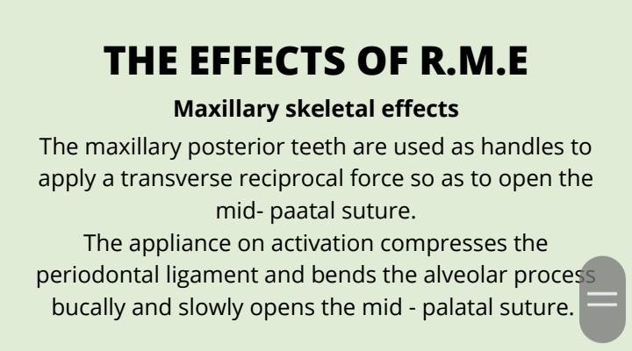

Slide 13
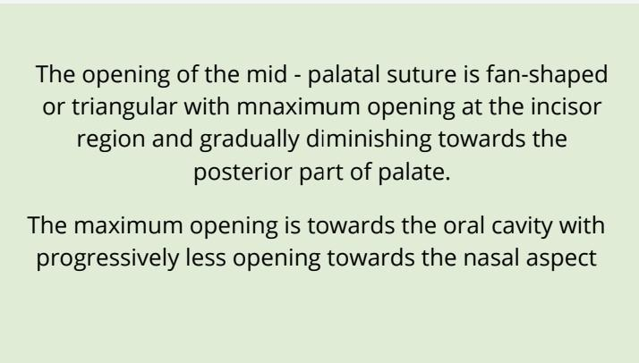

Slide 14
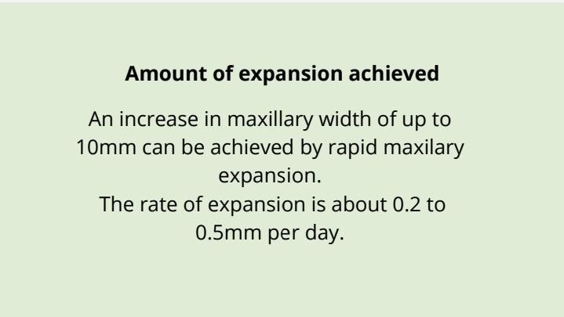

Slide 19
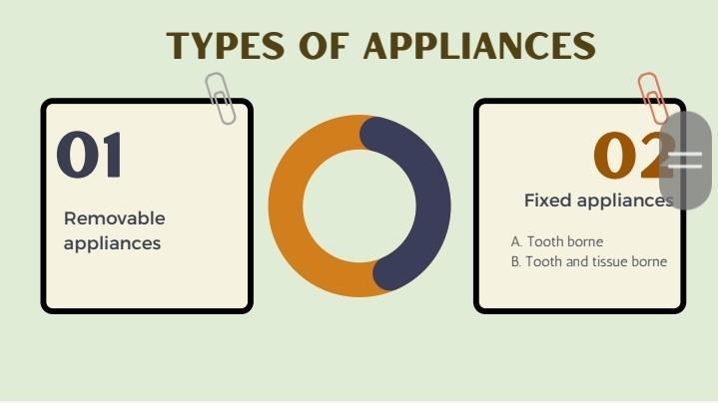

Slide 25
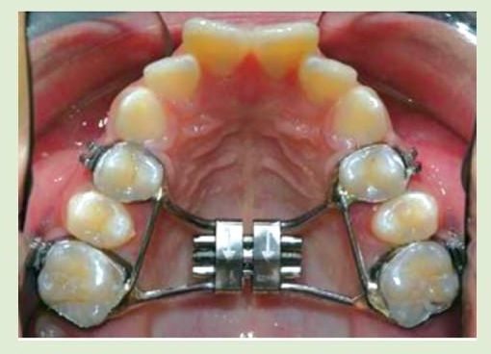
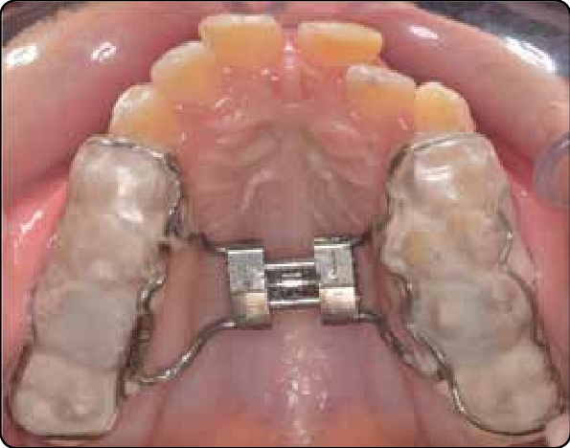

Slide 27
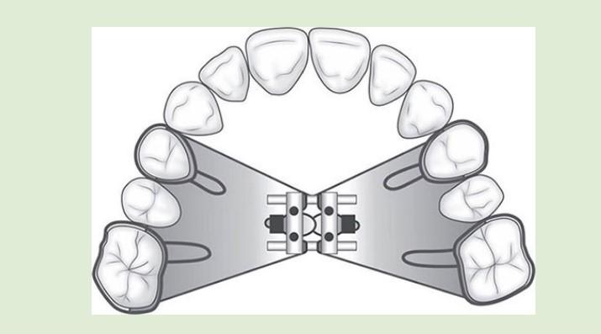

Slide 33
Possible immediate effects of premature appliance removal:
1.Pressure at the bridge of the nose
2.Pressure and blanching under the eyes and soft tissue

Slide 34
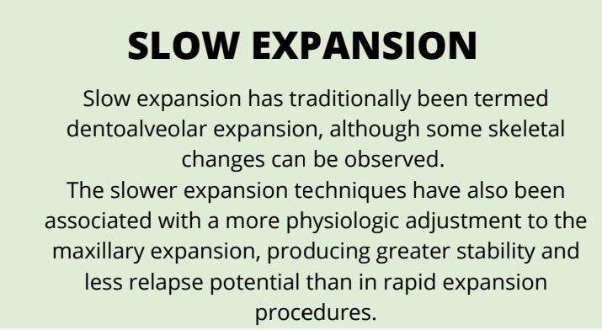

Slide 36
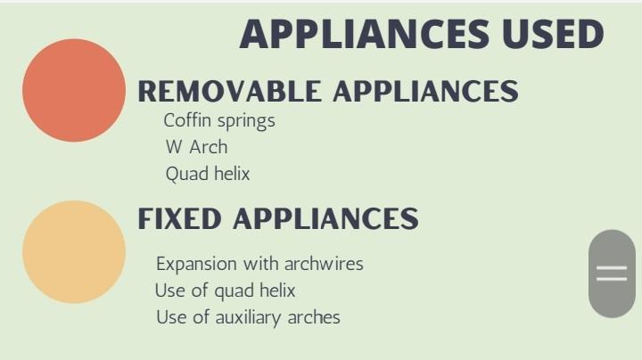

Slide 37
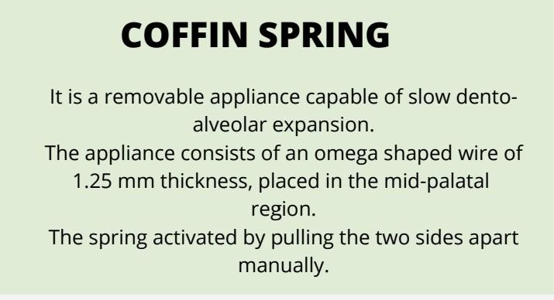

Slide 38
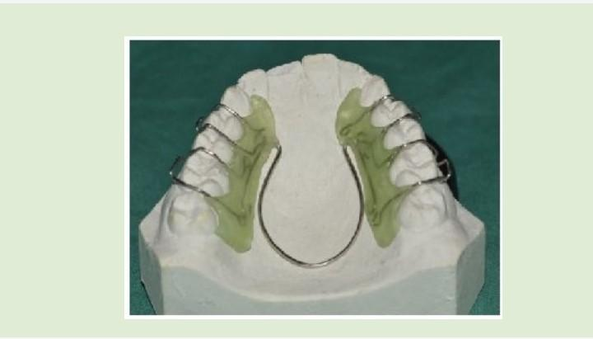

Slide 40
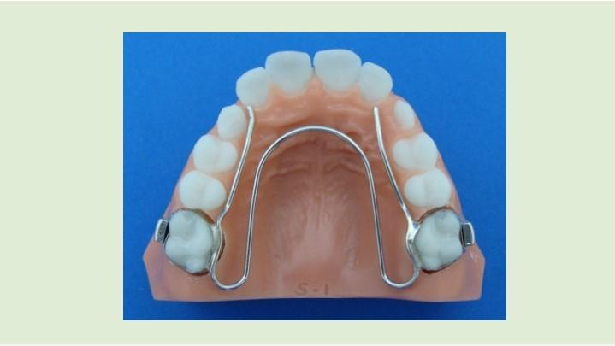

Slide 42
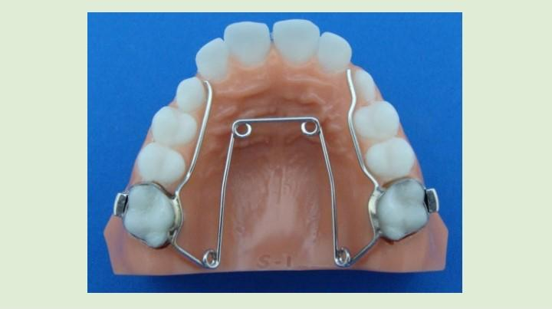

Slide 43
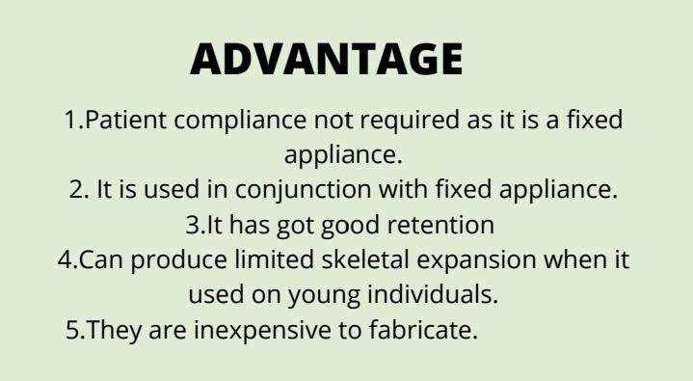

Slide 45
