Slide 2
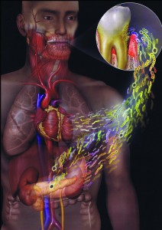
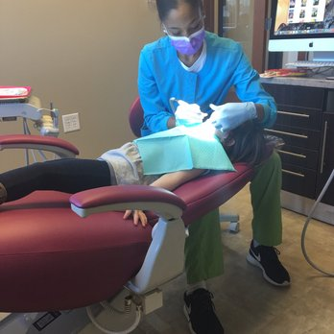
Dental considerations in Medically compromised patients

Slide 3
INTRODUCTION
Medical H/o is important as it aids the diagnosis of oral manifestations of systemic diseases.
Also ensures about the medical condition & medications which affect dental treatment.

Slide 4
Diabetes mellitus
Hypertension
Bleeding disorders
Cardiac conditions
Asthma
Tuberculosis
Liver diseases
Drug allergy

Slide 5
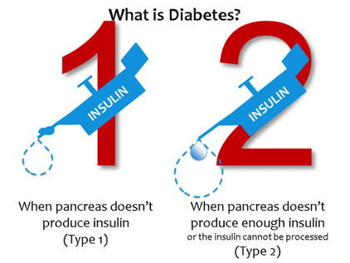
DIABETES MELLITUS
Metabolic disease characterized by abnormally elevated blood glucose level

Slide 6
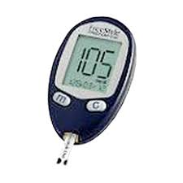
Diagnostic criteria
Fasting
Post prandial
HbA1c

Slide 7
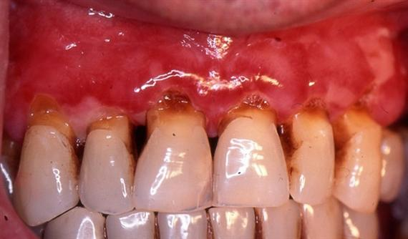
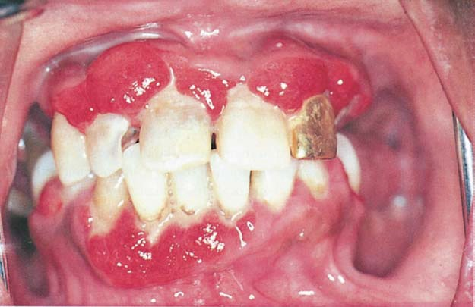
Oral manifestation
Altered wound healing
Xerostomia & bilateral salivary gland enlargement
Mucosal ulceration, burning sensation
Increased incidence of infections
Dental caries
Gingivitis & Periodontitis
Multiple periodontal abscess

Slide 8
Dental Management
Consultation with patient’s physician
Determine the type of DM, treatment
Patient should follow the usual drug regimen & diet
Monitoring Glucose level
Short appointments – morning
Adequate pain control & stress reduction

Slide 9
HYPERTENSION
Defined as having systolic Bp >140 mm Hg or diastolic Bp >90 mm Hg
Types
Primary
secondary

Slide 10
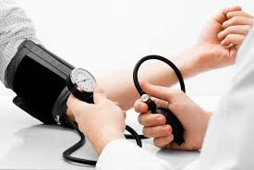
DIAGNOSTIC CRITERIA
classification
Normal
Prehypertension
Systolic Bp (mm Hg)
Diastolic Bp (mm Hg)
< 80
80 -89
<120
Stage 1
Stage 2
120 – 139
140 – 159
>160
90 -99
>100

Slide 11
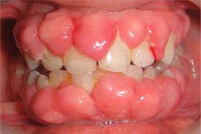
Oral changes
Mainly due to medications
Dry mouth
Lichenoid reaction
Altered taste sensation
Gingival overgrowth – Ca channel blockers
ulcerations

Slide 12
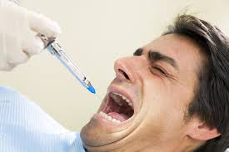
DENTAL MANAGEMENT
Reduce stress & anxiety
Short appointments
Do not use topical vasopressors to control bleeding
Orthostatic hypotension
Avoid epinephrine impregnated gingival retraction cord
Use LA with minimal concentration of adrenalin (1: 200000 dilution)
Aspirate & inject slowly

Slide 13
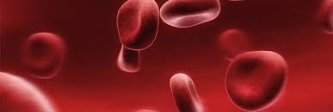
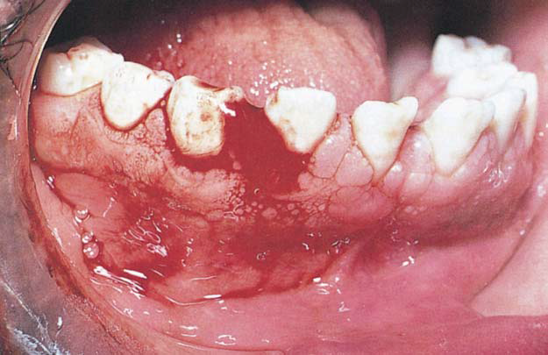
BLEEDING DISODERS
Vascular disorders
Platelet disorders
Thrombocytopathic disoders
Coagulation disorders:
Hemophilia A
Hemophilia B
Hemophilia C
Von willebrand’s disease

Slide 14
Oral Manifestations
Pinpoint hemorrhages – petechiae
Ecchymosis
Spontaneous gingival bleeding
Oral bleeding due to injuries

Slide 15
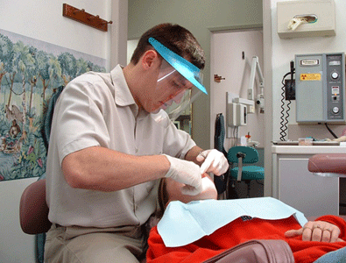
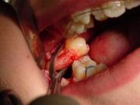
Dental considerations
Extraction of even a single tooth requires factor replacement therapy
Multiple extractions create a major bleeding hazard.
Inferior nerve block may cause bleeding in pterygomandibular & retrophayngeal area ---- respiratory obstruction
Infiltration & intraligamentary inj …… potential alternative

Slide 16
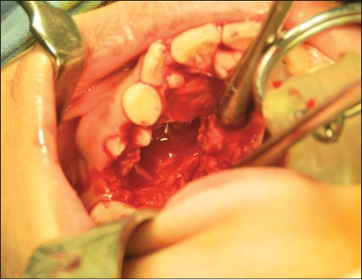
Bleeding can be controlled locally: with direct pressure and topical antifibrinolytic agents.
Antifibrinolytics (tranexamic acid) may diminish bleeding in patients with coagulation disorders.
Acrylic splint ----maintain clot

Slide 17
Pulp therapy
1. Preferable to extraction
2. Avoid overinstrumentation and overfilling
Periodontal therapy
1. No contraindication of probing and supragingival
scaling
2. Deep scaling, curettage, surgery need replacement
therapy

Slide 18
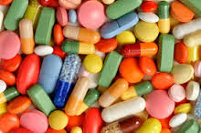
Choice of medication:
ASA --- interfere with hemostasis
NSAIDS , Pencillins, erythromycin, metronidazole, tetracyclines & miconazole --- increase the effect of warfarin

Slide 19
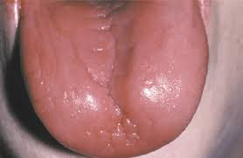
ANEMIA
Reduction in the oxygen carrying capacity of blood
Hb level:
Males --- < 13.5 gm/dl
Females --- < 11.5 gm/dl
ORAL MANIFESTATIONS:
Pallor
Angular cheilitis
Atrophic glossitis & glossodynia
High prevalence of candidiasis

Slide 20
Dental considerations
< 10 gm/ dL --- increase bleeding tendency
Macrolide antibiotics & sulpha drugs --- interfere with iron absorption

Slide 21
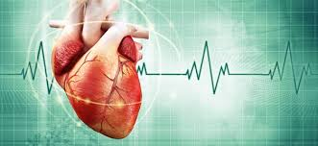
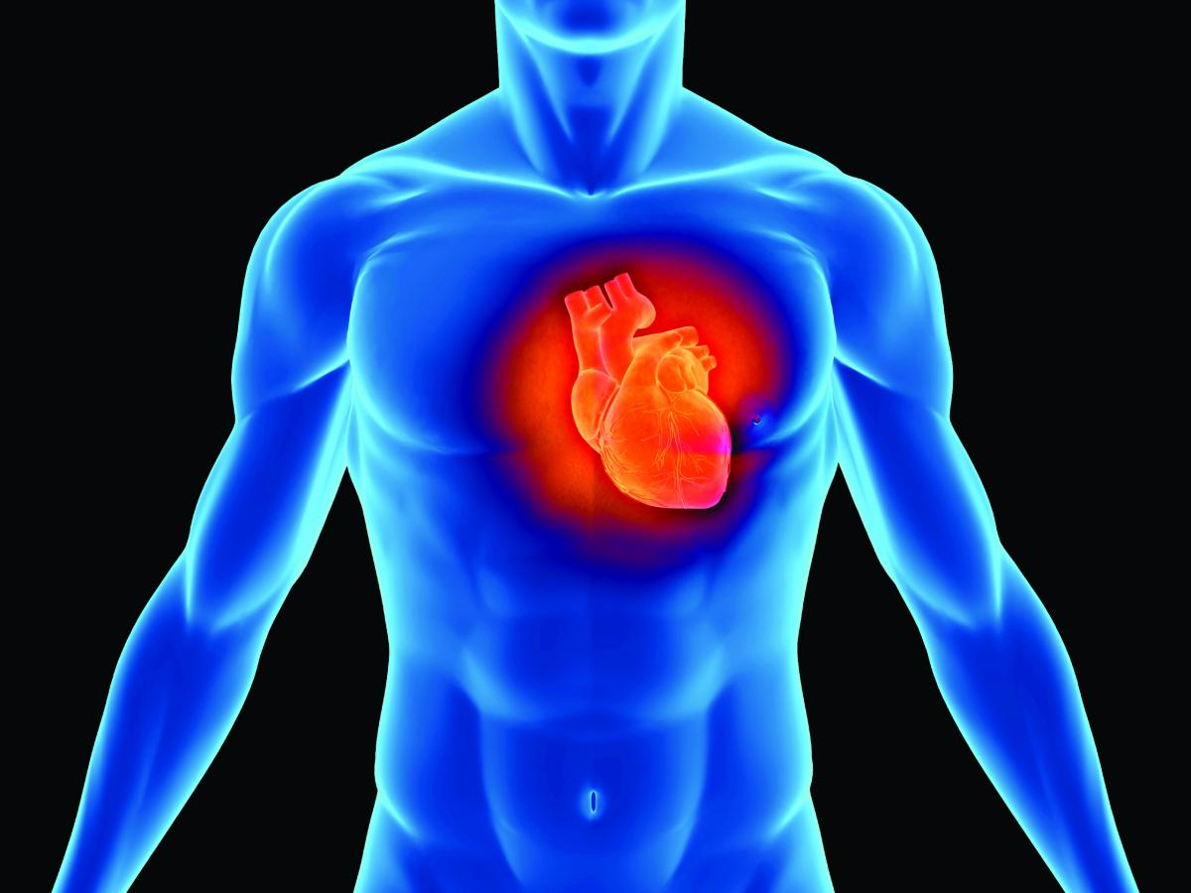
CARDIAC CONDITIONS
Angina
Myocardial infarction
Infective endocarditis
Heart failure

Slide 22
Dental considerations
Late morning or early afternoon appointments
Preventive approaches – topical rinses & fluorides
Local hemostatic agents

Slide 23
Antithrombotic drugs
Inhibitor of COX --- synthesis of PGs --- interferes with production of Tx A2 --- inhibit platetet aggregation --- prolonged bleeding
For extraction
Stop aspirin for 5 days, substitute alternative drug in consultation with MD
Risk – benefit ratio analyzed
Warfarin:
INR is measured
< 3 --- dose need not be altered.
Heparin:
Discontinued 4hrs before surgical procedures

Slide 24
MYOCARDIAL INFARCTION
Dental considerations:
Physician’s consent
Within 6 months of an MI – elective dental care deferred
Anxious patients – given preoperative glyceryl nitrate
Effective LA is important
Epinephrine impregnated gingival retraction cord avoided.

Slide 25
Minor analgesics: dental pain can be controlled with a minor analgesic, such as paracetamol.
- Local anesthesia:
No haemostatic cover: | Haemostatic cover required:
Buccal infiltration | Inferior dental block
Intra-papillary injection | Lingual infiltration
Intraligamentary injections

Slide 26
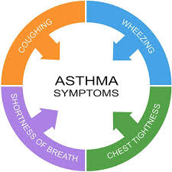
ASTHMA
Is a chronic inflammatory disorder of the airways and bronchial hyperactivity resulting in paroxysmal wheeze, cough, chest tightness & dyspnea.

Slide 27
ORAL MANIFESTATIONS:
use of Β₂ agonist --- Reduced salivary flow
Dental caries
Gingivitis
Use of nebulizers – dryness of mouth, oropharyngeal candidiasis

Slide 28
DENTAL CONSIDERATIONS
Stress reduction
Premedicate anxious patient
Late morning appointments
Dental products – tooth paste, fissure sealants, methyl methacrylate ---- exacerbation of asthma
F supplements ….. B₂ agonist
Antifungal medications
Avoid:
NSAID’s
Narcotics & Barbiturates --- bronchospasm

Slide 29
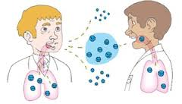
TUBERCULOSIS
Infectious disease caused by Mycobacterium tuberculosis
Air-borne
ORAL MANIFESTATIONS:
Tuberculous ulcer
Tuberculous gingivitis
Tuberculous osteomyelitis

Slide 30
Dental considerations
Treatment is deferred to prevent cross infection
Avoid aerosolization & splatter
Minimal use of ultrasonic scalers & high speed handpieces.
Operating air ---vented outside, not recirculated.

Slide 31
Patients with active TB
Dental emergencies only
Controlled environment
Pt’s with signs & symptoms suggestive of TB
Dental emergencies only
Referral
H/o TB
Routine dental treatment

Slide 32
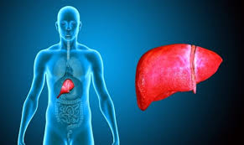
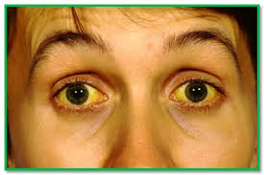
LIVER DISEASES
Jaundice – yellowish discoloration of tissue resulting from deposition of bilirubin.
It is a sign of liver disease
Oral manifestations:
Hemorrhagic changes, Petechiae, hematoma, jaundiced mucosal tissues, gingival bleeding.
Glossitis – alcoholic hepatitis

Slide 33
Dental considerations
Impaired metabolism of drugs in liver
Impaired hemostasis ---serious bleeding problem
Safe drugs:

Slide 35
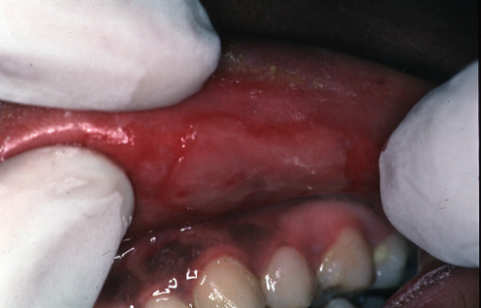
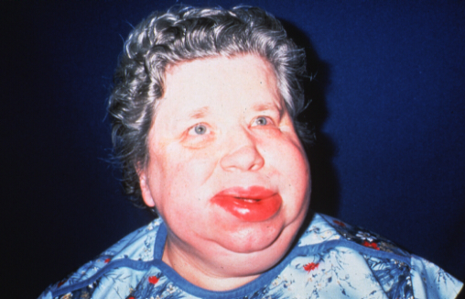
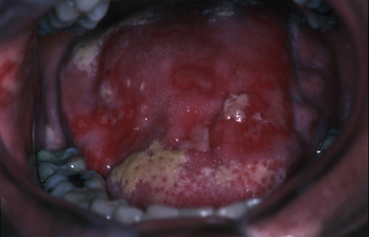
DRUG ALLERGY
Allergy is defined as a hypersensitive state acquired through exposure to a particular allergen
Pencillins, sulpha drugs, barbiturates, NSAIDs – Ibuprofen, ester type of anaesthetics
stomatitis,angioedema, EM

Slide 36
CONCLUSION
Dentist should be aware of potential complications while undertaking routine dental care.
Complete medical history is a must so that we can assess the general health of the patient.

