Slide 1
Good Morning

Slide 2
Case History

Slide 3
History
Demographic data
Name
Age
Sex
Address
Ph.no
Occupation
Income
religion

Slide 4
Cheif complaint
Should in patient’s words
Duration
Acute
chronic

Slide 5
History of Presenting illness
Pain
Swelling

Slide 6
Past medical history
Diabetes mellitus
Hypertension
Asthma
Gastric ulcer
Bleeding disorders
Allergy
Epilepsy
Jaundice
Trauma
Hospitalization

Slide 7
Past dental history

Slide 8
Personal history
Diet
Habits
Brushing habits
Adverse habits
Site, frequency, duration
Marital status

Slide 9
Family history
Parents and siblings
Any history of disease

Slide 10
Clinical examination
General
Systemic
Local

Slide 11
General examination
Nourishment, body built
Height, Weight
Vital signs
Pulse
Temperature
Blood pressure
Respiratory rate

Slide 12
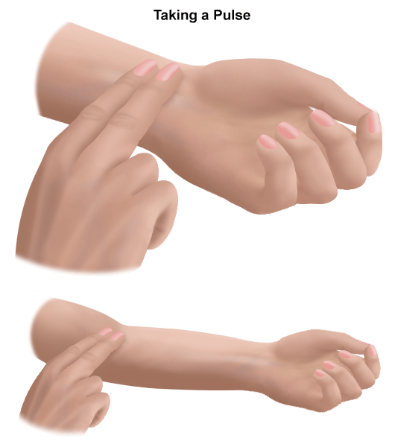

Slide 13
Peripheral signs
Anemia
Cyanosis
Clubbing
Icterus
lymphadenopathy

Slide 14
Systemic examination
CNS
CVS
RS
GIT
GUT

Slide 15
LOCAL EXAMINATION
Extraoral
Intraoral

Slide 16
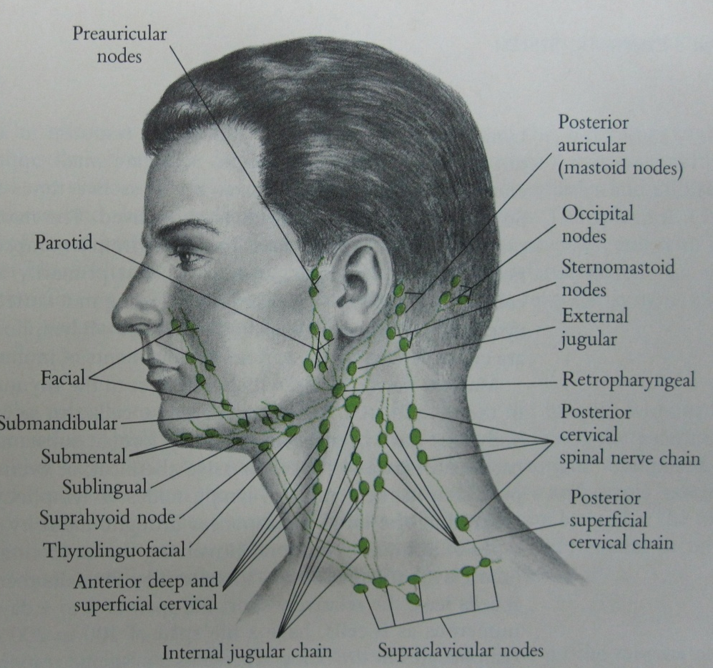
GENERAL LYMPH NODE EXAMINATION
CERVICAL
AXILLARY
INGUINAL

Slide 17
Extraoral examination
Facial asymmetry
Mouth opening
TMJ
Inspection
Palpation
Auscultation
Muscles of mastication
Lymph node examination

Slide 18
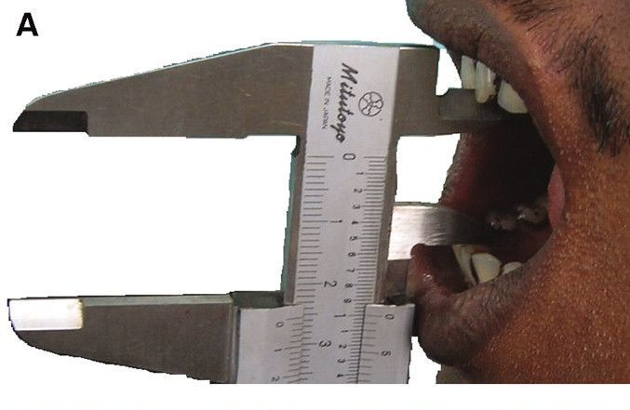

Slide 19
Intraoral examination
Hard
Soft tissues

Slide 20
Hard tissue examination
Teeth
Clinically present / missing teeth
Dental caries
Initial
Moderate
Deep
Root stump, restoration, grossly decayed
Molar relation
Mobility
Attrition, abrasion, erosion
Calculus
Stains

Slide 21
Soft tissues
Gingiva
Alveolar mucosa
Labial mucosa
Buccal mucosa
Tongue
Hard and soft palate
Floor of the mouth
Faucial pillars

Slide 22
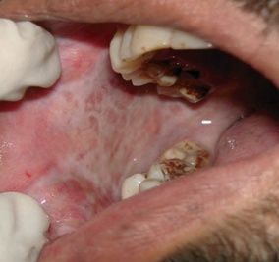
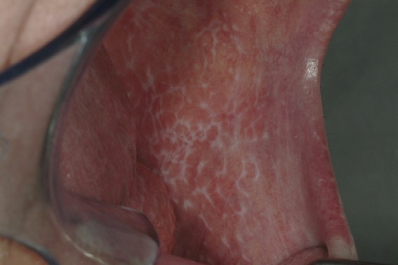
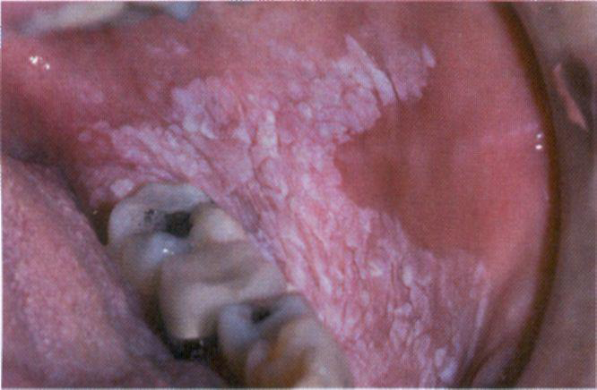

Slide 23
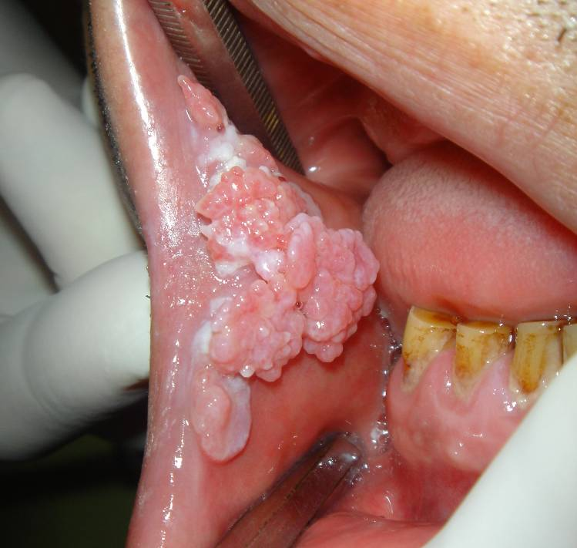
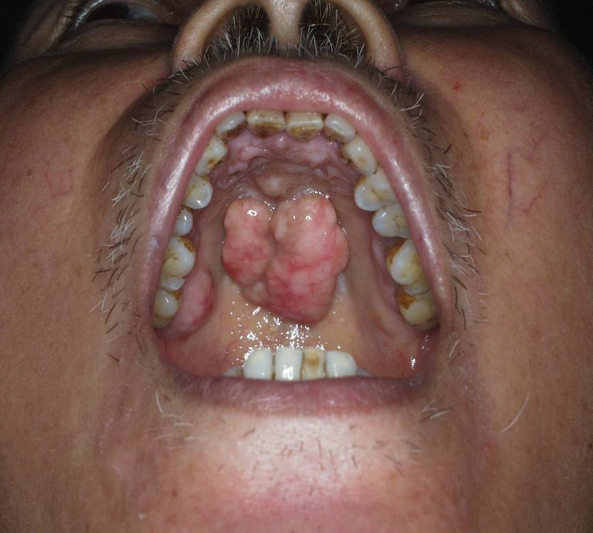
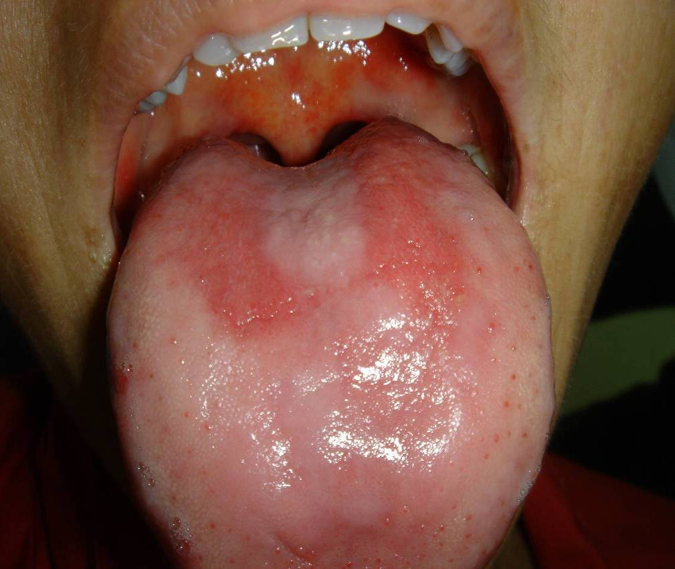
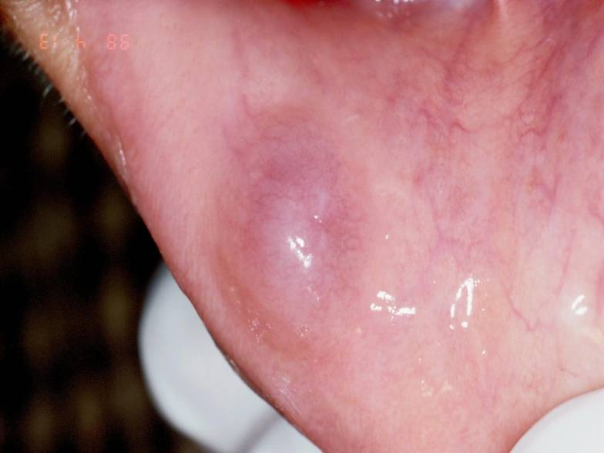

Slide 24
Diagnosis
Provisional diagnosis
Differential diagnosis
Investigations
Final diagnosis
Treatment plan

