Slide 1
ROLE OF VIRUS IN PERIODONTIUM
BY
DR.RADHIKA.M
DEPARTMENT OF PERIODONTOLOGY

Slide 2
CONTENTS
INTRODUCTION
HISTORY
STRUCTURE OF VIRUS
CLASSIFICATION OF VIRUS
ORAL VIRAL INFECTIONS
ETIOPATHOGENESIS IN PERIONTAL DISEASE
HERPES AND PERIODONTITIS
HPV
HIV
CORONA VIRUS
COCLUSION
REFERENCES

Slide 3
INTRODUCTION
The role of bacterial plaque in periodontal disease seems to be evident, on the contrary the role of virus have been largely unexplored and remains unclear.
Many bacterial infections in humans occur as superinfections of viral diseases.
A well known example is the bacterial complication in influenza outbreaks
Viruses might influence the development and severity of periodontal disease.

Slide 4
HISTORY OF VIRUS

Slide 5
STRUCTURE OF VIRUS

Slide 6
CLASSIFICATION OF VIRUS

Slide 7
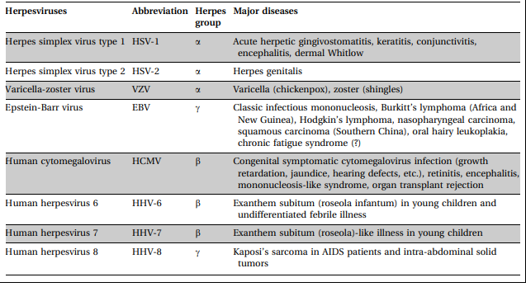
HUMAN HERPES VIRUSES .
There are 8 types of human herpes viruses in the Herpetoviridae family.

Slide 9
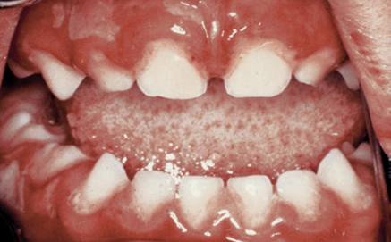
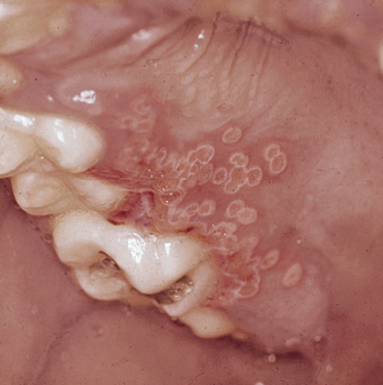
HERPES SIMPLEX VIRUS
DNA and it includes HSV 1 and HSV 2
HSV 1 usually causes oral maifestations
HSV 2 mainly involved in anogenital infections and only occasionally is involved in oral infection (scully 1989)
HERPETIC GINGIVOSTOMATITIS
RECURRENT HERPES INFECTION

Slide 10
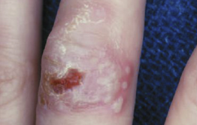
HERPES LABIALIS
HERPETIC WHITLOW

Slide 11
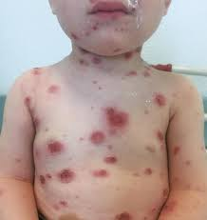
VARICELLA
The VZV is a highly contagious member of the herpes virus family, owing to similarities in its DNA core.
In children(6-11 years) is more commonly known as chickenpox, it can reactivate in adults as shingles
Spreading in droplet form, it proliferates in macrophages, leading to viremia that overwhelms the body’s defenses.
Skin lesions are preceded typically by oral lesions, which tend to be painless

Slide 12
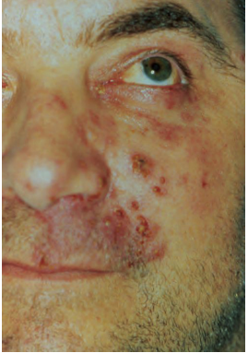
HERPES ZOSTER
Latent VZV is reactivated after many immunosuppressive states like human immunodeficiency virus (HIV) infection, radiation, or state of malignancy.
Typically, it affects the sensory nerves of the trunk, head, and neck, resulting in symptoms of pain or paresthesia in those dermatomes

Slide 13
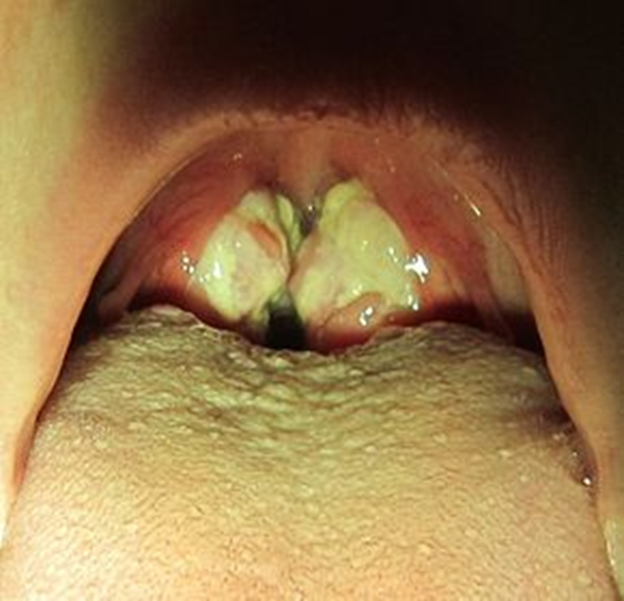
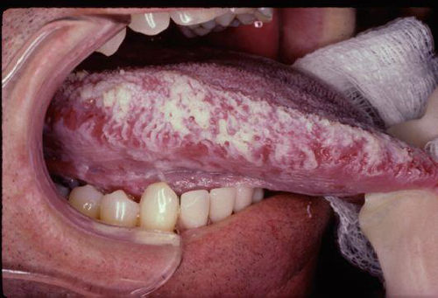
EPSTEIN BARR VIRUS
ORAL HAIRY LEUKOPLAKIA
INFECTIOUS MONONUCLEOSIS

Slide 14
CYTOMEGALOVIRUS
Neonatal CMV infections can produce
Dental disorders
enamel hypoplasia,
enamel hypomaturation,
attrition,
discoloration of dentin.

Slide 15
KAPOSIS SARCOMA
Angio proliferative disorder

Slide 16
PERIODONTAL DISEASES
ETIOPATHOGENESIS
Human virus plays a fundamental role in the pathogenesis of periodontal disease.
Viral infection impairs periodontal defense, thereby permitting subgingival overgrowth of periodontopathic bacteria.
Parra B, Slots J -1996
Higher prevalence of HCMV and EBV in subgingival specimens from adult periodontitis patients as compared to periodontally healthy or gingivitis patients .

Slide 17
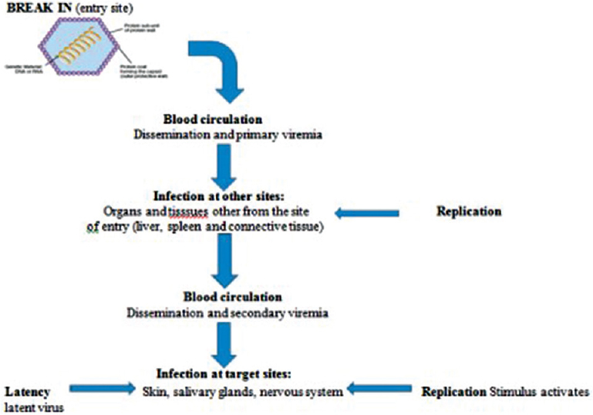
Viral infection steps:
Entry
Replication,
Dissemination,
Infection of target cells/organs.

Slide 18
HERPES VIRUS AND PERIODONTITIS
Herpesviruses came into the sight of periodontists as putative pathogens of periodontal disease in the mid-1990s.
Periodontal tissue breakdown occurs more frequently and progresses more rapidly in herpesvirus-infected than in herpesvirus-free periodontal sites.(J ØRGEN SLOTS )
Herpesvirus-associated periodontal sites also tend to harbor elevated levels of periodontopathic bacteria.

Slide 19
: Herpes viral-bacterial model of periodontitis.

Slide 20
EPSTEIN–BARR VIRUS AND PERIODONTITIS
EBV affects over 90% of humans and is usually transmitted by oral secretions or blood.
Viral replication in - Epithelial cells or
B cells of oropharynx
In periodontitis, the presence of EBV DNA is related to an elevated occurrence of Porphyromonas gingivalis, Tannerella forsythia, Campylobacter spp. and other periodontopathic bacteria.

Slide 21
COHEN J 1997
Bacteria
Gingivitis
Permits entry of EBV infected B cells
Progressive periodontal lesions

Slide 22
HUMAN CYTOMEGALOVIRUS AND PERIODONTITIS
HCMV infects many different epithelial cells, endothelial cells, smooth muscle cells, mesenchymal cells, hepatocytes, granulocytes, and monocyte-derived macrophages
The cytomegalovirus latent genome is carried into the periodontium by infected macrophages and T cells, and cytomegalovirus activation may eventually give rise to infection of additional cell types.

Slide 24
HERPESVIRUS AND AGGRESSIVE PERIODONTITIS
Saygun I, Kubar A, Ozdemir A, Yapar M, Slots J. Herpesviral-bacterial interrelationships in aggressive periodontitis. J Periodontal Res. 2004 Aug
HCMV, EBV-1 and HSV-1 were each detected in 72-78% of the aggressive periodontitis patients.

Slide 25
HERPESVIRUS IN ACUTE NECROTIZING ULCERATIVE GINGIVITIS
HCMV and (EBV-1) in ANUG sites and normal periodontal sites of Nigerian children with and without malnutrition that may promote herpesvirus activation, and the presence of particularly virulent periodontal bacteria.
Murayama Y, et al 1994

Slide 26
HERPESVIRUS AND CHRONIC PERIODONTITIS
The highest detection rate of subgingival herpesviruses in adult periodontitis patients may be due to local viral reactivation phenomena.
- Contreras A, Slots J.2014
Recurrent herpesvirus reactivation in elderly individuals occurs as a consequence of age-related immunosuppression. An age-related herpesvirus presence in the periodontium may partly explain the increased severity of periodontitis in elderly subjects.

Slide 27
HUMAN PAPPILOMA VIRUS AND PERIODONTITIS
HPV causes characteristic cytopathic effects (koilocytosis) and proliferation of epithelial cells.
Proliferation and migration of the junctional epithelium are a major hallmark of periodontal breakdown, these known biological effects of HPV might provide a link between viral infection and periodontal disease.
Page RC, Offenbacher S, Schroeder HE, Seymour GJ, Kornman KS 1997
A study confirmed that HPV types 6, 11, and 16 DNA are detected in gingival samples from patients with periodontal disease explaining the development of gingival papillomas and condylomas in the oral cavity.
Hormia M, Willberg J, Ruokonen H, Syrjanen S 2005

Slide 28
HPV enters the basal epithelial cell
HPV genome are established as autogenous replicating chromosomal elements and low level of HPV expression occurs
Productive replication and assembly of matured viral particles
When the basal cells containing HPV particles are exfoliated in gingival crevice
HPV gets detectecd in gingival epithelium
Characteristic cytopathic changes and proliferation of junctional epithelial cell
Periodontal pocket formation

Slide 29
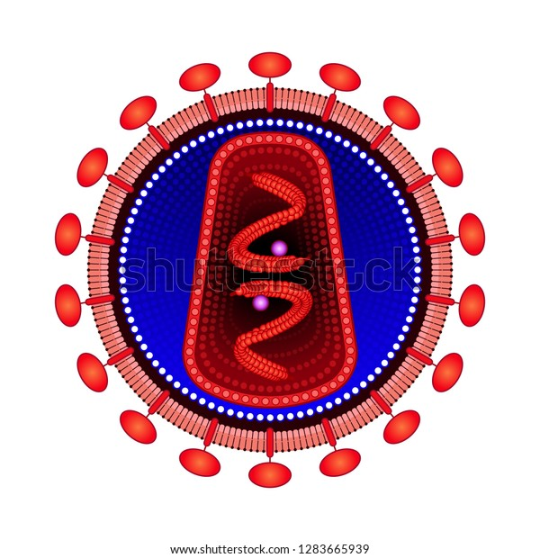
HIV and Periodontitis
Oral lesions associated to HIV are often the first clinical signs of this infection and can play a specific role in the diagnosis of patients with unknown HIV serostatus.
The primary target of HIV is CD4+-helper T cells.
Reduction in immune function that predisposes the individual to a number of opportunistic infection including periodontal diseases and also facilitate herpesviruses' reactivation or reinfection

Slide 30
Oral lesions which are strongly associated with HIV-infected patients
Oral candidiasis
Non Hodgkins lymphoma
Kaposis sarcoma
Oral hairy leukoplakia

Slide 31
CENTRE ON ORAL MANIFESTATION OF THE HIV CLASSIFIED
Periodontitis as lesions strongly associated with HIV
Four forms of HIV-associated periodontal disease
HIV
NUP
NUS
NUG
LINEAR GINGIVAL ERYTHEMA
LUDWIGS ANGINA
CANCRUM ORIS

Slide 32
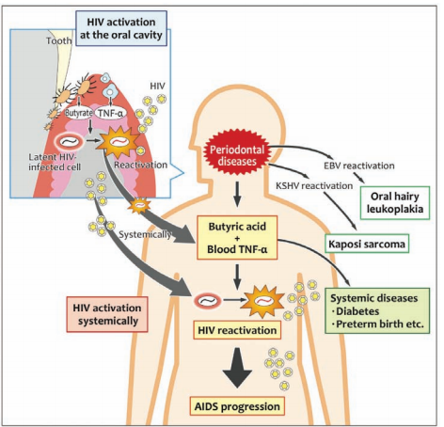
Possible causal link of periodontal diseases to AIDS progression.
Imai K, Victoriano AF, Ochiai K, Okamoto T. Microbial interaction of periodontopathic bacterium Porphyromonas gingivalis and HIV-possible causal link of periodontal diseases to AIDS progression-. Curr HIV Res. 2012

Slide 33
CORONA VIRUS AND PERIODONTITIS
Now we are facing an unprecedented global outbreak of severe acute respiratory syndrome (COVID-19) caused by a new coronavirus, SARS-CoV-2, with deleterious impact on global health and economics.
Oral expression of SARS-CoV-2 receptors
Cells from the oral cavity have been found to highly express ACE-2, in a comparable manner to lung cells.

Slide 34
Previous published data has also confirmed the expression of ACE-2 in gingival and periodontal ligament fibroblasts in rat and human tissues. Santos CF et al 2015
Recently, preliminary data suggested a novel infection route by SARS-CoV-2. It could infect cells by using its spike protein to bind to the Cluster of Differentiation 147 (CD 147) on cell membranes and not necessarily ACE-2 Wang K, Chen W 2020
Gingival epithelium expression of CD 147 is increased in cells harvested from periodontitis patients

Slide 35
Gupta et al indicated that Neutrophil Extracellular Trap production is involved in the pathogenesis of both diseases (Gupta & Sah2020)
Sahni et al suggested that the strong Th17 response in severe periodontitis could exacerbate the cytokine storm in COVID-19 (Sahni & Gupta, 2020).
Spontaneous rise in the prevalence of acute periodontal lesions, particularly necrotizing periodontal disease (NPD), in accordance with the increase in COVID-19 confirmed cases. (Patel & Woolley, 2020)

Slide 37
NEW STUDY LINKS PERIODONTITIS AND COVID‐19 COMPLICATIONS MAROUF et al. 2021
Of the 568 patients studied, those with periodontitis, the most severe form of gum disease, were at least three times more likely to experience COVID‐19 complications including death, ICU admission, and the need for assisted ventilation.
Additionally, COVID-19 patients with periodontitis showed increased levels of biomarkers associated with worsened disease outcomes including white blood cell levels, D‐dimer, and c-reactive protein.

Slide 38
Periodontal pocket could be a niche for SARS-CoV-2 virus infection.
In view of the existing limited data, the hypotheses that Periodontal pocket could act as a reservoir of SARS-CoV-2 relays on consistent and plausible observations.
If this is to be confirmed, future directions would be to use Periodontal pocket GCF/ plaque sampling as a testing tool for Covid-19.
Furthermore, periodontal therapy would be considered a parameter of care in the global clinical management of Covid-positive patients.

Slide 39
CONCLUSION
Maintaining gingival health by professional periodontal therapy and oral hygiene measures reduce the risk of transmissible viral disease.
Rapid advances in medical virology may also help to uncover the pathogenesis and treatments of viral diseases of mouth.
Prevention and therapy based upon antiviral approaches might avert the initiation, progression of periodontal disease caused by viruses.

Slide 40
REFERENCES
Role of periodontopathogenic virus in periodontal disease: a review Chandni Gupta, Deepa Dhruvakumar 2017
Parra B, Slots J. Detection of human viruses in periodontal pockets using polymerase chain reaction. Oral Microbiol Immunol 1996; 11:289–293.
Slots J. Oral viral infections of adults. Periodontol 2000 2009; 49:60–86.
Saygun I, Kubar A, Ozdemir A, Yapar M, Slots J. Herpes viral- bacterial interrelationships in aggressive periodontitis. J Periodontal Res 2004; 39:207–212.
Contreras A, Zadeh HH, Nowzari H, Slots J. Herpes virus infection of inflammatory cells in human periodontitis. Oral Microbiol Immunol 1999; 14:206–212.
Cohen JI. Epstein–Barr virus and the immune system hide and seek. JAMA 1997; 278:510–513

Slide 41
Imai K, Victriano AF, Ochiai K, Okamoto T. Microbial interaction of periodontopathic bacterium Porphyromonas gingivalis and HIV-possible causal link of periodontal diseases to AIDS progression. Curr HIV Res 2012; 10:238–244
Role of Viruses in Periodontal Diseases Mithlesh Bhagat1 , Roopali Tapashetti2 , Ghousia Fatima3 , Neha Bhutan 2020
Viruses in periodontal disease – a review I Cappuyns, P Gugerli, A Mombelli 2005
Hormia M, Willberg J, Ruokonen H, Syrjänen S. Marginal periodontium as a potential reservoir of human papillomavirus in oral mucosa. J Periodontol. 2005 Mar;76(3):358-63. doi: 10.1902/jop.2005.76.3.358. PMID: 15857068.

Slide 42
Association between periodontitis and severity of COVID-19 infection: A case–control study MAROUF et al J Clin Periodontol. 2021;48:483–491
COVID-19 & Periodontitis: The cytokine connection Vaibhav Sahnia, Shipra Guptab 2020
Could there be a link between oral hygiene and the severity of SARS-CoV-2 infections? Victoria Sampson, Nawar Kamona and Ariane Sampson
Periodontal pockets: A potential reservoir for SARS-CoV-2? Zahi Badrana,b , Alexis Gaudinc , Xavier Struilloua , Gilles Amadord , Assem Soueidana,2020

