Slide 1
Introduction
Oral submucous fibrosis (OSF) is a high risk precancerous condition which was first described in the early 1950s
Oral submucous fibrosis was described by Schwartz in1952 among five Indian females living in Kenya and he coined the term atrophia idiopathica (trophica) mucosaeoris.
It is characterized by changes in the connective tissue fibers of the lamina propria and deeper parts leading to stiffness of the mucosa and restricted mouth opening.
Oral Diseases (2011) 17 (Suppl. 1), 42–57

Slide 2
Definition
Oral submucous fibrosis (OSMF) is a insidious chronic condition of unknown etiology affecting the oral mucosa, occasionally extending to the pharynx and esophagus, characterized by dense collagen tissue deposition within submucosa. It is a precancerous condition.
The most widely accepted definition is by Pindborg JJ and Sirsat SM (1966).

Slide 3
Defintion
Oral submucous fibrosis (OSF) is a chronic, insidious disease that is associated with significant functional morbidity and an increased risk for malignancy. It initially affects the lamina propria of the oral mucosa and as the disease progresses it involves the submucosa and the deeper tissues including muscles of the oral cavity with resulting loss of fibroelasticity.
AR Kerr et al - Oral Diseases (2011) 17 (Suppl. 1), 42–57

Slide 4
Synonyms:
Submucous fibrosis of the palate and pillars (Joshi, 1952).
Atrophia idiopathica (trophica) mucosae oris. (Schwartz)
Diffuse oral submucous fibrosis (Lal 1953).
Idiopathic scleroderma of mouth (Su, 1954).
Submucous fibrosis of the palate (Sirsat and Khanolkar, 1957, 1960, 1962).
Submucous fibrosis of palate and cheek (Desa, 1957).
Idiopathic palatal fibrosis (Rao, 1962).
Oral submucous fibrosis (Pindborg and Sirsat, 1966).
Subepithelial fibrosis (Goleria, 1970).
Idiopathic oral fibrosis (Krishnamoorthy, 1970).
WHO Bulletin OMS. Vol 72 1994

Slide 5
KEY WORDS
Quid has been defined as a substance or mixture of substances placed in the mouth or chewed and remaining in contact with the mucosa usually containing one or both of the two basic ingredients tobacco and/or areca nut in raw or any manufactured or processed form (Zain et al., 1999).
A precancerous lesion is a morphologically altered tissue in which oral cancer is more likely to occur than in its apparently normal counterpart’;
A precancerous condition is a generalized state associated with a significantly increased risk of cancer’.
J Cancer Science & Theraphy - Volume 1(2) : 072-077 (2009) - 075

Slide 6
Etiology: Initial events of the disease process:
J Oral Pathol Med (2005) 34: 321–8

Slide 7
Etiology
GUTKA
Areca nut
Slaked lime
Tobacco
Collagen synthesis
Reactive oxygen species
DNA & Fibroblast damage
DNA damage
Fibroblast damage
Gingival blood flow
Cell turnover (By killing cells)
Reactive oxygen species
DNA Damage &
Chromosomal abnormalites
nm
ORAL MUCOUS FIBROSIS
ORAL CANCER
PERIODONTAL DISEASE
Oral Surg Oral Med Oral Pathol oral radiol 2010 :109:857-864

Slide 8
Aetiological factors for OSF
Constituents of areca nut, mainly arecoline + tannin (synergistic role)
These chemicals appear to interfere with the molecular processes of deposition and/or degradation of extracellular matrix molecules such as collagen, causing imbalance in the normal process
Reduced phagocytosis of collagen by fibroblasts
Up or down regulation of key enzymes such as lysyl oxidase, matrix metalloproteinases and tissue inhibitors of matrix metalloproteinases.
Oral Oncology (2006) 42, 561– 568

Slide 9
Collagen production pathway
J Oral Pathol Med (2005) 34: 321–8

Slide 10
Collagen Degradation pathway
J Oral Pathol Med (2005) 34: 321–8

Slide 11
pathogenesis of oral submucous fibrosis-Overall effect of activated TGF beta pathway

Slide 12
Role of Heat shock proteins (HSP) in pathogenesis of OSF
HSP47, is a 47 kDa collagen-binding heat shock protein (HSP), which belongs to the serine protease inhibitor superfamily containing a serpin signature sequence (17).
HSP47 is known as a molecular chaperone that is specifically involved in the processing and quality control of collagen molecules Shung et al., (2008) first found that arecoline is capable of stimulating HSP47 mRNA expression in human BMFs.
HSP47 plays an important role in the synthesis, processing, and assembly of various collagens.
J Cancer Science & Theraphy - Volume 1(2) : 072-077 (2009) - 075

Slide 13
Role of Copper in areca nut -pathogenesis of OSF
The copper content of areca nut is high and the possible role of copper as a mediator of fibrosis is supported by the demonstration of up regulation of lysyl oxidase in OSF biopsies.
Lysyl oxidase a copper dependent enzyme and plays a key role in collagen synthesis and its cross linkage.
Oral Oncology (2006) 42, 561– 568

Slide 14
EPIDEMIOLOGY
The disease is predominantly seen in India, Bangladesh, Sri Lanka, Pakistan, Taiwan, China and among other Asiatics, with a reported prevalence ranging up to 0.4% in Indian rural population (Murti et al., 1995).
Recent epidemiological data indicates that, the number of cases of OSF has risen rapidly in India from an estimated 250,000 cases in 1980 to 2 million cases in 1993.
Oral Oncology (2006) 42, 561– 568

Slide 15
functional staging of oral submucous fibrosis (Haider et al) .
Proposed disease Grading System – Oral submucous fibrosis
Grade 1 – Mild: Any features of the disease triad for OSF
(burning, depapillation, blanching or leathery mucosa) may
be reported – and inter-incisal opening >35 mm
Grade 2 – Moderate: Above features of OSF +
inter-incisal limitation of opening 20–35 mm
Grade 3 – Severe: Above features of OSF + inter-incisal
opening <20 mm
Grade 4A – OSF + other potentially malignant disorder on
clinical examination
Grade 4B – OSF with any grade of oral epithelial dysplasia on biopsy
Grade 5 – OSF + oral squamous cell carcinoma (SCC)
Oral Diseases (2011) 17 (Suppl. 1), 42–57.

Slide 16
Staging
In addition to the above clinical staging, in 1995 Khanna and Andrade developed a group classification system for the surgical management of trismus.
Group I: This is the earliest stage and is not associated with mouth opening limitations. It refers to patients with an interincisal distance of greater than 35 mm.
Group II: This refers to patients with an interincisal distance of 26-35 mm.
Group III: These are moderately advanced cases. This stage refers to patients with an interincisal distance of 15-26 mm. Fibrotic bands are visible at the soft palate, and pterygomandibular raphe and anterior pillars of fauces are present.
Group IVA: Trismus is severe, with an interincisal distance of less than 15 mm and extensive fibrosis of all the oral mucosa.
Group IVB: Disease is most advanced, with premalignant and malignant changes throughout the mucosa.

Slide 17
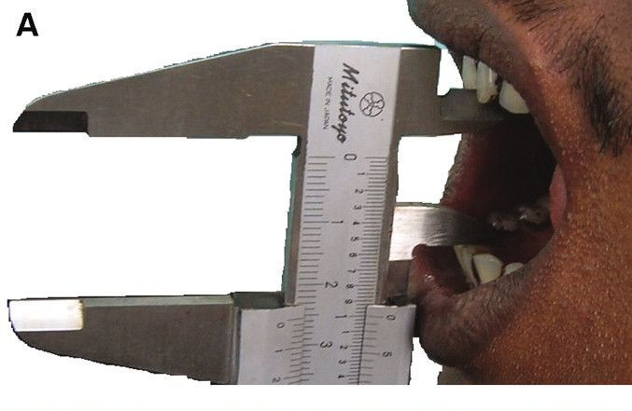
Clinical photographs of a patient with moderate (Grade 1) oral submucous fibrosis (OSF). Inter-incisal opening was <35mm
Note blanching of tissues

Slide 18
Clinical photographs of a patient with moderate (Grade 2) oral submucous fibrosis (OSF). Inter-incisal opening was <25 mm
The lower lip demonstrated very little elasticity. Note blanching of tissues

Slide 19
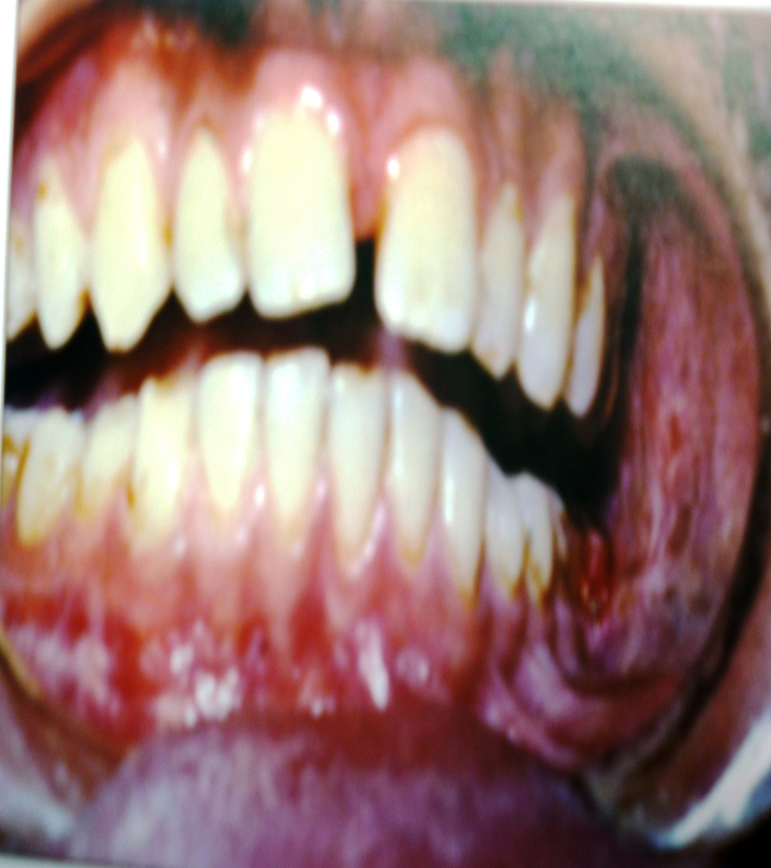
Clinical photographs of a patient with severe (Grade 3) oral submucous fibrosis (OSF). Inter-incisal opening was <5 mm

Slide 20
Symptoms and signs of oral submucous fibrosis.
Progressive inability to open the mouth (trismus) due to
oral fibrosis and scarring
Oral pain and a burning sensation upon consumption of
spicy foodstuffs
Increased salivation
Change of gustatory sensation
Hearing loss due to stenosis of the eustachian tubes
Dryness of the mouth
Nasal tonality to the voice
Impaired mouth movements (eg, eating, whistling,
blowing, sucking)
J Cancer Science & Theraphy - Volume 1(2) : 072-077 (2009) - 075

Slide 21
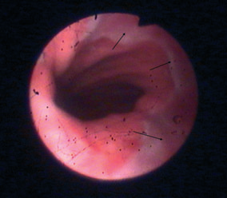
Visual esophageal endoscopic changes (blanching)
Dysphagia to solids (if the esophagus is involved)
Laboratory findings:
Decreased hemoglobin levels
Decreased iron levels
Decreased protein levels
Increased erythrocyte sedimentation rate
Decreased vitamin B complex levels
J Cancer Science & Theraphy - Volume 1(2) : 072-077 (2009) - 075

Slide 22
Clinical presentations of oral submucous fibrosis
Burning sensation, excerbated by spicy food Vesiculation Blanching of mucosa Leathery mucosa | Fibrous bands within mucosa Limitation of mouth opening Narrowing of oropharyngeal orifice with distortion of uvula Woody changes to mucosa and tongue
Late presentation
Early forms
J Oral Pathol Med (2007) 36: 575–80

Slide 23
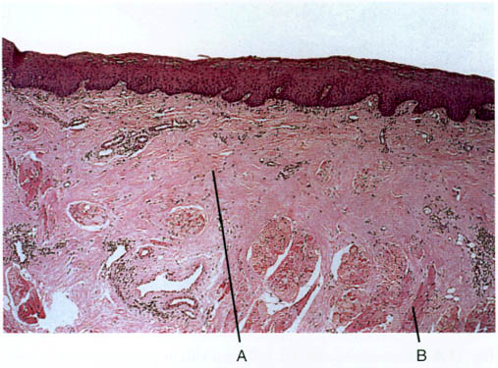
HlSTOPATHOLOGY
The subepithelial connective tissue becomes thickened, hyaline and avascular, and there may be infiltration by modest numbers of chronic inflammatory cells.
The epithelium usually becomes thinned and may show atypia. Underlying muscle fibres undergo progressive atrophy
There is fibrosis (A) extending from the epithelium down into the underlying muscle
(B)which is replaced by hyalinised fibrous tissue.

Slide 24
Precancerous nature and malignant transformation
Pindborg in 1972 put forward five criteria to prove that the OSMF is precancerous (Pindborg et al., 1984). They included, high occurrence of OSF in oral cancer patients, higher incidence of SCC in patients with OSF, histological diagnosis of cancer without any clinical suspicion in OSF, high frequency of epithelial dysplasia and higher prevalence of leukoplakia among OSF cases(Pindborg et al., 1967).
Malignant transformation rate of OSF was found to be in the range of 7–13%. According to long term follow-up studies a transformation rate of 7.6% over a period of17 years was reported (Murti et al., 1985)
J Cancer Science & Theraphy - Volume 1(2) : 072-077 (2009) - 075

Slide 25
Diagnosis
No specific test will confirm a suspected diagnosis of submucous fibrosis.The diagnosis is made from a history of repetitive exposures to betel nut or a similar substance, the clinical appearance, and the tex­ture of the tissue.
An incisional biopsy will reveal a thinned epithelial surface and the excessive deposition of otherwise normal collagen in the submucosa.
Indeed, a biopsy of the most severe area or of an area of ulcerations is recommended to rule out squamous cell carcinoma because the slake lime in the betel nut-stoke lime preparation is a known carcinogen, and submucous fibrosis is considered to be a prema-lignant sign.
Oral and maxillofacial pathology: a rationale for diagnosis and treatment–Robert E. Marx and Diane Stern

Slide 26
Differential Diagnosis
Amyloidosis: Hyalinized stroma can be distinguished from amyloid infiltration by using Congo red and thioflavine T staining under polarized and immunofluorescent light, respectively.
Generalized fibromatosis: Although soft tissue masses are not produced in the usual sense, the fibrosis of oral submucous fibrosis may be confused with generalized fibromatosis.
Oral manifestations of scleroderma: Scleroderma can be distinguished by other cutaneous, systemic, and characteristic laboratory findings. A case of localized plaque-type morphea was seen in a patient with long-standing oral submucous fibrosis.
Oral lichen planus: Wickham striae can mimic atrophy and fibrosis.
Anemia: Pale oral mucosa can mimic atrophy and fibrosis

Slide 27
Differential Diagnosis
Radiation fibrosis
Chronic infections, particularly actinomycosis,
Temporomandibular joint bony ankylosis
& fibrous ankylosis
Juvenile rheumatoid arthritis
pro­gressive myositis ossificans
Oral and maxillofacial pathology: a rationale for diagnosis and treatment–Robert E. Marx and Diane Stern

Slide 28
Differential Diagnosis
The presentation of a restricted jaw opening is suggestive of radiation Fibrosis if there is a history of radiotherapy of over 5,000 cGy.
Chronic infections, particularly actinomycosis, are well-known to induce a fibrosis and may also present with a limited jaw opening with a firm and inelastic quality.
In addition, temporomandibular joint bony ankylosis and fibrous ankylosis from injuries or foreign bodies, juvenile rheumatoid arthritis and both traumatic.
pro­gressive myositis ossificans can produce a limited jaw opening. However, in each the oral mucosa will be supple and of normal color and texture.
Oral and maxillofacial pathology: a rationale for diagnosis and treatment–Robert E. Marx and Diane Stern

Slide 29
PATIENT EDUCATION
Instruct patients regarding the importance of discontinuing the habit of chewing betel quid.
Inform patients that eliminating tobacco from the quid product may reduce the risk of oral cancer.
Instruct patients to avoid spicy foodstuffs.
Instruct patients to eat a complete and healthy diet to avoid malnutrition.
Instruct patients regarding maintaining proper oral hygiene and scheduling regular oral examinations.
Oral Submucous Fibrosis: Follow-up- eMEDICINE(Dermatology)

Slide 30
Treatment -MEDICAL
TREATMENT
ENZYMES
ANTIOXIDENT
CARDIOVASCULAR DRUGS
STEROIDS
INTERFERON γ

Slide 31
J oral path & med : 2005 , by P.Rajalalitha,S.Vali

Slide 32
STEROIDS
MECHANISM OF ACTION
Anti-Inflammatory activity
Increases the apoptosis of inflammatory cells
DOSAGE
Triamcinolone acetonide(kenalog, Aristocort-A) – 10mg/ml, twice a wk
Dexamethasone (Decardon) – 4mg/ml
ADVERRSE EFFECTS
Less useful in reversing the abnormal deposition of fibrotic tissues & recovering the suppleness of the mucosa
High incidence of relapse
6-8wks
Drug treatment of OSMF, J Oral Maxillofacial Surgery:2009, July 67(7) 1510-1515

Slide 33
LEVAMISOLE
Immuno-modulatory drug
Dosage : vermisole, 50mg tab TID
MOA :Modifies both cellular & humoral immunity
Anti inflammatory effects and its ability to modulate inflammatory cytokines --- reduces burning sensation
Reduction of serum IgG, IgA & IgM
Levamisole and antioxidants in the management of oral submucous fibrosis: A comparative study, JIAOMR,2009 , 20(4):

Slide 34
ENZYMES
Effective drug to reverse debilitating fibrosis by degrading abnormal fibrous tissue
COLLAGENASE
Increase circulation & epithelial regeneration after lysis of the submucous tissue
Given intralesionally
CHYMOTRYPSIN
Endopeptidase
Hydrolyses ester & peptide bonds
Used as a proteolytic & anti-inflammatory agent
J Oral Maxillofacial Surgery:2009, July 67(7) 1510-1515

Slide 35
HYALURONIDASE
MECHANISM OF ACTION
Depolymerizes hyaluronic acid, Lowering the viscosity of the intercellular cementing substance
Decreasing collagen formation
DOSAGE
Hyalase,1500 I.U. dissolved in 2 c.c of 2% lignocaine
Hyaluronidase + steroids : relief from burning sensation, stiffness & disappearance of vesicles
Adverse effects :Chemical irritation of injected fluids , aggravates fibrosis, trismus & dysphagia .

Slide 36
INTERFERON - γ
Inhibitory effect on collagenous production & cell proliferation
Increase the synthesis of collagenase
Anti-fibrotic
DOSAGE: 0.01 – 10U/ml
rhINF-γ - 50μg(0.25ml) intralesionally twice a wk over 8 wks
Improvement in mouth opening of 8 + 4 mm
Reduction in burning sensation & increased suppleness of Buccal mucosa
Post treatment immunohistochemistry
Reduction in inflammatory cell infiltrate & Altered level of cytokines
Adverse effects:
Simple headache, flu-like symptoms & myalgia
Haque et al ,J Oral Path Med;2001;30:12-21

Slide 37
CARDIOVASCULAR DRUGS
Pentoxifylline
Buflomedil
Nylidrin
Success rate : 62.07%
( Int J Oral Maxillofac Surg. 1987 Dec ;16 (6):695-9)

Slide 38
PENTOXIFYLLINE
Methylxanthine derivative, has vasodilating properties
Fibrinolytic & anti plasmin activity, Anti-inflammatory
DOSAGE
Imm immuno-modulating actions include increasing leucocytes adhesion.
blocks TNF-α induced synthesis of fibroblast collagen.
Dosage : Trental – 400mg tab TID, minimum 8 wks
Adverse effects : gastric irritation
MECHANISM OF ACTION
A new adjunct in the treatment of oral submucous fibrosis IJDR,2006; 17:190-8

Slide 39
BUFLOMEDIL
Vasoactive agent
Effective adjunct therapeutic drug – early & advanced stages of OSMF
Relives the ischemic effect & helps nutritional & therapeutic substances reach the affected tissues (Lai et al)
J Oral Maxillofacial Surgery:2009, July 67(7) 1510-1515

Slide 40
ANTIOXIDANTS
Lycopene
β-Carotene
Vitamin A,B,C & E
Zinc
Selenium
Magnesium
J Oral Maxillofacial Surgery:2009, July 67(7) 1510-1515

Slide 41
LYCOPENE
MECHANISM OF ACTION:inhibition of abnormal fibroblasts
Up-regulation of lymphocyte resistance to stress
Anti-inflammatory
Chemopreventive agent for oral premalignant lesions
DOSAGE: Therapeutic dosage :6 – 60mg/day
Lycored , 10mg twice a day for 2 months
Reduces the burning sensation.Used along with steroid it is more efficacious

Slide 42
ANTIOXIDANTS
Vitamin E :
Prevents the oxidation of PUFA
Prevents the formation of ROS
β- carotene – 50,000IU & vitamin E for 6wks
Effective increase in mouth opening & tongue protrusion
Oral Maxillofacial Surgery:2009, July 67(7) 1510-1515

Slide 43
ZINC
Epithelializing agent
Dosage : Zinc sulphate 220mg TDS
Zinc alone /in combination with vitamin-A better in grade I & II
Zinc + cortisone effective in grade III
Increases the extent of relief and no relapse was observed upto a period of 15 months
Indian J Pharm: 1991,23: 236-241

Slide 44
COPPER CHELATORS
Inhibits LOX & directly binds with collagen fibrils, preventing cross linking into stable collagen tissue.
Local use of D-penicillamine is useful.
J oral path & Med : 2005 , by P.Rajalalitha,S.Vali

Slide 45
CURCUMIN
Natural polyphenol, a major yellow pigment in turmeric,
mustard
Mechanism of action :
Antioxidant & Anti-inflammatory activity
Suppresses the expression of extracellular matrix genes
Inhibiting CTGF gene expression
oral oncology ;45(2009) e99-e105

Slide 46
Treatment
Alternative procedures, such as insertion of an oral stent, physiotherapy, local heat therapy, mouth exercises using acrylic carrots and ice cream sticks, have been tried with variable rates of success.
In most cases, depending on the stage of disease and extent of oral involvement, therapy consisting of a combination of the above-mentioned drugs and surgery.
J Cancer Science & Theraphy - Volume 1(2) : 072-077 (2009) - 075

Slide 47
Treatment
As fibrosis cannot be reversed, when mouth opening is severely limited surgical interventions-such as myotomy, coronoidectomy and excision of fibrotic bands are required.
Reconstruction using such techniques as buccal pad flap, superficial temporal flap and forearm flap, can also be performed.
J Cancer Science & Theraphy - Volume 1(2) : 072-077 (2009) - 075

Slide 48
Conclusion:
Oral sub-mucous fibrosis is a complex precancerous condition of the oral cavity and oropharynx. It is fast becoming an epidemic in India and is considered as an oral health problem with high degree of malignant potential.
Unfortunately the complex pathophysiology of the lesion is still obscure and treatment modalities for lowering the changes have not been successful .

Slide 49
REFERENCES
Oral Diseases (2011) 17 (Suppl. 1), 42–57
Journal of Investigative and Clinical Dentistry (2011), 2,10–15
J Cancer Science & Theraphy - Volume 1(2) : 072-077 (2009) - 075
J Oral Maxillofacial Surgery:2009, July 67(7) 1510-1515
J Oral Pathol Med (2007) 36: 575–80
J Oral Pathol Med (2005) 34: 321–8
Oral Oncology (2006) 42, 561– 568
Oral and maxillofacial pathology: a rationale for diagnosis and treatment–Robert E. Marx and Diane Stern

Slide 50
REFERENCES
A comparative study, JIAOMR,2009 , 20(4):
J Oral Maxillofacial Surgery:2009, July 67(7) 1510-1515
J Oral Maxillofacial Surgery:2009, July 67(7) 1510-1515
A new adjunct in the treatment of oral submucous fibrosis , IJDR,2006;17:190-8
Int J Oral Maxillofac Surg. 1987 Dec ;16 (6):695-9
Haque et al ,J Oral Path Med;2001;30:12-21
A comparative study, JIAOMR,2009 , 20(4)

