Slide 1
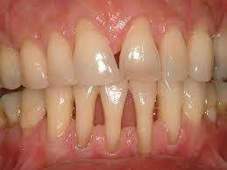
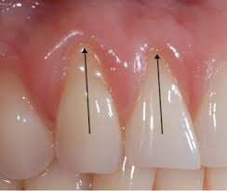
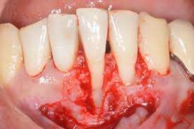
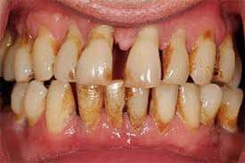
Gingival Recession
Dr.S.Santhosh MDS

Slide 2
Introduction
Definition: Exposure of the tooth by apical migration of the gingiva is called gingival recession.
Also known as receding gums.

Slide 3
Introduction
More prevalent in men.
Increase with age.

Slide 4
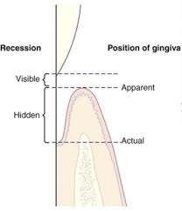
Position of the gingiva
Recession is exposure of the root surface by apical shift in the position of the gingiva
There are two types of the position of the gingiva:
Actual position Apparent position

Slide 5
Position of the gingiva
Actual position:
The actual position is the level of the most coronal end of the epithelium attachment on the tooth.
Apparent position of the gingiva:
The apparent position is the level of the crest of gingival margin.

Slide 6
Position of the gingiva
Severity of the recession is determined by the actual position of the gingiva not by apparent position.
For example: Some of the part of denuded root is covered by inflamed
pocket wall, thus the some of the recession is visible and some are hidden.
Total recession will be the some of two.

Slide 7
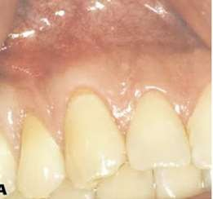
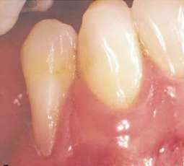
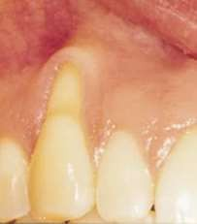
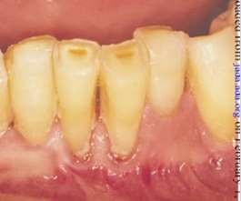
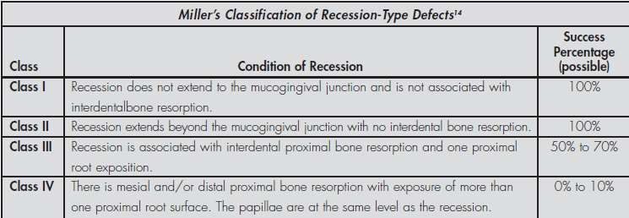
Classification

Slide 8
CLINICAL
CHARACTARISTICS

Slide 9
Clinical Characteristics
The following signs and symptoms may be clinical absorbed
Apical migration of the crest of the marginal gingiva.
Tissue may be red and inflamed or pink and firm
Dentin hypersensitivity: Erosion of the cementum may lead to exposing of dentin that cause dentine sensitivity.
Teeth may also appear longer than normal (a larger part of the crown is visible if gums are receding)

Slide 10
Clinical Characteristics
The roots of the tooth are exposed and visible
Change in the tooth’s color (due to the color difference between enamel and cementum)
Spaces between teeth seem to grow (the space is the same, but it seems larger because the gums do not fill it any more)
Cavities below the gum line

Slide 11
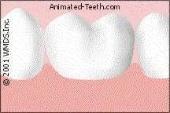
Symptoms and problems
Sensitivity
Esthetic complains
Root caries
Teeth discoloration
Abrasion
Difficulty maintaining plaque control

Slide 12
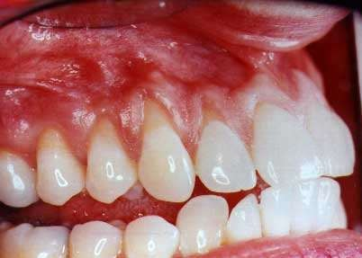
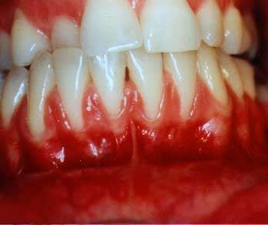
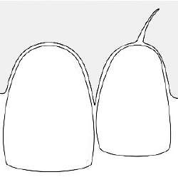
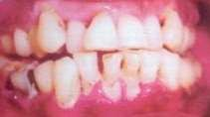
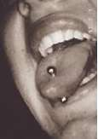
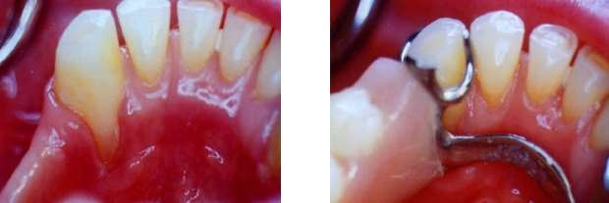
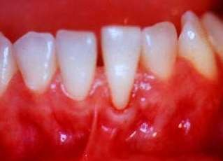
Causes
Anatomical
Plaque induced periodontitis
Trauma

Slide 13
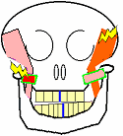
Trauma (con᾿t)

Slide 14
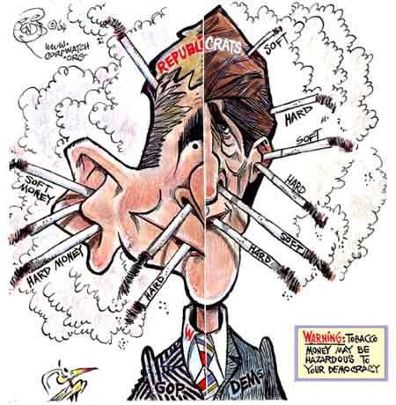
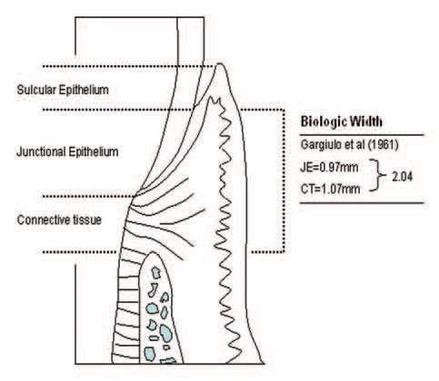
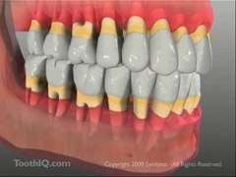
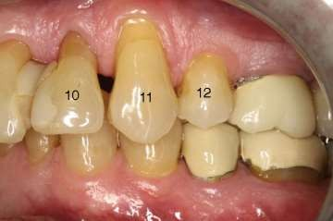
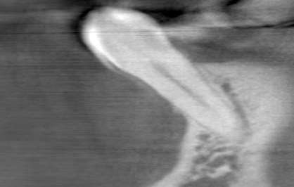
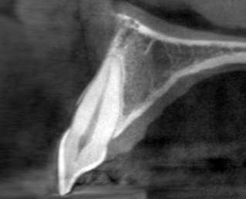
Iatrogenic factors
Smoking and Tobacco products

Slide 15
Aging
was also thought to cause gum recession. However this idea was discarded because of lack of convincing evidence that aging cause’s shift of gingival attachment .
Hormonal changes
Hormonal changes in women during pregnancy, menstruation and lactation can cause gums to become more sensitive and become more vulnerable to recession.

Slide 16
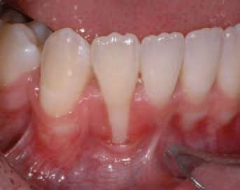
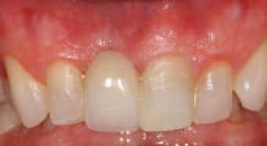
Gingival biotype.

Slide 17
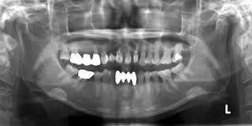
Radiographic sign

Slide 18
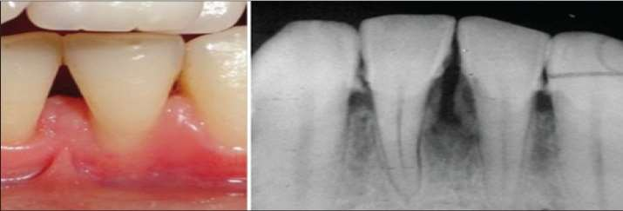
Radiographic Finding
Although in most cases there are only soft tissues are involved.
In advance level there are destruction of interdental alveolar bone that can
be seen in radiograph.

Slide 19
ETIOLOGY
?

Slide 20
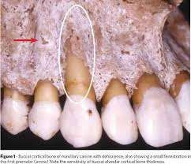
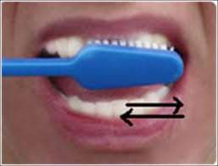
Etiology of Gingival Recession
There are so many causes of the gingival recession, some of them are discussed
here:
Faulty tooth brushing technique (horizontal movement) or using brush with hard toothbrush.
Tooth malposition ( Alveolar bone dehiscence)

Slide 21
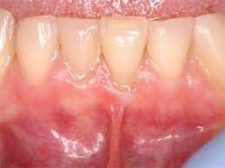
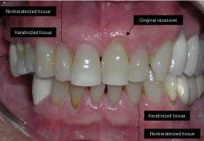
Etiology of Gingival Recession
Abnormal frenum attachment.
Hereditary thin, fragile or insufficient gingival tissue predisposes to gingival recession.
Bacterial plaque

Slide 22
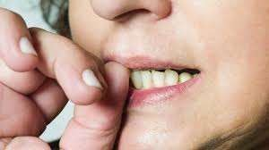
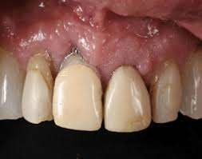
Etiology of Gingival Recession
Self-inflicted trauma, such as habits like digging a fingernail or pencil into the gum.
Overhanging gingival marginal or over countered restoration

Slide 23
Treatment of Gingival Recession
Treatment plane for gingival recession have three main concern:
Halting or retarding of the progressive loss of tissue
Restoring gingival height
Patient education

Slide 24
Treatment of Gingival Recession
To halt or retard the gingival recession it is very necessary to remove the etiological factor.
Nontraumatic plaque control at the affected site.
Avoid scrubbing tooth brushing and also avoid toothbrush with hard bristles.
Scaling or root planing if calculus present or root surface is rough.
Condition of the tissue is reevaluated after 6 weeks.

Slide 25
Surgical treatment
If the issue is still persist or need to restore gingival height, the following surgical procedure can be performed:
Lateral sliding pedicle Flap Double-papillae flap
Free autogenous soft-tissue graft
Coronally positioned flap

Slide 26
Surgical
Non-surgicaL
Monitoring and prevention
Use of desensitising agents, varnishes
Composite restoration
Removable gingival veneers
Orthodontics
1- free soft tissue graft a- Epithelia graft
b- Subepithelial C.T graft
2- pedicle soft tissue flap a- rotational flap
b- advancement flap
Treatment

Slide 27
Monitoring and prevention
If the recession is not progressing and does not provoke tooth sensitivity or poor aesthetics, then tooth- brushing instructions and regular observation through a strict maintenance program would be the optimal treatment.

Slide 28
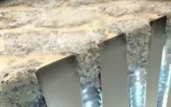
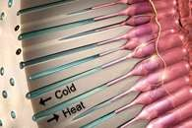
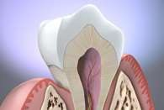
Desensitising agents, varnishes
Treatment of dentine hypersensitivity is based on blocking the dentinal tubules and preventing nerve stimulation .
Pro-Argin™ Technology contains arginine, an amino acid naturally found in saliva, and calcium carbonate .

Slide 29
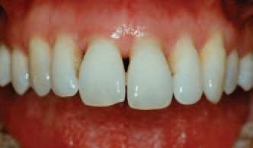
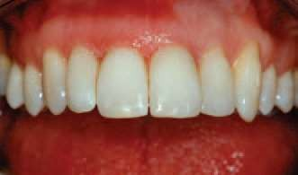
Composite restorations
Use of composite resin to mask recession defects and eliminate black triangles caused by recession.
Enameloplasty was carried out to even incisal plane in this case

Slide 30
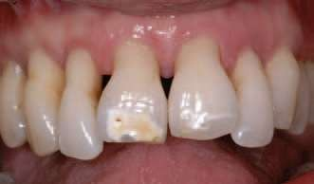
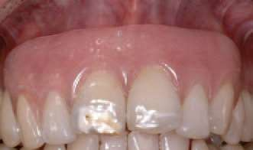
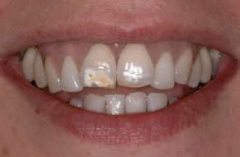
Removable gingival veneers

Slide 31
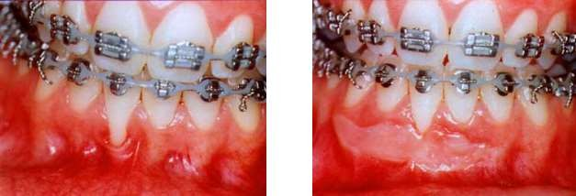
Orthodontics
In some cases surgical intervention and grafting may help to treat the recession defect; however, if orthodontic treatment is an option that the patient is willing to consider then any surgical intervention should be delayed until after orthodontic tooth movement has been completed.

Slide 32
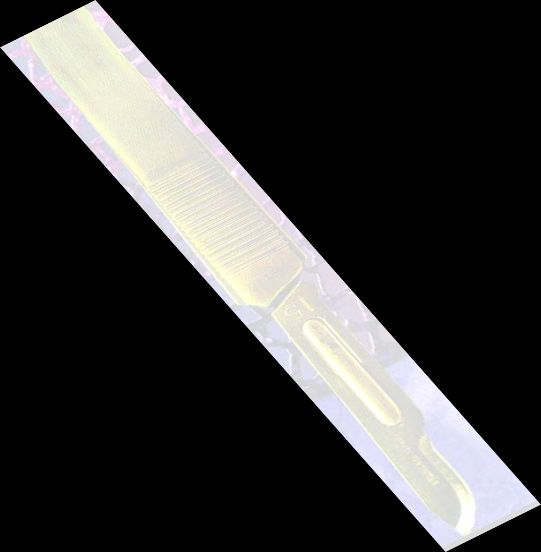
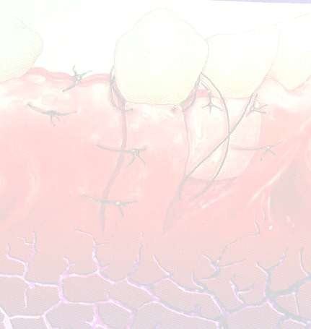
Indications for surgical intervention
The need to improve soft tissue aesthetics
Reduce hypersensitivity Improve plaque control
Prevent further progression of recession defect

Slide 33
Factors affecting outcome of periodontal plastic surgery
Condition of root surface – presence of calculus, caries, contaminated cementum or restorations on root surface
Prominent fraenal attachments
Depth of vestibule
Tissue type (Thickness of split thickness flaps raised )
Size of the recession defect and graft material
Smoking
Patient oral hygiene.

Slide 34
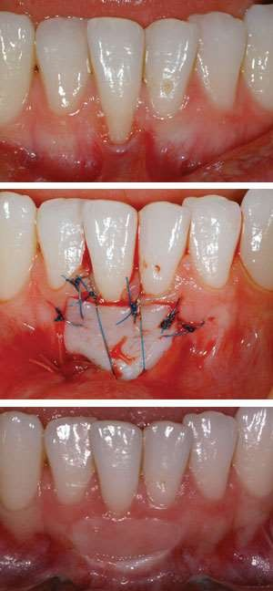
The Free Gingival Graft
1- The epithelialised free gingival graft can be used in either a one stage or two-stage procedure to cover the exposed root surface
there needs to be adequate overlap of the graft tissue with the soft tissue around the recession defect at the recipient site.
Immobilisation of the graft at the recipient
site is also essential
Disadvantage : the epithelialised free gingival graft is that it retains the colour of the donor tissue

Slide 35
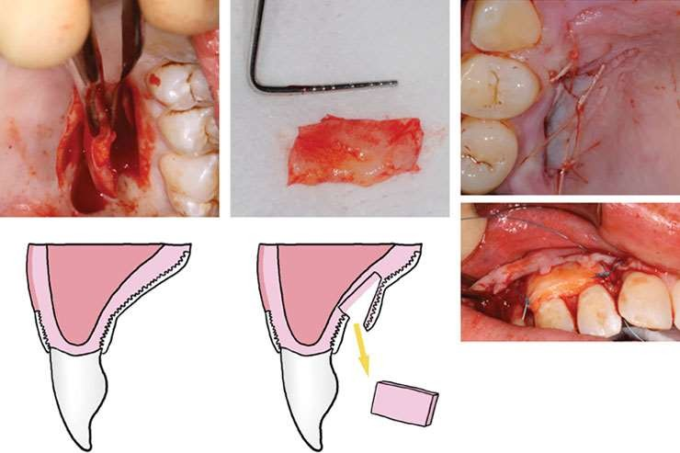
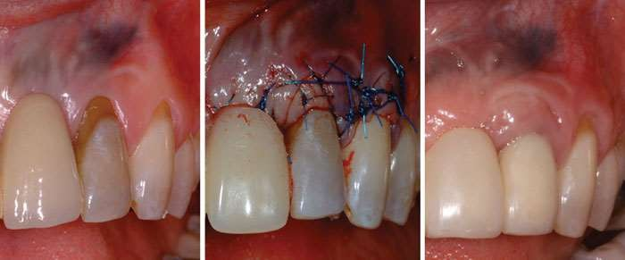
The Free Gingival Graft
2- Subepithelial connective tissue graft

Slide 36
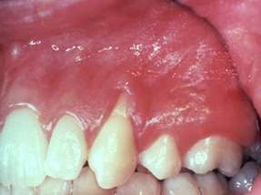
The pedicle flap
Advancement flap

Slide 37
The pedicle flap
Lateral

Slide 38
The pedicle flap
Transpositional flap by PENNEL ET EL

Slide 39
The pedicle flap
Double papilla flap

Slide 40
Guided tissue regeneration
The mean root coverage achieved with guided tissue regeneration has been shown to vary between 48-94%

Slide 41
The use of Allografts and Xenografts in management of gingival recession
A recent systematic review concluded that these grafts may be useful in situations where
A large recession defect needs to be treated .
Graft tissue harvested from the palate would provide an insufficient volume of tissue.

Slide 42
Prognosis
The subepithelial connective tissue graft has been shown to provide a
greater percentage root coverage than the epithelialised free gingival graft
Subepithelial connective tissue graft combined with a coronally advanced flap has been shown to provide better root coverage than the coronally advanced flap alone over a five year follow up period
When the subepithelial connective tissue graft is compared with guided tissue regeneration, the subepithelial graft has shown evidence of achieving greater root coverage

Slide 43
Criteria of successful root coverage

Slide 44
Treatment
In addition to the above treatment, the following may also indicated.
Orthodontic movement or recontouring of the tooth to place it within the alveolar housing.
Replacement of over contoured restoration.
Correction of abnormal habits like chewing on pencil etc.
Correction of malocclusion.

Slide 45
Patient Education
Patient should be informed about areas of recession and potential problem related to them.
Patent cooperation in the treatment of recession is important.
Advise the patient to regularly maintain the oral hygiene and to gentle use of soft and firm tooth brush.
Quit Tobacco Consumption
Eat a healthy, well-balanced diet

Slide 46
Potential Problem Related To Gingival Recession

Slide 47
Potential Problem Related To Gingival Recession
Receding gums can have some serious impact on overall health. Gingiva give protection to the teeth and control plaque accumulation. Easily production of cavity on denuded root.
Increased tooth sensitivity to cold and hot.
In severe cases, receding gums can lead to tooth loss. Cosmetic and aesthetic issues.

Slide 48
Preventive measures for gingival recession

Slide 49
Preventive measures for gingival recession
The following precaution may inhabit gingival recession:
Non traumatic plaque control.
Maintaining oral hygiene.
Avoiding use of tooth brush with hard and short bristles.
Brushing the teeth in a circular motion instead of horizontal or scrubbing technique.
Immediately treat gingivitis or periodontitis

Slide 50
Preventive measures for gingival recession
Move the teeth to the right alveolar housing if needed.
Not performed any orthodontic treatment in the presence of gingival inflammation.
treat occlusal trauma soon as first appeared.
Never use over countered restoration or appliances that impinge the gingiva.

Slide 51
References
Carranza’s Clinical Periodontology 11th Edition
S.I. Balajhi Essentials of Periodontics 7th Edition
Ana SJ et al, Dental Press Journal of Orthodontics, vol. 21 May-Jun 2016
Dr. Alan Sidi BDS Msc Phd, Gum Recession Treatment by London’s #1 Dentist
Images are taken from Google.

