Slide 1
GINGIVAL CREVICULAR FLUID
P.K.Sasikumar, MDS, PhD

Slide 2
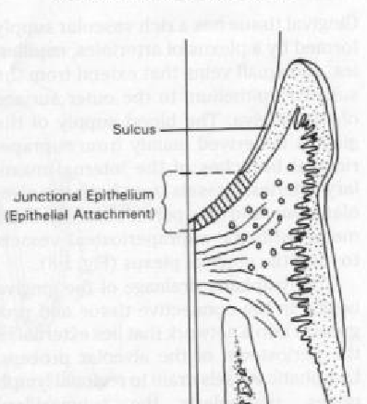
Anatomy of the gingival crevice
The gingival sulcus
is the shallow crevice or
space around the tooth ,
bounded by the surface
of the tooth on one side and
the epithelial lining the
free margin of the
gingiva on the other.

Slide 3
Is GCF a Transduate of interstitial fluid?
From the work of Alfano (1974) and from the hypothesis postulated by Pashley (1976) which suggested that the initial fluid produced could simply represent interstitial fluid which appears in the crevice as a result of an osmotic gradient. This initial, pre-inflammatory fluid was considered to be a transduate, and, on stimulation, this changed to become an inflammatory exudate

Slide 4
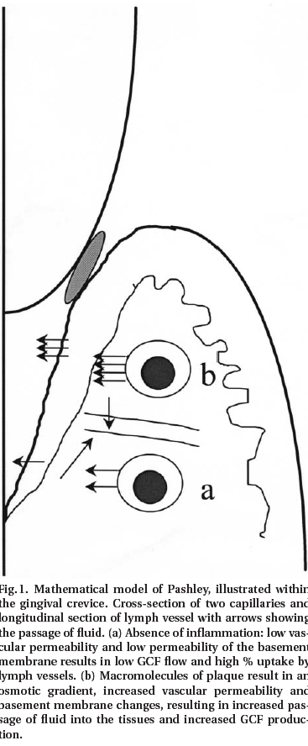
The model proposed by Pashley
predicted that GCF production is governed
by the passage of fluid from capillaries into
the tissues (capillary filtrate) and the removal
of this fluid by the lymphatic system
(lymphatic uptake). When the rate of
capillary filtrate exceeds that of lymphatic
uptake, fluid will accumulate as edema
and/or leave the area as GCF

Slide 5
Factors modulating:
  Filtration coefficient of the lymphatic and capillary endothelium
  Osmotic pressure within the different compartments.
Even in health also, if the osmotic pressure of the sulcular fluid exceeds that of the tissue fluid, there will be net increase in the flow of GCF.

Slide 6
GINGIVAL VASCULATURE AND CREVICULAR FLUID
Brill in 1959 demonstrated that increased vascular permeability plays an important role in the production of gingival fluid
Egelberg in 1966, in a first experiment obtained an increased permeability of the blood vessels of healthy gingiva by the use of three different methods:
  topical application of histamine,
  gentle massage of the gingival by means of a ball-ended amalgam plugger
  scraping of the gingiva crevice by means of a blunted dental explorer

Slide 7
FUNCTIONS :
1) cleanse material from the sulcus
2) contain plasma proteins that may improve adhesion of the epithelium to the tooth.
3) Possess antimicrobial properties.
4) Exert antibody activity in defense of the gingiva.

Slide 8
PERMEABILITY OF JUNCTIONAL AND ORAL SULCULAR EPITHELIA
Substances that have been shown to penetrate the sulcular epithelium include albumin, Endotoxins, thymidine, histamine, phenytoin, peroxidase.
The main pathway for the transport of substances across the junctional and sulcular epithelia seems to be the intercellular spaces which according to Schroeder and Munzel – Pedrazzoli (1970) form 18% of the total volume of the junctional epithelium and 12% that of the oral sulcular epithelium.

Slide 9
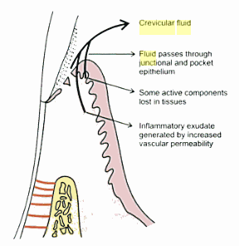
According to Squier (1973) the degree of permeability of the oral mucosa does not seem to depend upon its degree of Keratinization. The mechanisms of penetration through an intact epithelium were reviewed by Squier and Johnson.
Three routes have been described:
  Passage form CT into the sulcus
  Passage from the sulcus into the CT
  Passage of substances through pathological or experimentally modified gingival sulcus

Slide 10
Passage form CT into the sulcus:
In a series of experiments, Brill verified the assumption that
Interstitial fluid entered the gingival sulcus through its epithelial wall ------ by showing that the tracer material, Sodium fluorescein administered parenterally or per orally, could be recovered form the gingival sulcus but not form other oral epithelia.

Slide 11
Methods of collection
Intracrevicular washing
Absorbing paper strips
Twisted threads
Micropippetes

Slide 12
Gingival washing methods
In this technique the gingival crevice is perfused with an isotonic solution, such as Hanks’ balanced salt solution, usually of fixed volume.
The fluid collected then represents a dilution of crevicular fluid and contains both cells and soluble constituents such as plasma proteins.

Slide 13
2 different techniques have been used.
The simplest technique – instillation and re-aspiration of 10ml of Hanks’ balanced salt solution at the interdental papilla Skapski H, 1976.
This process was repeated 12 times to allow thorough mixing of the transport solution and GCF.
This technique could therefore be applied either to individual interdental units or to multiple units which were then pooled.
A more complicated method Oppenheim FG, 1970 involved the construction of a customized acrylic stent which isolated the gingival tissues from the rest of the mouth.
The tissues were then irrigated for 15min, with a saline solution, using a peristaltic pump, and the diluted GCF was removed.

Slide 14
Adavantage and disadvantages
The washing technique is particularly valuable for harvesting cells from the gingival crevice region.
However, the production of customized acrylic stents is complicated and technically demanding.
It is technique of limited application and has been restricted to the study of GCF obtained from only a few individuals.
Only applied to the maxillary arch, because of the difficulties of producing a technically satisfactory appliance for the mandibular arch.
GCF from individual sites cannot be analyzed.
All fluid may not be recovered during the aspiration and re-aspiration procedure. Thus accurate quantification of GCF volume or composition is not possible as the precise dilution factor cannot be determined.

Slide 15
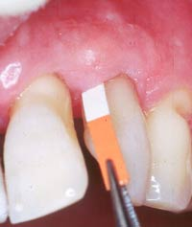
Absorbent filter paper strip
These strips are placed within the sulcus (Intrasulcular method) or at its entrance (Extrasulcular method). The placement of filter paper strip in relation to the sulcus or pocket is important.
The Brill technique places it into the pocket until resistance is encountered.
DISADVANTAGE ---- This method introduces a degree of irritation of the sulcular epithelium than can, by itself trigger the oozing of fluid.

Slide 16
To minimize this irritation, Loe and Holm – Pedersen 1965 placed the filter paper strip just at the entrance of the pocket or over the pocket entrance. In this way, fluid seeping out is picked up by the strip, but the sulcular epithelium will not be in contact with the paper.

Slide 17
Method of collection
INTRACREVICULAR
Strip inserted into the gingival crevice
EXTRACREVICULAR
strips are overlaid on the gingival crevice region in an attempt to minimize trauma.

Slide 18
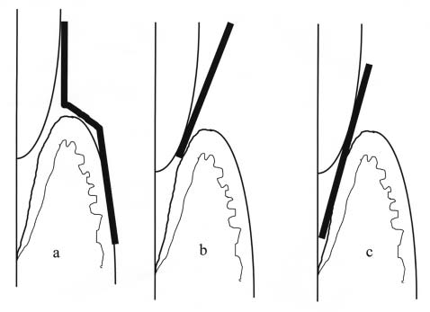
positioning of papers for the filter paper strip method of collection: (a) extracrevicular
method; (b) intracrevicular method ‘superficial’ [Löe & Holm-Pederson], (c) intracrevicular method ‘deep’ [Brill].

Slide 19
Preweighed twisted threads
Threads were placed in the gingival crevice around the tooth ,and the amount of fluid collected was estimated by weigh in the sample thread.
Used by WEINSTEIN et al 1967
Notes:
19

Slide 20
Micropipettes/ capillary tubing
KRASSE AND EGELBERG 1958 were first to utilize capillary tubing.
This permits the collection of fluid by capillary action.
After isolation and drying of collection site,capillary tubes of known diameter are inserted into the entrance of gingival crevice, GCF migrates into the tube by capillary action.
As diameter is known, the amount of GCF can be calculated by measuring the distance which the GCF has migrated.
And finally, their content is then centrifuged and analyzed.
Notes:
20

Slide 21
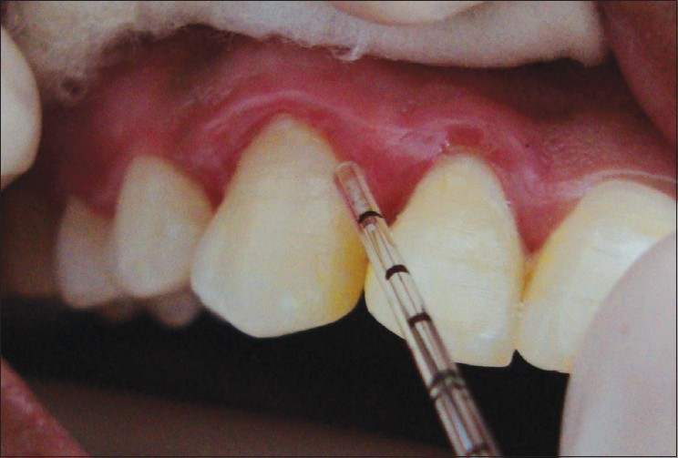
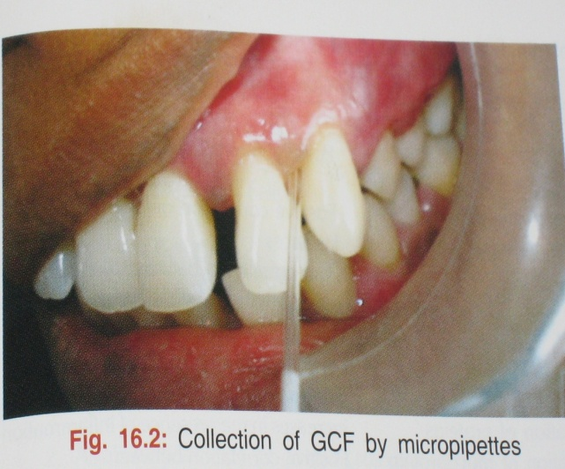

Slide 22
Advantage: provides an undiluted sample of native GCF
Disadvantages:
  Difficult to hold capillary tube at the entrance of gingival crevice for such lengthy periods
  Difficult to remove the complete sample from the tubing
  May cause trauma as excessive holding of pipette is required
  The collection of the fluid is difficult because the viscosity of the fluid makes the aspiration difficult

Slide 23
Crevicular washings
The Method Of Oppenheim:
This method uses an appliance consisting of a hard acrylic plate covering the maxilla with soft borders and a groove following the gingival margins, connected to four collection tubes.
The washings are obtained by rinsing the crevicular areas from one side to the other, using a peristaltic pump.
Notes:
23

Slide 24
ADVANTAGES:
  Useful for longitudinal studies
  Permits collection without disturbing the integrity of the marginal tissues
  Contamination is least
DISADVANTAGES:
  Complex procedure
  Represents a dilution of crevicular fluid

Slide 25
The Method Of Skapski And Lehner:
  This method uses two injection needles fitted one within the other such that during sampling the inside, or ejection, needle is at the bottom of the pocket and the outside, or collecting, one is at the gingival margin. The collection needle is drained into a sample tube by continuous suction
Notes:
25

Slide 26
ADVANTAGES
  Useful for cases of clinically normal gingival
  Useful for studying the number and state of cells and bacteria form the crevicular area
DISADVANTAGES;
  Does not permit absolute Quantitative assessment as the dilution factor cannot be determined

Slide 27
Problems during GCF collection
Contamination
The major sources of contamination of GCF sample would be blood, saliva, or plaque.
Sampling time
The problem with prolonged collection times is that the nature of the GCF sample collected is likely to change with the protein concentration of the initial GCF collected.

Slide 28
Volume determination
Recovery from strips
Data reporting
Constituents found within GCF samples have either
been reported as absolute amount (mg), concentrations
(mg/ml)

Slide 29
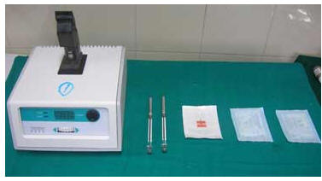
PERIOTRON
An electronic method has been devised for measuring gingival fluid absorbed on paper strips by Harco electronics called Periotron (Dental product division Winnipeg, Manitoba, Canada).

Slide 30
An electronic measuring device which measures the affect on the electric current flow of wetted paper strip.
It has 2 metal jaws which acts as the plates of an electrical condenser.
When a dry strip is places → zero reading is obtained
A wet paper strip will increase the capacitance in proportion to the volume of fluid and this can be measured as an increased value in the readout.
Three models → 600, 6000 and 8000.
Limitations: inability to measure the volume of FCG greater than 1.0µl.

Slide 31
Composition of GCF
Enzymatic components
Host derived & other products
Bacteria derived
Non enzymatic components
Cellular component
Electrolytes
Organic component

Slide 32
Enzymes & other compounds in GCF
Acid phosphates
Alkaline phosphatase
Alpha 1 antitrypsin
Arylsulphatse
Aspartate aminotransfarase
Chondroition sulphate
Immunoglobulins (IgG, IgA, IgG4, IgM)
Cystatins
B-glucuronidase
Cathepsin
Matrix metalloproteins
Cytokines – IL-1 α, β IL-6, IL-8

Slide 33
Bacteria derived enzymes
Acid phosphatase
Alkaline phosphatase
Collagenase
Hyaluronidase
Phospholipse-A
Phospholipase-C

Slide 34
Cellular elements
Bacteria
Desquamated epithelial cells
Leucocytes ( PMN’S, monocytes/macrophages)
Electrolytes
Potassium
Calcium
Sodium
Organic compounds
Carbohydrates-glucosehexosamine
-Hexuronic acid
Proteins

Slide 35
Metabolic end products
Lactic acid
Urea
Hydroxyproline
Endotoxins
Cytotoxic substances
Hydrogen sulphide

Slide 36
Cellular Elements:
The cellular elements found in the gingival fluid include bacteria, desquamated epithelial cells, and leukocytes (PMN’s, lymphocytes and monocytes) which migrate through the sulcular epithelium.

Slide 37
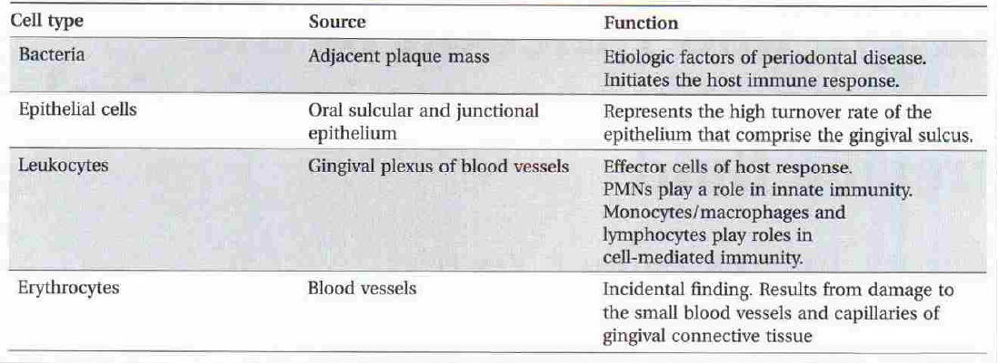

Slide 38
Electrolytes
Potassium, sodium, calcium, magnesium and fluoride have been studied in gingival fluid. Most studies have shown a positive correlation of calcium and sodium concentrations and the sodium to potassium ratio with inflammation.

Slide 39
Organic Compounds
Carbohydrates, proteins and lipids have been investigated. Glucose hexosamine and hexuronic acid are two of the compounds found in gingival fluid. Glucose concentration in gingival fluid is 3-4 times greater than that in serum.
This is interpreted not only as a result of metabolic activity of adjacent tissues, but also as a function of the local microbial flora.

Slide 40
Metabolic And Bacterial Products
Metabolic and bacterial products identified in gingival fluid include lactic acid, urea, hydroxy proline, endotoxins, prostaglandins, cytotoxic substances, hydrogen sulphide and antibacterial factors.

Slide 41
Enzyme And Enzyme Inhibitors
Various enzymes known to be present in gingival fluid include: -
Acid phosphatase,
Alkaline phosphatase,
Pyrophosphatase,
β - Glucoronidase,
Lysozyme,
Hyaluronidase,

Slide 42
Proteolytic enzymes includes:
Cathepsin D,
Elastase,
Cathepsin G,
Plasminogen activators,
Collagenase and
Bacterial proteinases (i.e. endo and exopeptidases), and
Lactic dehydrogenase serum proteinase inhibitors such as α₂ – macroglobulin, α₁ – antitrypsin, α₁ – antichymotrypsin have also been known to be present in GCF.

Slide 43
Potential diagnostic markers in GCF
Dipeptidyl peptidase – II
Dipeptidyl peptidase – IV
Neutrophil elastase
ICTP
IgG
IL-1
IL-4
PGE2
Alkaline phosphatase
Aspartate aminotransferase
Beta glucoranidase
Cathepsin – b
Collagenase – 2 (MMP – 8)
Collagenase – 3 (MMP – 13)

Slide 44
Host response & inflammatory markers
Cytokines – IL-1 α,β, 1ra, 6, 8, 2, TNF α, IFN γ
RANTES
Leukotriene B4
PGE2
Lactoferrin
Transferrin
C reactive protein
IgG1,IgG2,IgG3,IgG4,IgM,IgA

Slide 45
Markers in GCF
Platelet activating factor
Cystatins
CD14
Visfatin
Resistin
Vasoactive intestinal peptide
Plasminogen activator

Slide 46
Thank you

