Slide 1
FORENSIC ODONTOLOGY

Slide 2
FORENSIC is derived from the Latin word forum, which means “court of law”.
Forensic odontology or Forensic dentistry is the dental specialty that relates and applies dental knowledge to the legal problems.

Slide 3
American academy of forensic odontology in 1972, defined forensic odontology as the application of dental science to the law: that is the use of dental evidence in the interest of the justice.
Forensic odontology has been defined as that branch of dentistry which, in interest of justice, deals with the proper handling and examination of dental evidence and with proper evaluation and presentation of dental findings(Kieser Neilson 1981)

Slide 4
Forensic Odontology Involves
1. Identifying unknown human remains through dental records and assisting at the location of a mass disaster.
2. Eliciting the ethnicity and assisting in building up a picture of lifestyle and diet of skeletal remains at archaeological sites.
3. Determining the gender of unidentified individuals.
4. Age estimation of both the living and the deceased.
5. Recognition and analysis of bite marks found on victims of attacks and in other substances such as foodstuffs.
6. Presenting evidence in court as an expert witness.

Slide 5
DENTAL IDENTIFICATION PROCEDURES
There are two forms of dental identification
1.Comparative identification---compare the dead individual’s teeth with presumed dental records of the individual.
2. Reconstruction identification or dental profiling---attempt to elicit the ethnicity, race ,gender, age and occupation of the dead individual. This is undertaken when no clues of the deceased person exists.

Slide 6
Comparative Identification
Comparative identification is conventional method of post mortem dental identification and includes four steps
Oral autopsy
Obtaining dental records
Comparing post and ante mortem dental data
Writing a report and drawing conclusions.

Slide 7
Comparative Identification
Oral autopsy
Autopsy also known as necropsy or post mortem, involves examination of the deceased, usually with dissection to expose the organs to determine the cause of the death.
1. The forensic dentist should have adequate knowledge about common post mortem findings such as rigor mortis, decomposition and post mortem artifacts.
2. Rigor mortis may render the jaws rigid and use of mouth gags or intra oral myotomy is essential for jaw separation.
4. The status of each tooth be noted and through examination of hard and soft tissue injuries.
5. All information entered on the standard’ Interpol post mortem form which is color coded pink’

Slide 8
Obtaining dental records (ANTE MORTEM)
Dental records containing information of treatment and dental status of a person.
Records may be in the form of dental charts, radiographs, casts and photographs.
If multiple dentists have treated all record to transcribed onto standard Interpol ante mortem form which is color coded yellow.

Slide 9
Comparing post and ante mortem dental data
Data compared on the features that include tooth morphology and associated bony structures, pathology and dental restorations.
Writing a report and drawing conclusions.
A detailed report based on comparison must be clearly stated and depending on the range of conclusion they can be modified as
1. Confirms identification
2. Probable identification
3. Possible identification
4. Insufficient information
5. Excludes identification

Slide 10
PALATAL RUGAE IDENTIFICATION
Palatal rugae are ridges on the anterior part of palatal mucosa on each side of midpalatine raphae, behind the incisive papilla. They are unique to an individual. They do not change shape with age.
They are well protected by lips, cheeks, tongue buccal pad of fat, in cases of fire and high impact trauma.

Slide 12
Primary rugae : >5mm
Secondary rugae : 3 – 5mm
Fragmentary rugae : 2 -3mm
Branched
Unified
Cross-linked
Annular
Papillary

Slide 13
Gender determination
Based on
Craniofacial morphology & dimensions
Tooth morphology
Tooth dimensions
By DNA analysis
Amelogenin (AMEL) is located on X and Y chromosome
Females have 2 identical AMEL gene; males - 2 non identical gene

Slide 14
Mesio distal diameter of mandibular canines
Males > 7mm
Females < 6.7mm
Root length of maxillary cuspid is >3mm more in males than females

Slide 15
 | Skull features | Male | Female
1 | Architecture | Rugged | Smooth
2 | Frontal and parietal eminences | small | Large
3 | Forehead | sloping | Vertical
4 | Supraorbital ridges | Well developed | Absent or Slight developed
5 | Glabella | Prominent curvature | Relatively flat
6 | Nasion | Marked depression | Rarely depressed
7 | Orbits | squarish,with rounded margins | Rounded, with sharp margins
8 | Cheek bones | Bulky and lateral arched | Lighter, compressed
9 | Posterior root of zygoma | Well developed | Slight
10 | supramastoid crest | marked developed | faint or absent
11 | Mastoid process | Large | Small
12 | Mastoid crest | Slight to moderate | Marked
13 | Tympanic plate of temporal bone | Well developed | Delicate
14 | Occipital condyles | Large | Small
15 | Glenoid fossa | Deep | Shallow
16 | Digastric fossa | Broad | Narrow
17 | Palate | Large, V-shaped | Smaller, parabolic shape
18 | General features | Larger, thicker; broader ascending ramus | smaller, thinner; narrow ascending ramus
19 | Condyles | Larger | Smaller
20 | Body height | Greater depth at symphysis | Shallow at symphysis
21 | Shape of chin | Squarish | Rounded/pointed
22 | Gonial angle | Less obtuse | More obtuse

Slide 17
Age determination
Estimation of age plays an important role in forensic identification.
Dentition is one among the four systems used in estimating age.
Other three being
bone development,
secondary sexual characters,
stature and weight.

Slide 18
The methods of age estimation aided by dentition as natal, neonatal period and children up to 14 yrs, aided by craniofacial skeleton from 14- 20 yrs in young adults and adults.
Methods utilized:
1. Visual method
2. Radiographic method
3. Histological method
4. Physical and chemical methods.

Slide 19
Visual and Clinical method
Eruption of the teeth
Spacing between the teeth
Age estimation by tooth count
Radiological method
Age estimation of fetus or the young infant
From birth to twenty years

Slide 20
The developmental patterns and eruption of the deciduous teeth, followed by the development and eruption of the permanent dentition, serve as the most reliable indicator of the chronological age.
From 14 to 23 years, the residual growth of the second molar root structure and the third molar developing through the apical closure represent a means of chronological age estimation.

Slide 21
Age estimation using 3rd molar development
Mandibular 3rd molar is an unusual tooth characterized by considerable variabilities in formation timing, variations in crown and root morphology.
It offers a unique advantage over other teeth because its development tends to continue over a long period and until a later stage.

Slide 22
The skeletal development was assessed on hand wrist radiographs.
A strong correlation was found between the third molar development and both skeletal and chronological age.

Slide 23
Jaw and population studied | Tooth | Eruption age | Root completion age
Upper jaw western Indian | M₂ M₃ M₂ M₃ | 12- 13 yrs 17- 21 yrs 12- 14 yrs 17- 25 yrs | 14- 16 yrs 18- 25 yrs 14- 16 yrs 18- 25 yrs
Lower jaw western Indian | M₂ M₃ M₂ M₃ | 11- 13 yrs 17- 21 yrs 12- 14 yrs 17- 25 yrs | 14- 15 yrs 18- 25 yrs 14- 16 yrs 18- 25 yrs

Slide 24
Age estimation beyond 20 years
After the age of 20 it is extremely difficult to estimate the age of any individual by teeth.
The different features connected with the formation and eruption of the teeth have ended with the exception to 3rd molar

Slide 25
Certain morphological changes occur in the teeth with advancing years such as
Changes in the form of the crown by abrasion
Changes in the form of pulp chamber by the deposition of secondary dentin
Changes in the form of the roots by the addition of cementum
Recession of gingiva

Slide 26
Gustafson (1970) worked out a method for determination of age of an individual by means of examination of single tooth.
6 factors were examined:
Attrition (A)
Secondary dentin (S)
Periodontitis (P)
Transparency of the roots (T)
Cementum Apposition (C)
Root resorption (R)
Total score
Age = (11.43 + 3.63X) yrs

Slide 27
Other methods of age estimation
Teeth colour
Calcium/ phosphate ratio
Number of dentinal tubules
Flurescence from dentin and cementum
Root canal shrinkage

Slide 28
Using enamel
Not only are the shapes, contours and sizes of the human teeth indicating of gender biology, but recent scientific advances show that the major protein found in human enamel (amelogenin) has a slightly different signature in male and female enamel.
The AMEL gene that encodes for the male amelogenin is located in the Y chromosome.
The female has two different AMEL genes.

Slide 29
Using dental DNA
DNA is abundant through out the human body and there are distinct anatomic locations with in the tooth where DNA is found.
On the basis of the gross volume, the coronal pulp chamber and radicular canals are obvious targets for DNA sampling.

Slide 30
Approaches to sampling
Based on the microanatomy of the human tooth as the location of cells that harbor potentially useful DNA, four techniques were considered which include:
The DNA sample obtained is studied using PCR

Slide 31
1. Crush the entire tooth: this technique appears to be the most easier in assessing the dental DNA.
2. Conventional endodontic access opening for extraction of pulp.
3. Vertical split of the tooth
4. Horizontal section: a horizontal section through the cervical root, subjacent to the CEJ, avoids most restorations and provides the operator access to both the radicular and coronal pulp chambers.

Slide 32
Bite Marks

Slide 33
Crime investigation includes bite marks, child abuse, and lip prints.
Bite marks have been defined” as a mark caused by teeth either alone or in combination with other mouth parts.
Human bite mark
1.Outline broad and U shaped.
2.Broad centrals, narrow laterals and is blunt.
3.Present on breast, abdomen, thigh , shoulders.
Animal bite marks
1.Narrow and V shaped.
2.Broad laterals, narrow central and deeper canine marks.
3.Present on exposed skin and extremities.

Slide 35
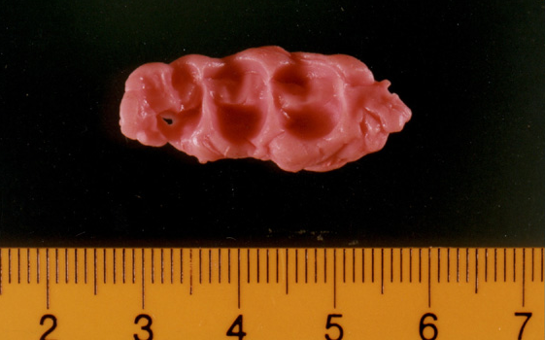
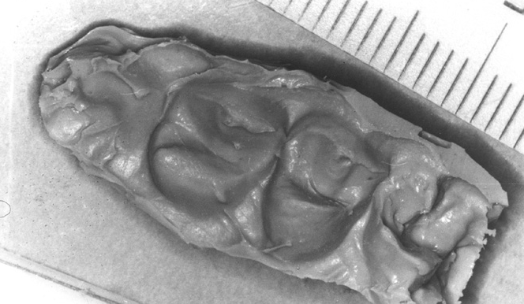
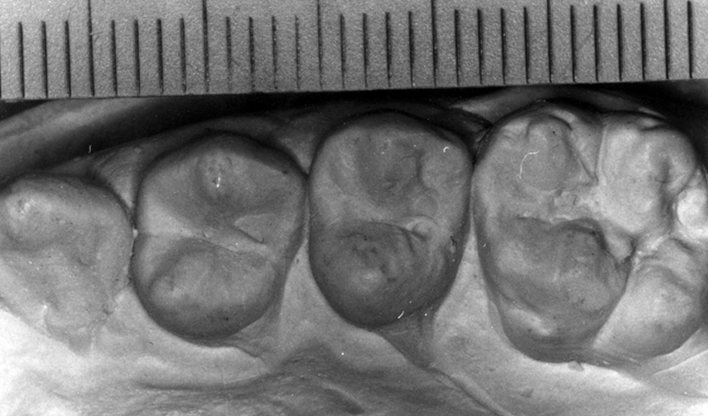
BITE MARKS EVIDENCE
PROTOCOL----AMERICAN BOARD OF FORENSIC ODONTOLOGY
Photography
2. Visual examination
3. Saliva swab
4. Impressions
5. Evidence collection from suspect

Slide 36
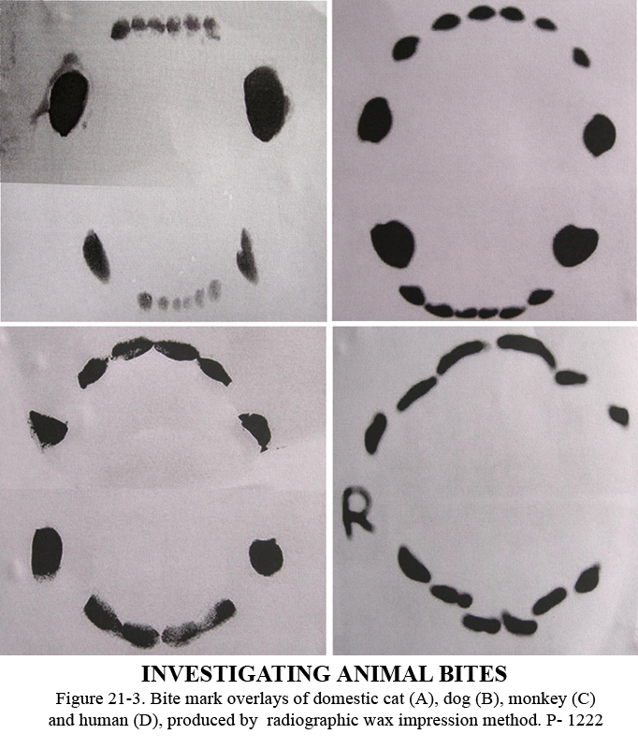
BITE MARKS OVERLAYS

Slide 37
Conclusion of bite mark
Positive identification—Charecteristics matches between bite mark and pattern of suspected
Possible identification – No Charecteristics matches
Excludes identification– When the features on the bite mark indicate that the suspected teeth could not caused them it represents negative

Slide 38
LIP PRINTS
Tsuchihashi named the wrinkles and groves visible on the lips as ‘SULCI LABIOUM RUBRORUM’
The imprint produced by the groves is termed as ‘CHEILOSCOPY’

Slide 39
FIRST Classified by Santos
Simple wrinkles
Straight line
Curved line
Angled line
Sine shaped curve
Compound wrinkles
Bifurcated
Trifurcated
Anomalous

Slide 40
Type 1- Clear cut vertical groves
Type 2- Intersecting
Type 3- Branching
Type 4- Reticular
Type 5- Cannot be differentiated

Slide 41
THANK YOU

