Slide 1
DEVELOPMENTAL DISORDERS OF TEETH

Slide 2
Abnormalities of
Size
Shape
Structure
eruption

Slide 3
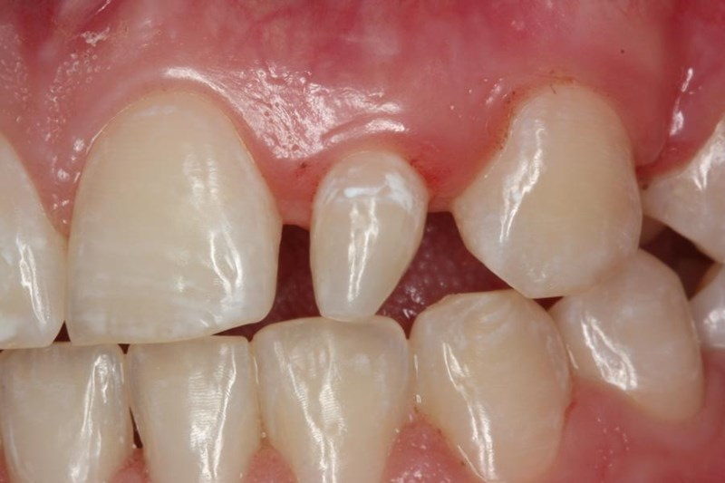
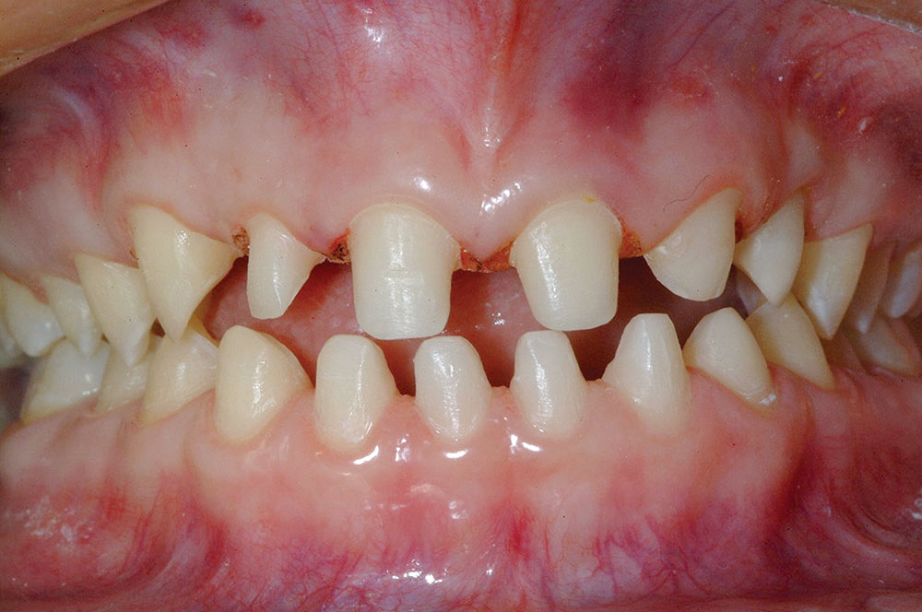
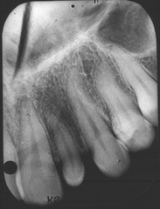
Microdontia

Slide 4
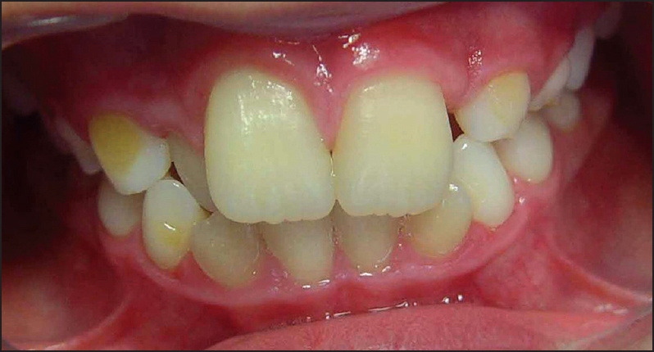
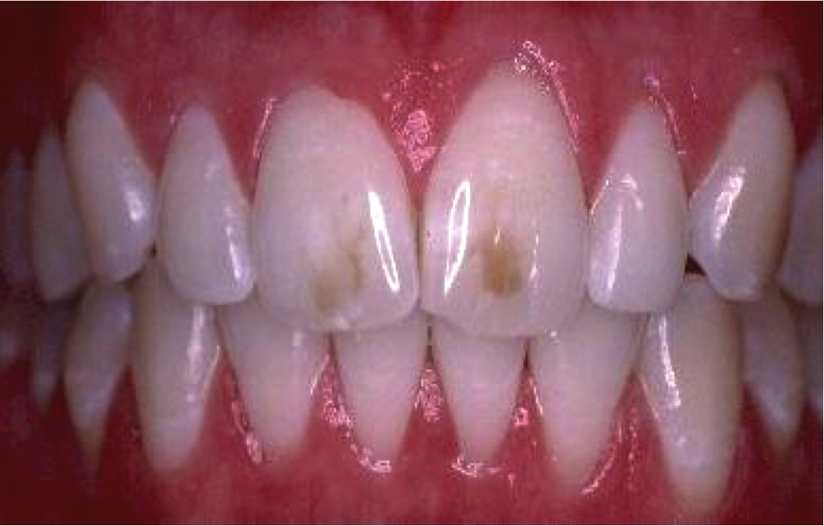
MACRODONTIA

Slide 5
ANODONTIA
Complete lack of tooth development
Anodontia, hypodontia, oligodontia
Syndromes associated
Hereditary ectodermal dysplasia, cleidocranial dysostosis

Slide 6
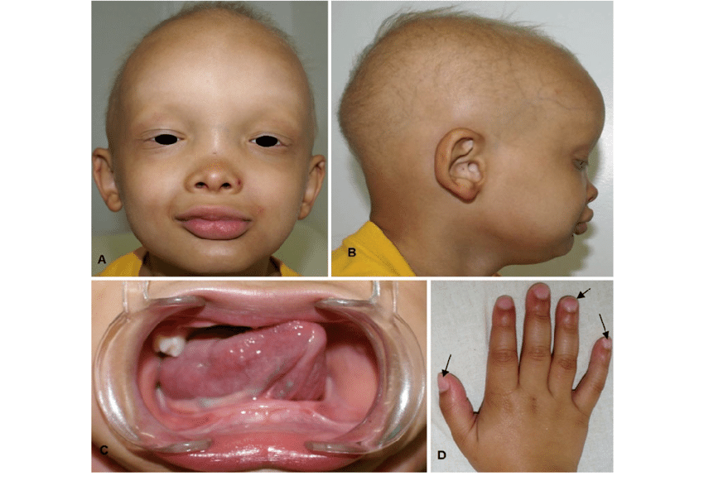

Slide 7
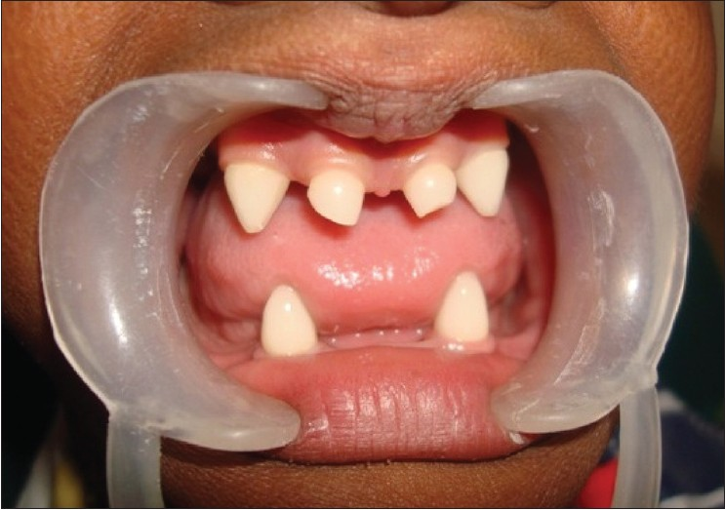
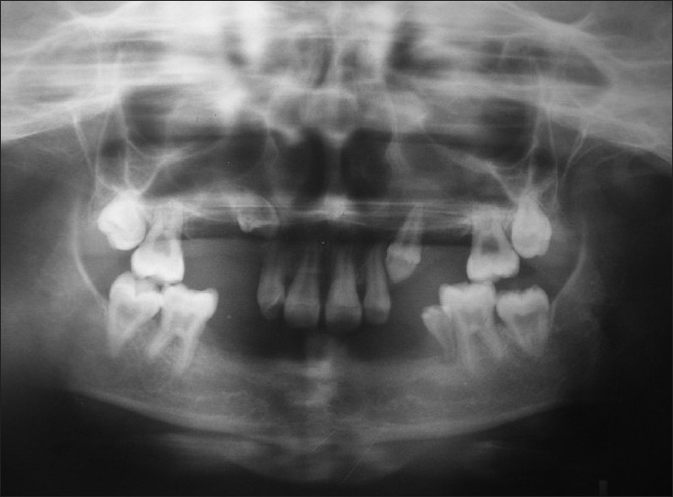
HYPODONTIA

Slide 8
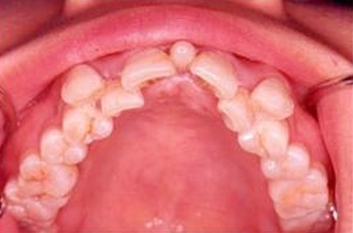
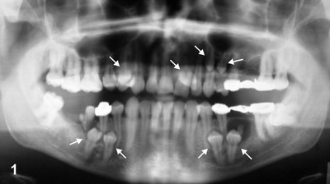
HYPERDONTIA

Slide 9
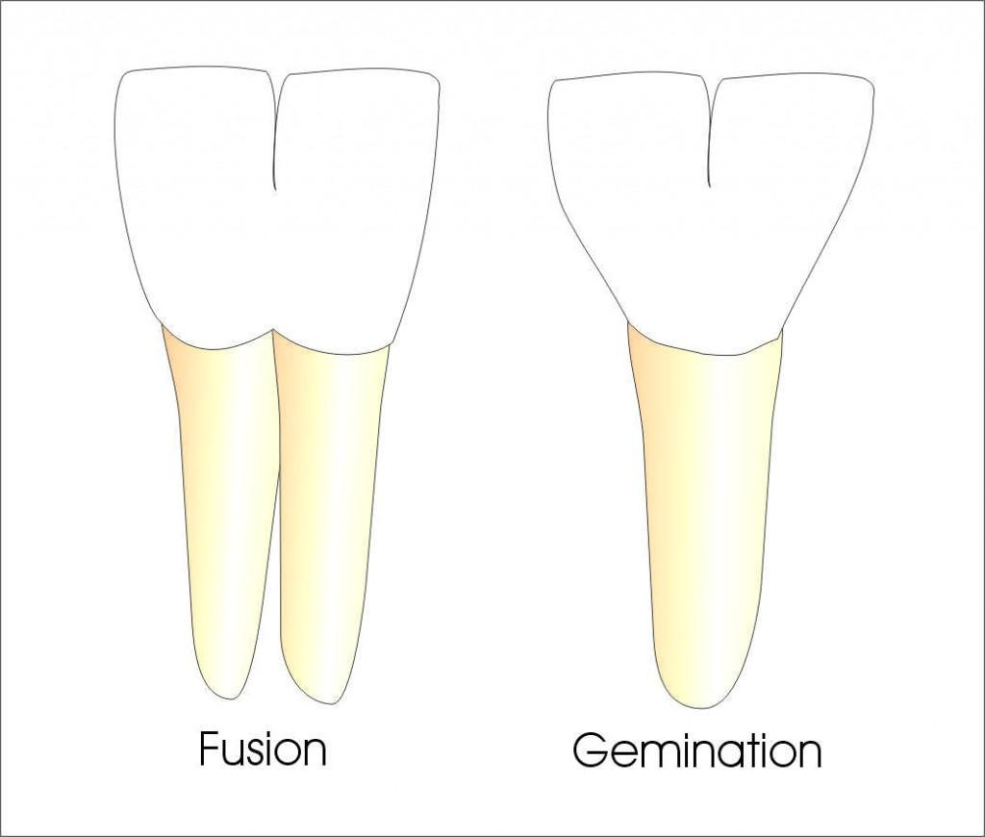
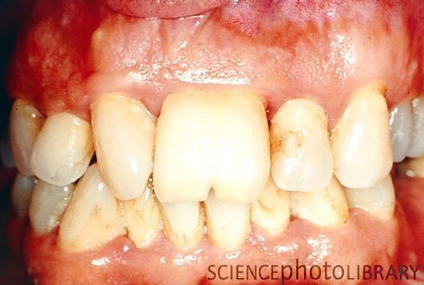
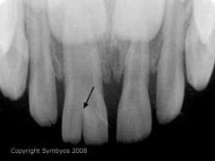
GEMINATION

Slide 10
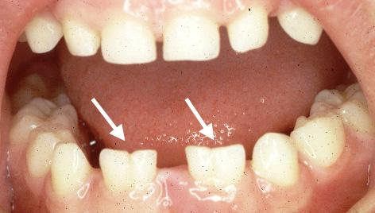
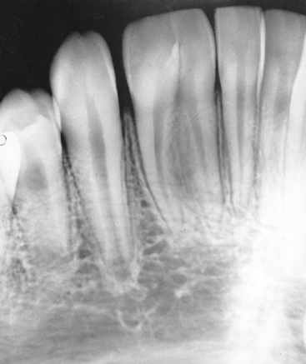
FUSION

Slide 11
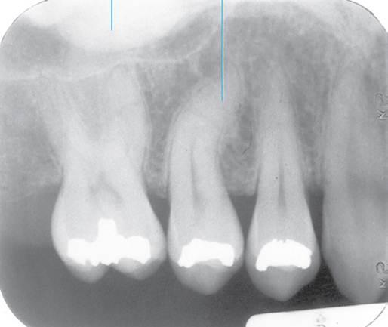
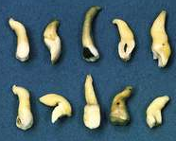
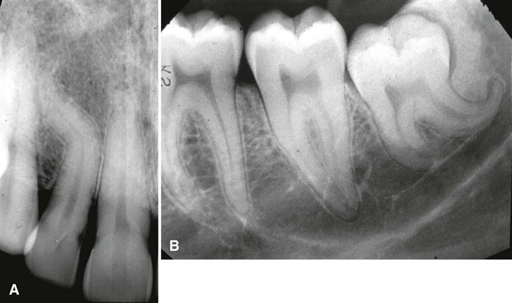
DILACERATION

Slide 12
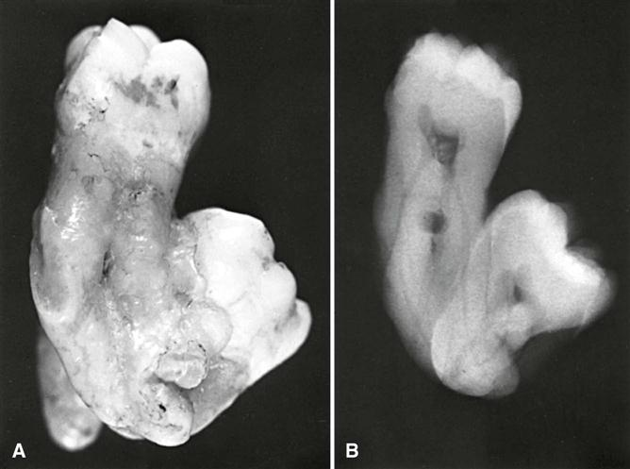
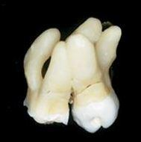
CONCRECENCE

Slide 13
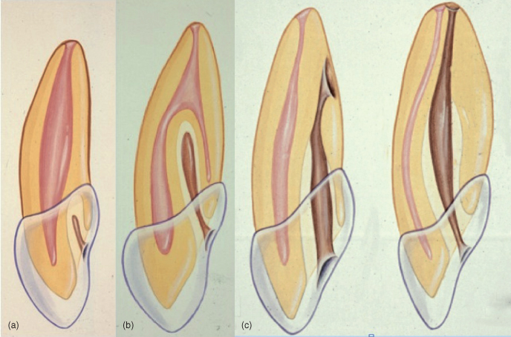
DENS INVAGINATUS

Slide 14
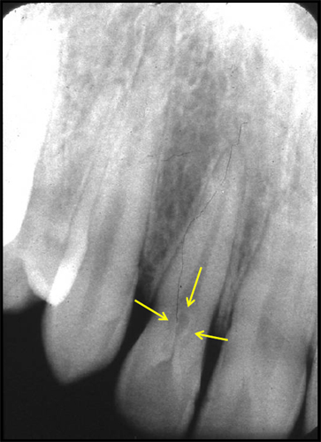
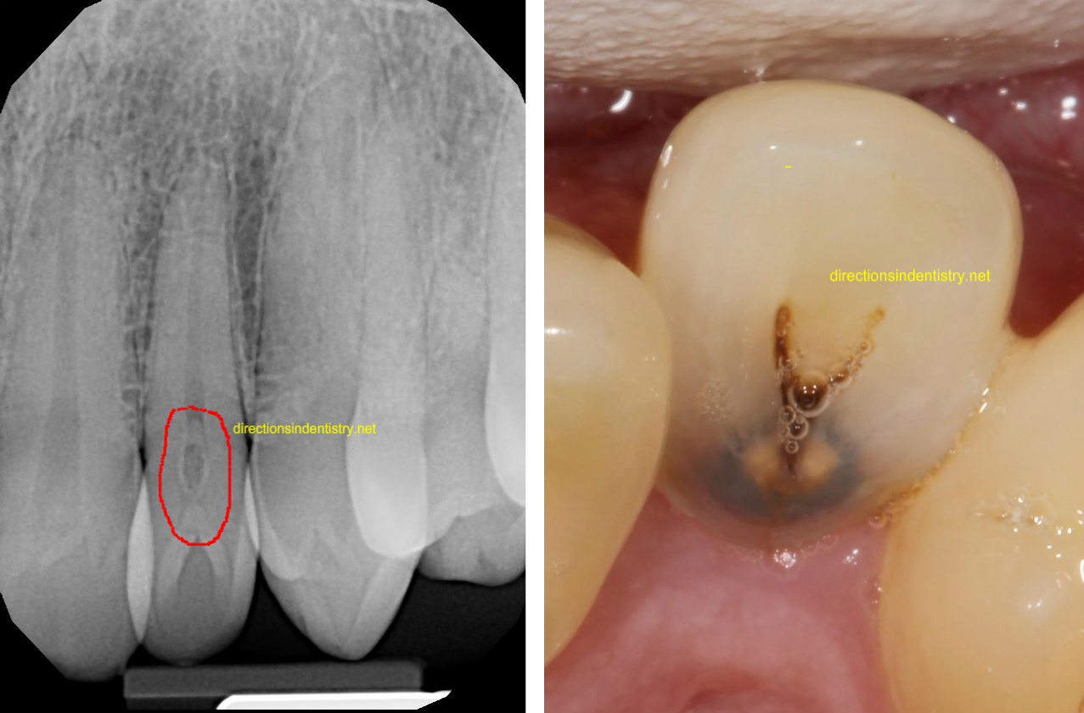

Slide 15
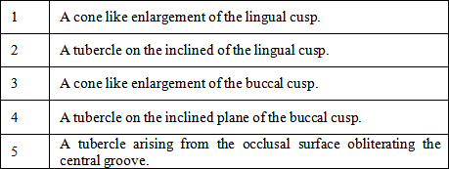
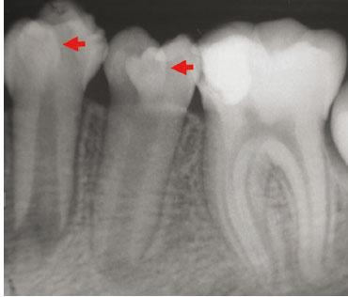
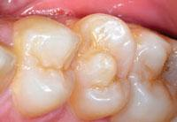
DENS EVAGINATUS

Slide 16
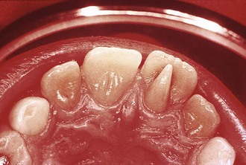
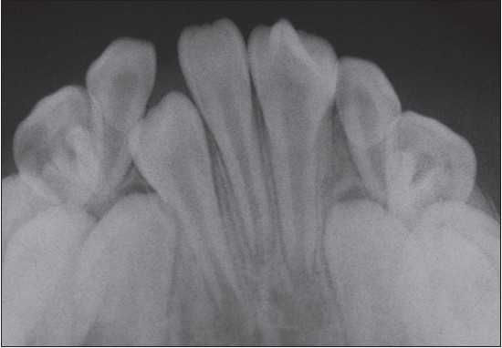
SHOVEL SHAPED INCISORS LEONG’S PREMOLAR

Slide 17
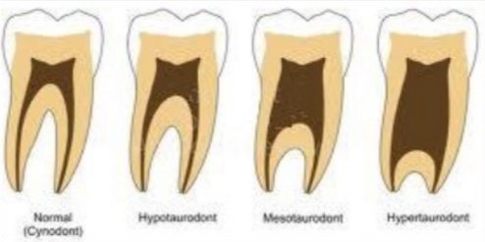
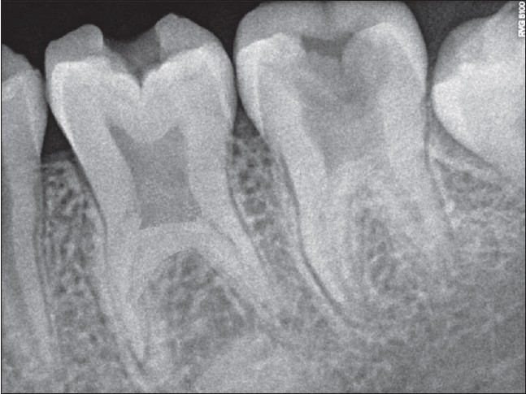
TAURODONTISM

Slide 18
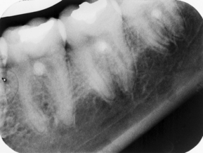
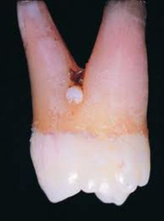
Enamel pearl

Slide 19
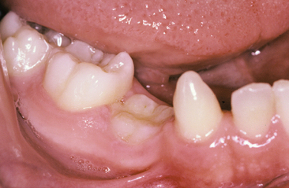
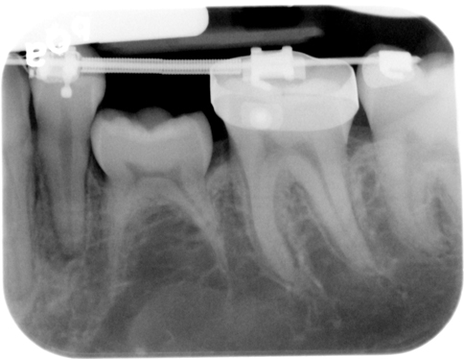
SUBMERGED TOOTH

Slide 20
Structure of the teeth

Slide 21
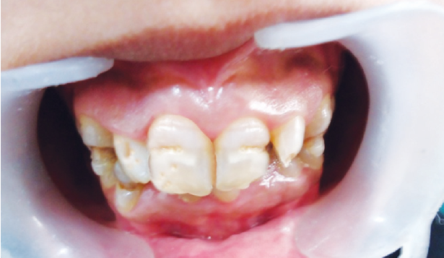
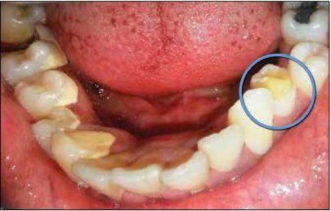
TURNER’S HYPOPLASIA

Slide 22
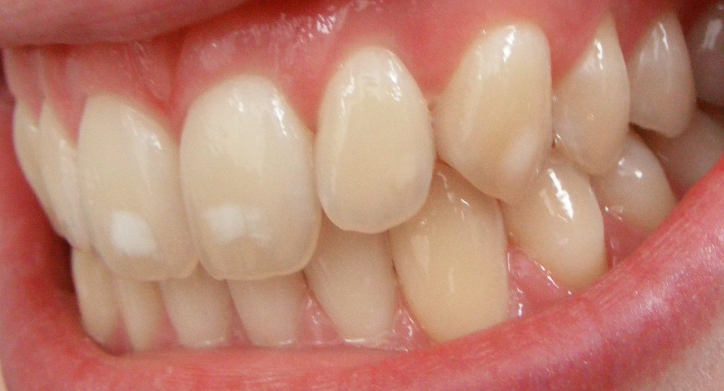
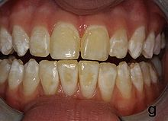
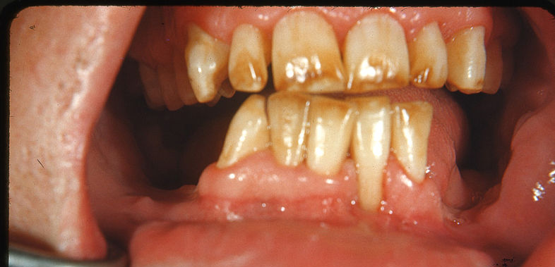
DENTAL FLUOROSIS

Slide 24
DECIDUOUS TEETH
neonatal jaudice → yellow
congenital porphyria → red
Tetracycline
permanent teeth
periapical infection of d. predeccesor – Turner tooth
systemic diseases

Slide 25
genetic
amelogenesis imperfecta
dentinogenesis imperfecta
Ehlers-Danlos syndrome, Gardner´s syndrome
infective – congenital syphilis
metabolic – childhood infections, rickets
drugs – tetracycline, cytotoxic chemotherapy
fluorosis

Slide 26
Amelogenesis imperfecta
all teeth + whole enamel x dentine normal
Hereditary enamel hypoplasia
AD inheritance
defect of matrix formation – pits, grooves, hard
Hereditary enamel hypocalcification
AD + AR inheritance
normal matrix poorly calcified – soft, chalky

Slide 27
Represents group of hereditary defects of enamel associated with any other generalized defect.

Slide 28
TYPES
Hypoplastic
Autosomal dominant
Autosomal recessive
X linked dominant
Hypocalcification
AD
AR
Hypomaturation
AD
AR
Snow capped teeth

Slide 29
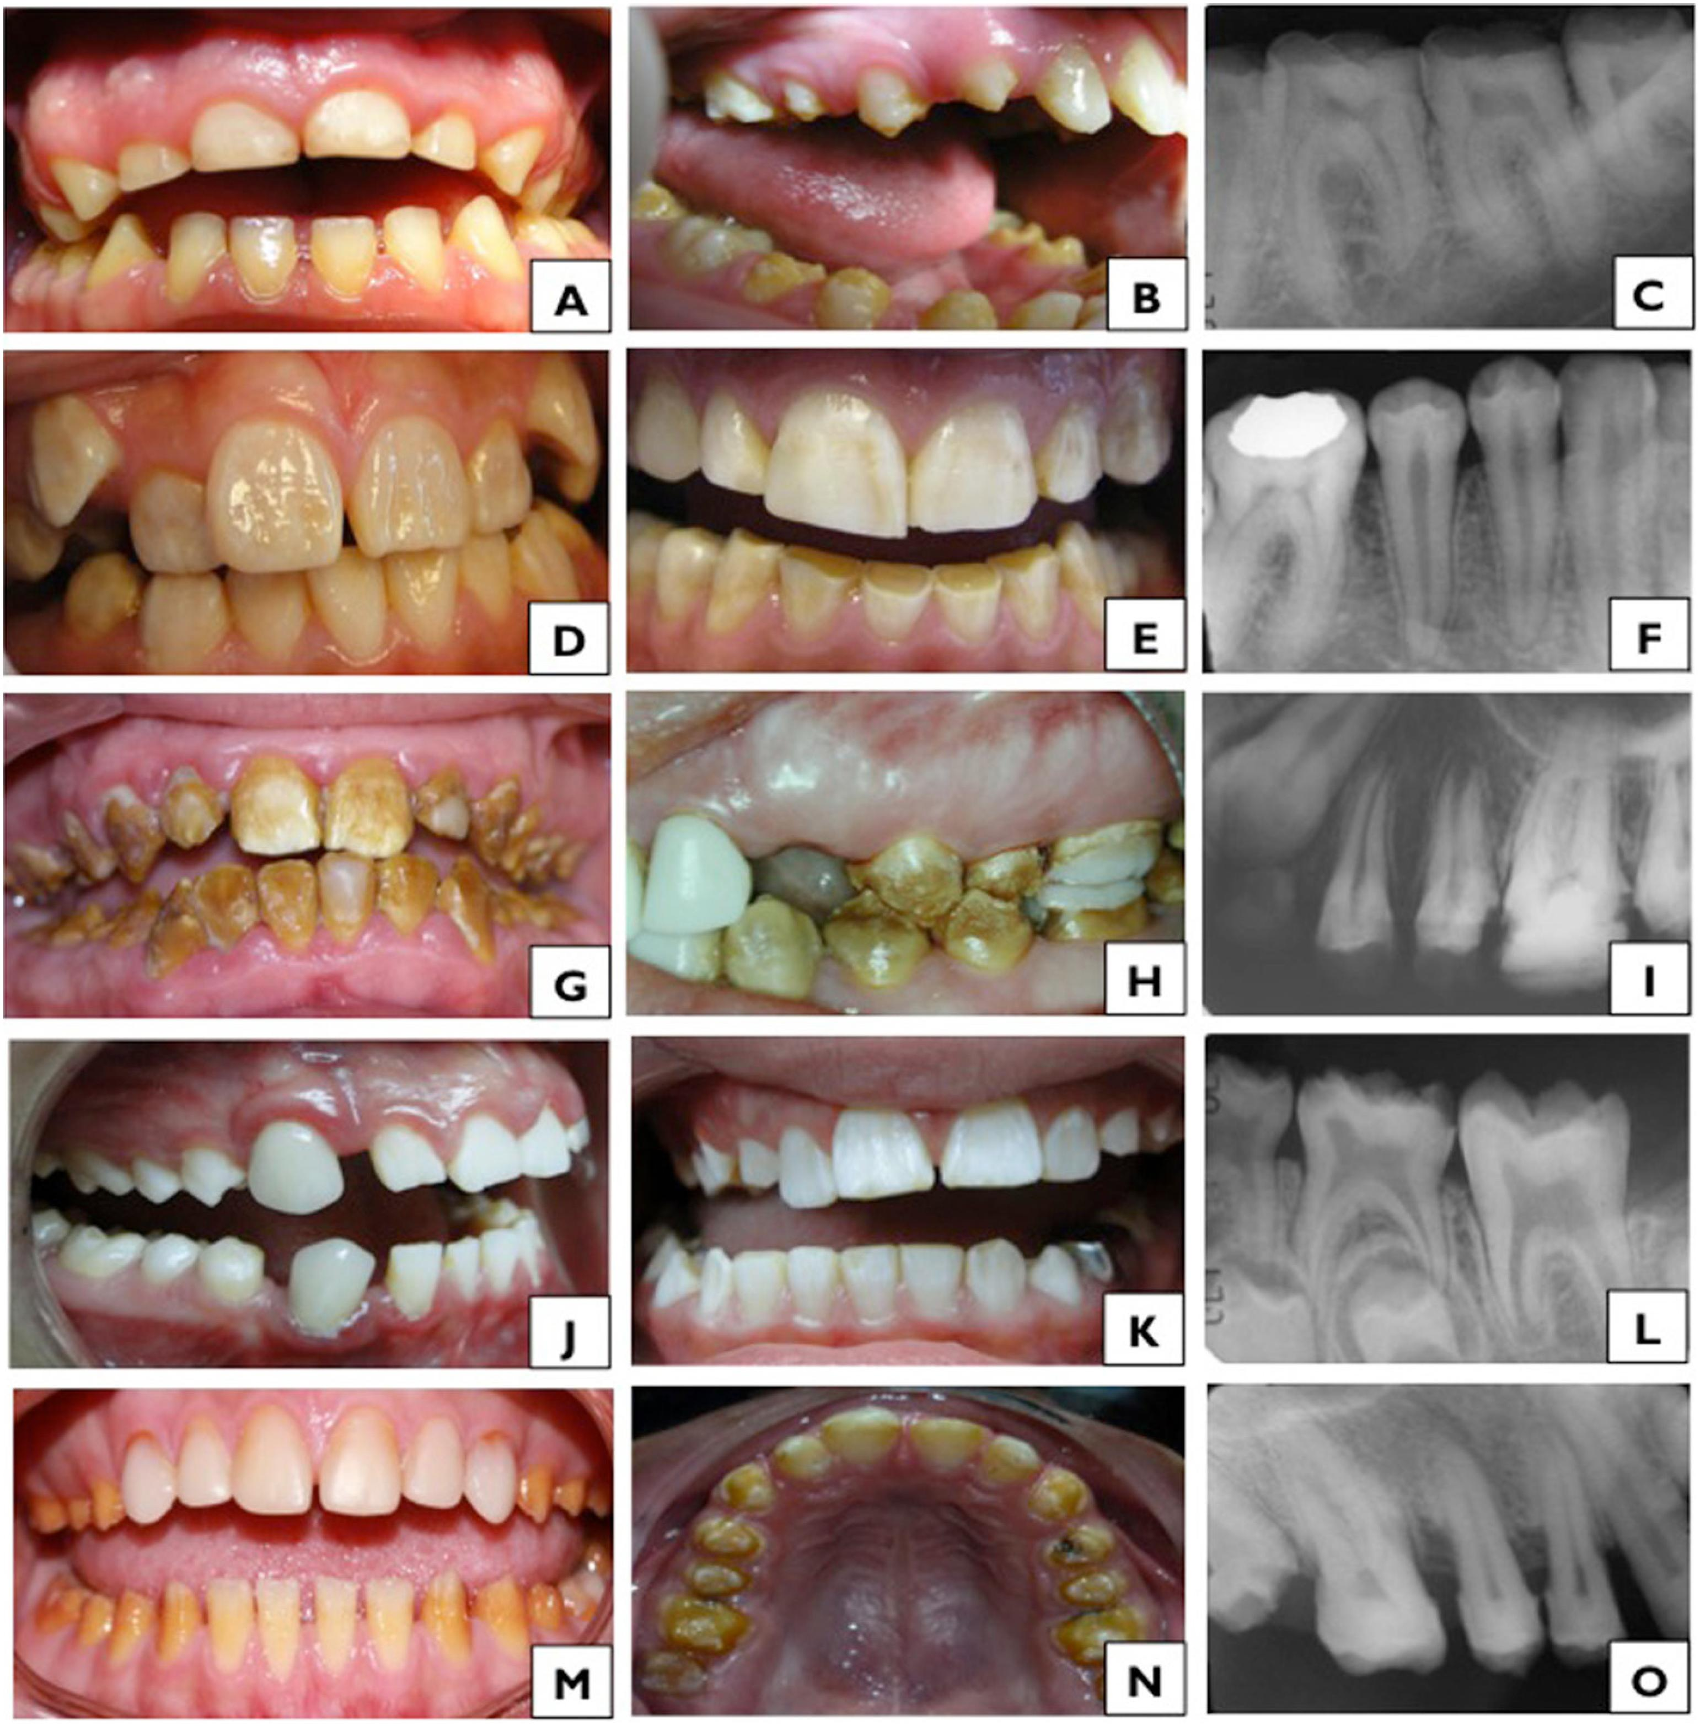

Slide 30
Clinical features

Slide 31
Radiographic features

Slide 32
Diagnosis
cheesy consistency
Loss of enamel cap

Slide 33
treatment

Slide 34
DENTINOGENESIS IMPERFECTA
Is a hereditary developmental disturbance of the dentin in the absence of any systemic disorder.
Associated with mutation of the DSPP (dentin sialophosphoprotein) gene.

Slide 35
Classification:
Witkop’s
Dentinogenesis imperfecta
Hereditary opalescent teeth
Brandywine isolate
Shield’s
DI I
DI II
DI III

Slide 37
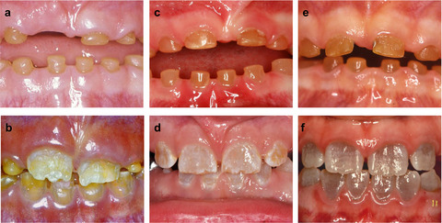

Slide 38
Clinical features:
Autosomal dominant
All teeth; both dentitions are affected
Blue- brown discoloration, enamel frequently separates easily from the underlying defective dentin
Accelerated attrition, bulbous crowns
Progressive, sensorineural, high frequency hearing loss.

Slide 39
Radiographic features
Bulbous crowns, cervical constriction, thin roots, early obliteration of root canals & pulp chambers.
Sometimes normal-sized pulps or pulpal enlargement (shell teeth)

Slide 40
treatment
Overlay dentures placed on teeth covered with fluoride releasing GIC
Implants ; full dentures

Slide 41
Dentin dysplasia
This has no correlation with systemic disease / dentinogenesis imperfecta
Types:
I – radicular dentin dysplasia; rootless teeth
II – coronal dentin dysplasia

Slide 42
Clinical features
Type I
Loss of organization of the root dentin leads to a shortened root length
Autosomal dominant; 1:1,00,000
Enamel & coronal dentin – normal& well formed
Deficient roots because of loss of radicular dentin
Shortened roots, absence of pulp canal / small crescent shaped pulp chambers
Tooth mobility & premature exfoliation

Slide 43
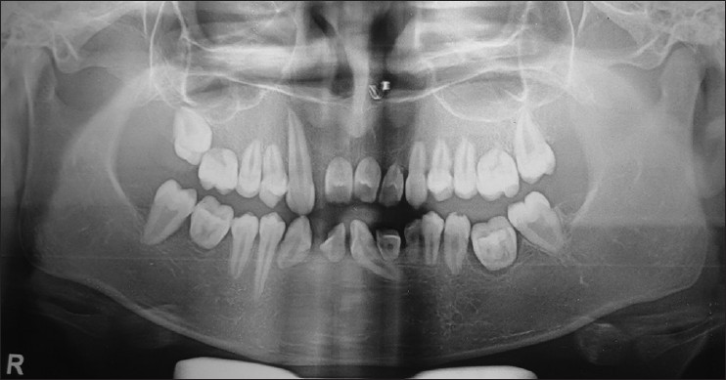

Slide 44
Type II:
Autosomal dominant; root length is normal in both dentition
Blue- amber-brown translucence
Radiographic features:
bulbous crown, cervical constriction, thin roots & early obliterationof the pulp
Thistle tube shaped / flame shaped
Pulp stones

Slide 46
H/P
Whorls of tubular dentin & atypical osteodentin appears as stream flowing around boulders.
Treatment:
RCT

Slide 47
Regional odontodysplasia
Localized, nonhereditary developmental abnormality of teeth with extensive adverse effects on the formation of enamel, dentin & pulp.
Causes: idiopathic; related to various syndromes growth abnormalities, neural disorders & vascular malformations

Slide 48
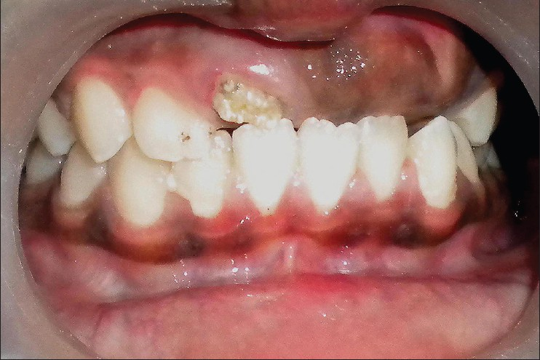
Clinical features:
Portion of the teeth is affected
Both dentitions; females
Maxillary anteriors; left quadrant
Pulpal or periapical patholgy without any gross dental caries
Delayed / incomplete eruption of teeth
Affected teeth – hypoplastic & small, discoloured yellow brown
Several furrows / pits & grooves
Gingiva around the affected teeth appears enlarged

Slide 49
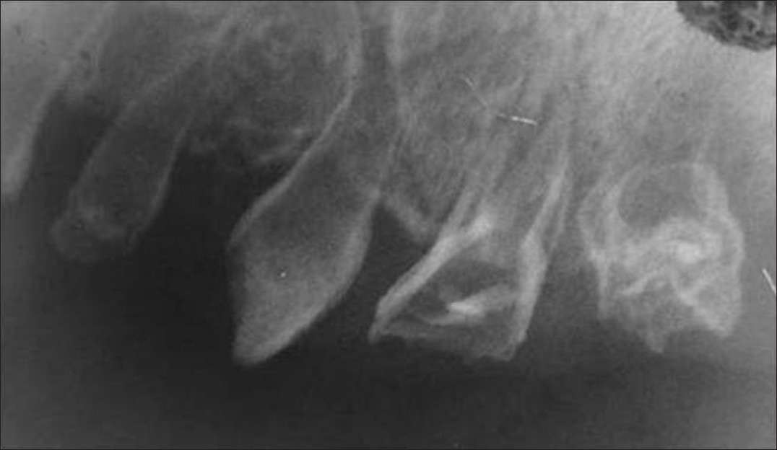
R/F
Ghost like appearace –decreased radiopacity & lack of distinction between the enamel & dentin.
Irregular shape with hypoplastic crowns, large pulp chambers, pulp calcifications, incomplete root formation & wide open apices
Treatment:
RCT, Apexification

