Slide 1
CLASS 2 MALOCCLUSION & MANAGEMENT

Slide 2
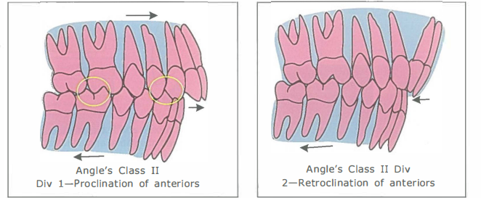
DEFINITION
Class 2 Malocclusion indicates that mandibular arch is in distal relation to maxillary arch.Also called post normal occlusion.
Distobuccal cusp of upper first molar occludes in buccal groove of mandibular first molar .
Division 1 – Proclination of Incisors :Division 2- Retroclination of Incisors
Subdivision – Class 2 molar relation on one side and class 1 relation on other side

Slide 3
CLINICAL FEATURES
EXTRAORAL:
■ Convex profile and leptoproscopic face
■ Decreased nasolabial angle indicating the proclination of the upper central incisors
■ Short hypotonic upper lip fails to have a tight lip seal
■ Incompetent lips
■ Everted lower lips
■ Deep mentolabial sulcus
■ Hyperactive mental is muscle

Slide 5
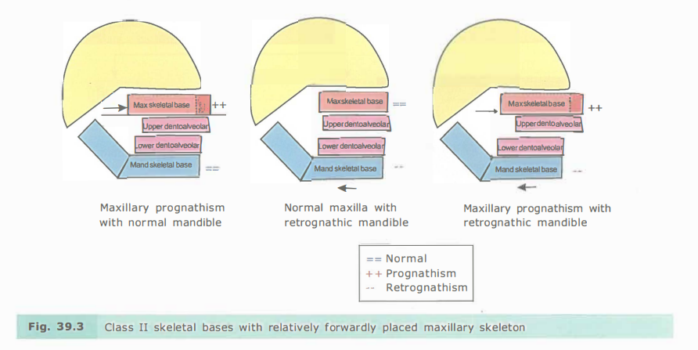
SKELETAL FEATURES:
Mandibular Retrusion
Maxillary Protrusion
Combination type

Slide 6
INTRAORAL:
Class 2 molar and canine relation
Proclination of upper anterior teeth
Anterior deep bite
Lower anterior proclination
Spacing and Crowding
Narrow V shaped palatal arch and Deep palate.

Slide 8
CLASS 2 MOLAR RELATION
It varies from end on molar relation to full fledged class 2 molar relation .
In mild cases upper first molar is a cusp ahead of lower first molar.
In severe class 2 skeletal cases upper first molar is fully ahead of lower first molar.

Slide 9
CANINE RELATION
Class 2 molar relation is associated with class 2 canine relation with excessive overjet caused by spacing and protrusion of maxillary teeth as in skeletal cases .
It is also possible to find class 2 molar relationship associated with class 1 canine relationship and normal overjet caused by crowding or loss of maxillary teeth mesial to first molars.

Slide 10
ANTERIOR TOOTH INCLINATION
DIVISION 1 : Proclination of upper anteriors
DIVISION 2 : Retroclination of upper anteriors.

Slide 11
DEEP OVERBITE & DEEP CURVE OF SPEE
Proclination of Upper anteriors
Absence of centric stops
Lower tooth fails to contact with palatal suface of upper anteriors
Free to erupt leading to an increased anterior overbite and excessive curve of spee

Slide 12
PROCLINATION FO LOWER ANTERIORS
It is a natural compensation that has taken place to reduce the overjet .

Slide 13
LIP TRAP
A characteristic feature of class 2 div 1 is the presence of abnormal muscle activity .
The lower lip cushions the palatal aspect of upper teeth .
This feature typical of a class 2 division 1 is referred to as “Lip Trap”
This lip trap further pushes the upper central incisors more forwards , increases the overjet .
Tongue lowers occupies a lower position failing to counteract the Buccinator activity .
Narrowing of upper arch at the premolar and canine region thereby produces V –Shaped upper arch.
And there will be also Hyperactive mentalis activity.

Slide 14
ETIOLOGY
PRENATAL
NATAL
POSTNATAL FACTORS
PRENATAL FACTORS:
Hereditary Conditions like Pierre Robin syndrome and Mandibulofacial dysostosis in which the maxilla will be normal and mandible will be small.
CONGENITAL FACTORS:
Mainly associated with malformation of 1 st and second brachial arches .

Slide 15
NATAL FACTORS:
Forceps delivery might damages either or both the temporomandibular joints causes internal hemorrhage ,loss of tissue and subsequent damage of TMJ resulting in ankylosis and impaired mandibular growth.
POST NATAL FACTORS:
-Traumatic injuries leading to ankylosis ,infective diseases like rheumatoid arthritis , long term radiation therapy.
-Mesial drift of maxillary molars due to premature loss of deciduous molars ,congenital absence of second primary molars.
- Abnormal functions such as mouth breathing, abnormal swallowing pattern , thumb sucking and tongue thrusting.

Slide 16
TREATMENT OBJECTIVES
Reduction of Overjet and Overbite
Correction of Crowding and Local irregularities.
Correction of unstable molar relationship
Correction of crossbite,Openbite , deep bite if any
Normalizing the musculature

Slide 17
MANAGEMENT
Primary dentition period-No active treatment.
Growth modification
-Maxillary extroral traction
-Functional appliances
Camouflage
-Extractions-Class 2 elastics and differential anchorage
-Non –extraction – Distalization of molars
Surgical Correction

Slide 19
GROWTH MODIFICATION
Growth modification is usually carried out during the mixed dentition or early permanent dentition period prior to thr cessation of active growth.
Prerequsite:
Accurate diagnosis of underlying skeletal discrepancy.
Correction of Maxillary Prognathism:
Head Gear Therapy.
Correction of Mandibular Deficiency:
Active growth period- Myofunctional appliances lik eActivator and Twinblock.
Abnormal muscle activity & constricted maxillary arch – Frankel Regulator
End of prepubertal growth peak period- Fixed functional appliance like Herbst appliance or Jasper jumper , powerscope, Forsus Fatigue appliances.

Slide 20
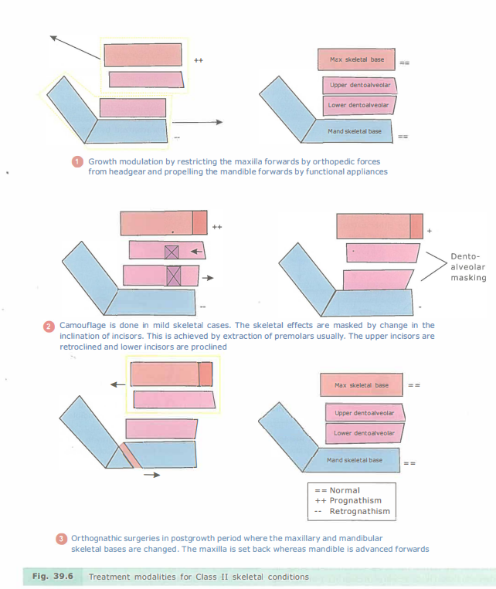

Slide 21
CAMOUFLAGE
It is done in patients where active growth is completed.
Camouflage is the masking of underlying skeletal discrepancy by repositioning the dental structures.
CLASS 2 CASES:
-In class 2 cases with proclined upper tooth and increased overjet, well aligned lower arch first premolars are extracted only in the upper arch –class 2 molar relation is maintained.
-If there problem also in the lower arch , extraction of first premolar is done in both upper and lower arches.
- In minimum anchorage cases second premolar is extracted thus burning the anchorage.

Slide 23
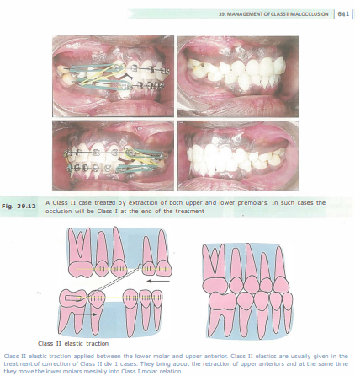
BAKER’S ANCHORAGE
INTERARCH TRACTION:
Class 2 elastics is given from mandibular molar to maxillary canine which gives mesial force to mandibular posterior teeth and distal force to maxillary anterior teeth.
DISADVANTAGE:
Because of the vertical vector of force that accompanies the use of class 2 elastics , occlusal plane rotates upward posteriorly and downward anteriorly.
It is contraindicated in long face patients.

Slide 24
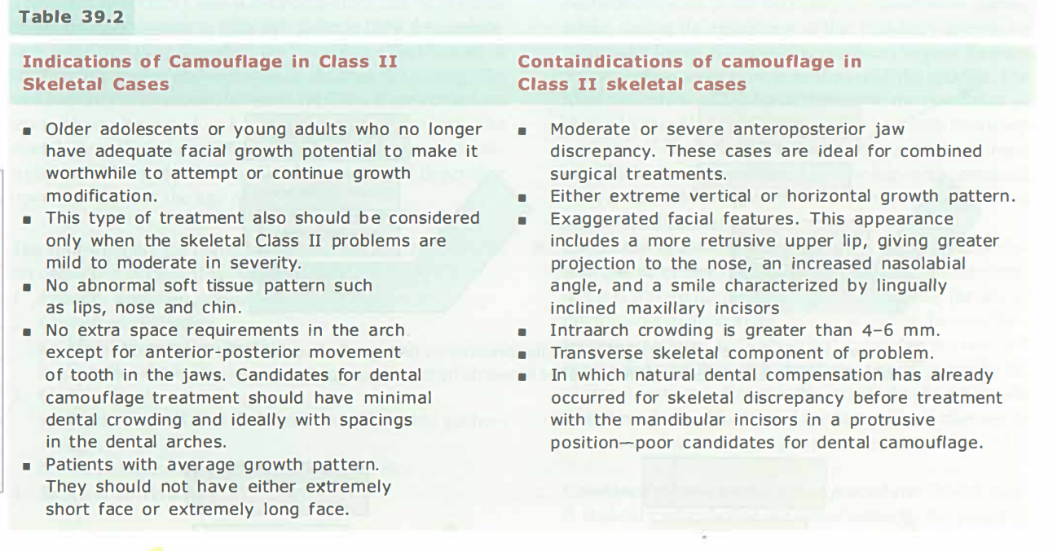

Slide 25
MOLAR DISTALIZATION
Done in mild class 2 cases usually before eruption of second permanent molars and mainly indicated if the class 2 molar relationship develops due to premature loss of deciduous teeth or small primary molars.

Slide 26
SURGICAL CORRECTION
It is mainly done in Severe skeletal discrepancy or extremely severe dentoalveolar problem.
PRESURGICAL DECOMPENSATION:
It is done to decompensate the actual compensation that was present in the dental arch.In this the teeth are moved in the opposite direction .
Categories:
- Maxillary Impaction
- Anterior Maxillary subapical setback
-Mandibular Advancement
- Mandibular total subapical setback
-Mandibular total subapical advancement.

Slide 27
Maxillary Impaction -Total maxillary osteotomy - Posterior or bilateral posterior segmental maxillary Osteotomies. | Vertical maxillary excess
Anterior maxillary subapical setback | Maxillary excess limited to anteroposterior dimension with no associated maxillary vertical or transverse problems.
Mandibular total subapical advancement | Used to advance the mandibular dentoalveolus without changing the profile of the patient.
Mandibular Advancement BSSO Intraoral vertical ramus Osteotomy
Combined Surgical Procedures.

Slide 29
ASSOCIATED PROBLEMS
Deep Bite- Anterior Bite Plane, intrusion of Anteriors or Extrusion of Posteriors.
Crossbite- Maxillary Expansion Appliances / Cross Ealstics
Open Bite- Posterior Bite Planes , Box elastics.

Slide 30
CLASS 2 DIVISION 2 MALOCCLUSION
It is characterized by class 2 molar relation with retroclined upper incisors.
It is a natural dentoalveolar compensation for class 2 skeletal paatern in order to decrease the overjet ,masking the underlying skeletal effect.
TYPE A : Permanent incisors are palatally retroclined without occurrence of crowding.
TYPE B :Maxillary central Incisors are palatally retroclined and laterals are labially tipped
TYPE C: Four maxillary permanent incisors are palatally retroclined with canines labially positioned.

Slide 31
CLINICAL FEATURES
EXTRAORAL FEATURES:
Pleasing straight profile
Decreased LAFH
Anticlockwise rotation of mandible
Increased Nasolabial angle indicating retroclination of incisors
Competent lips in contrast to class 1 malocclusion
Deepened mentolabial sulcus
Everted upper & Lower lips.

Slide 32
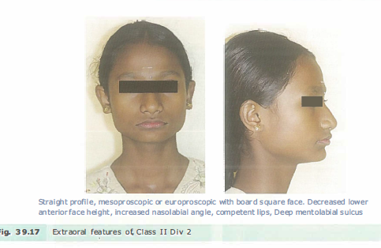

Slide 33
INTRAORAL FEATURES:
Molars are in Distoocclusion
Retroclined Central Incisors
Deep overbite leading to palatal inflammation & stripping of gingiva
Excessive wear of lower teeth
FUNCTIONAL FEATURES:
Backward path of closure
Presence of abnormal muscle activity.

Slide 34
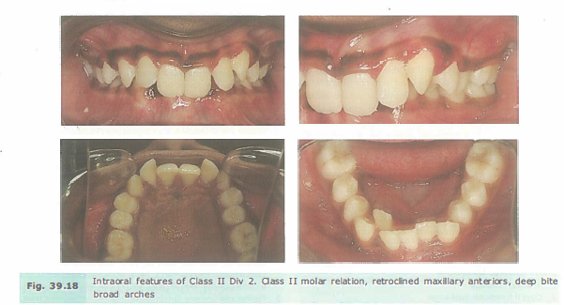

Slide 35
TREATMENT OBJECTIVES
Relieving of gingival trauma by correcting existing deep bite
Correction of buccal segment relationship
Reif of crowding and local irregularities.
Deep overbite is reduced by
Reduction in Incisal overbite
Alteration in incisor inclination.

Slide 36
RETENTION
Overcorrection of occlusal relationships to prevent relapse.

