Slide 1
Grid

Slide 3
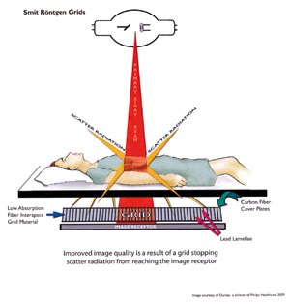

Slide 4
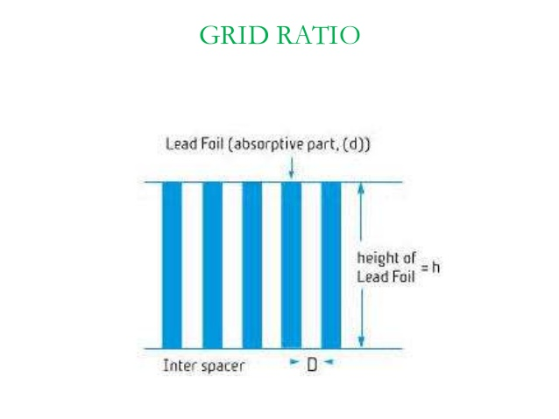

Slide 5
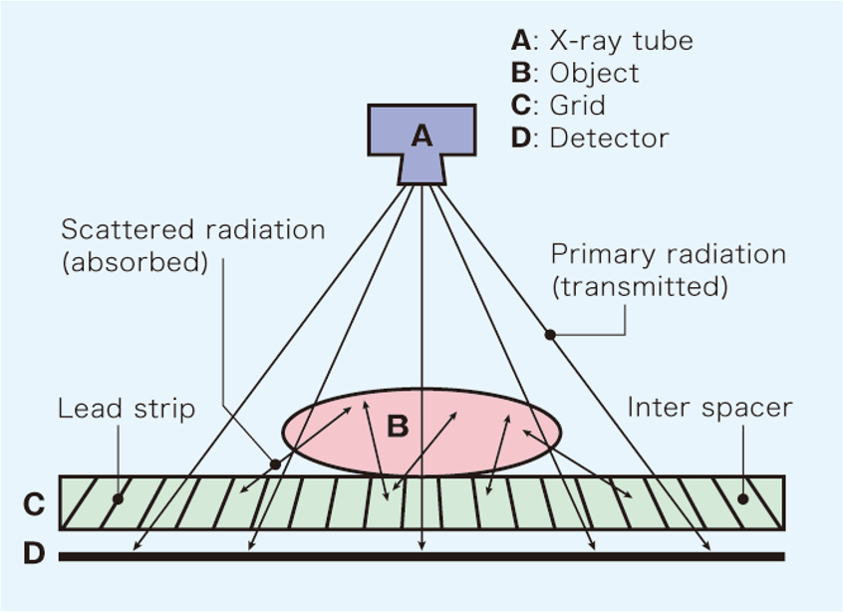

Slide 6
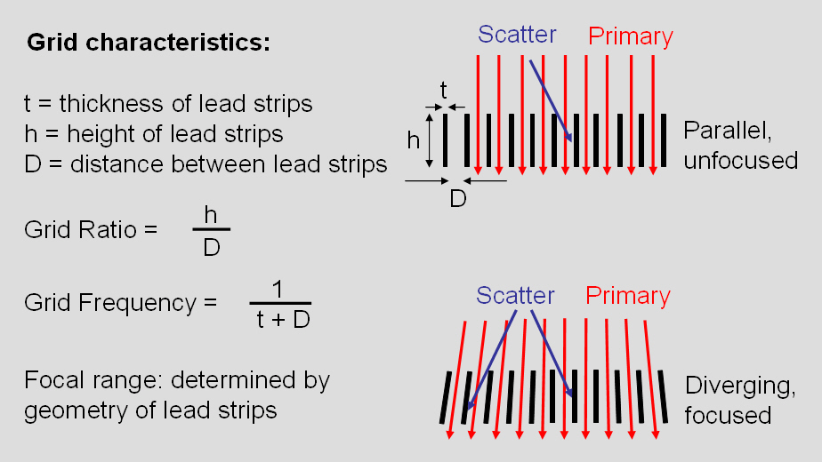

Slide 7
Types of Grid
Parallel
Crossed
Focused
Moving Grid (Potter – Bucky)

Slide 8
Parallel
lead strips are parallel to each other, in their longitudinal axis
Easy to design
Disadv – grid cut off --- attenuation of primary radiation is greater at the edges & it can be partial or complete cut off

Slide 9
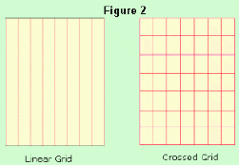
Crossed
Lead strips that are parallel to both the long axis and short axis of the grid.

Slide 10
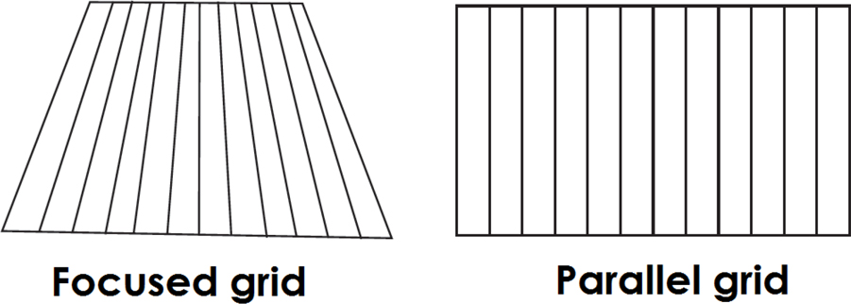
Focused
Mainly to reduce grid cut off

Slide 11
Moving Grid / Potter -Bucky

