Slide 1
X-RAY MACHINES

Slide 2
introduction
history of x-ray machine
need for x-ray machine
parts of x-ray machine
introduction
history of x-ray machine
need for x-ray machine
parts of x-ray machine
introduction
history of x-ray machine
need for x-ray machine
parts of x-ray machine
CONTENTS
Introduction
History of x-ray machine
Need for x-ray machine
Parts of x-ray machine
Electric circuit
Hand held x-ray machines

Slide 3
INTRODUCTION
When fast-moving electrons slam into a metal object, x rays are produced. The kinetic energy of the electron is transformed into electromagnetic energy.
The function of the x-ray machine is to provide a sufficient intensity of electron flow in a controlled manner to produce an x-ray beam of desired quantity and quality.

Slide 4
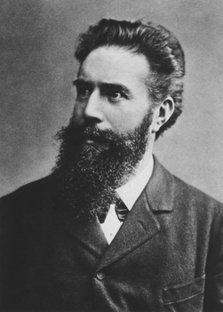
HISTORY
Discovered and named by
Dr. W. C. Röentgen at
University of Würzburg, 1895
Awarded first Nobel prize for physics, 1901

Slide 5
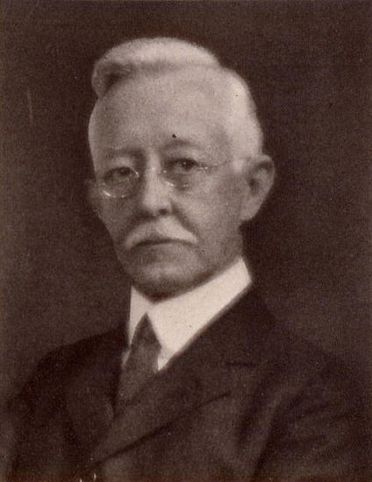
FATHER OF DENTAL
RADIOLOGY
FIRST DENTAL XRAY
FLIM HOLDER
PARRELLELING TECHNIQUE
ROOT CANAL THERAPHY
x
EDMUND KELLS 1856-1928

Slide 6
FUNCTIONS
Diagnostic X-Ray machines
Function at maximum voltages ranging from 40 to 150 kvp and at tube currents from 25 to 120 mA
Therapeutic X-rays
usually operated at higher or lower voltages & tube current not exceeding 20 mA
Stewart c bushong 3rd edition

Slide 7
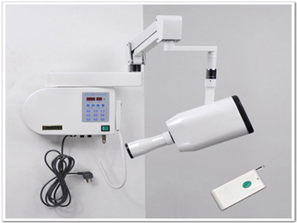
PARTS OF X-RAY MACHINE
THREE PRINCIPAL PARTS
The x-ray tube,
High-voltage section generator,
The control console.
Stewart c bushong 3rd edition

Slide 8
MAIN COMPONENTS OF THE TUBE HEAD
GLASS X-RAY TUBE
STEP UP TRANSFORMER
STEP DOWN TRANSFORMER
SURROUNDING LEAD SHIELD
INSULATING OIL
ALUMINIUM FILTERATION
COLLIMATER
BEAM INDICATER DEVICE (BID)

Slide 9
EXTENSION ARM
The wall-mounted extension arm suspends the x-ray tubehead and houses the electrical wires that extend from the control panel to the tubehead.
TUBE HEAD SEAL or the aluminum or leaded-glass covering of the tubehead that permits the exit of x-rays from the tubehead; it seals the oil in the tube-head and acts as a filter to the x-ray beam

Slide 10
TUBEHEAD
The x-ray tubehead is a tightly sealed, heavy metal housing that contains the x-ray tube that produces dental x-rays.
METAL HOUSING or the metal body of the tubehead that surrounds the x-ray tube and transformers and is filled with oil; it protects the x-ray tube and grounds the high-voltage components. INSULATING OIL or the oil that surrounds the x-ray tube and transformers inside the tubehead; it prevents overheating by absorbing the heat created by the production of x-rays.

Slide 11
OIL IN THE X-RAY TUBEHEAD
Insulates the electrical components
Cools the anode
Filters the x-ray beam
Step-up
Trans
oil
Step-down
Trans

Slide 12
X-RAY TUBE or the heart of the x-ray generating system
TRANSFORMER, or a device that alters the voltage of incoming electricity,
ALUMINUM DISKS or sheets of 0.5-mm thick aluminium placed in the path of the x-ray beam; they filter out the non-penetrating, longer wavelength x-rays Aluminum filtration
LEAD COLLIMATOR or a lead plate with a central hole that fits directly over the opening of the metal housing where the x-rays exit; it restricts the size of the x-ray beam
POSITION-INDICATING DEVICE (PID) or open-ended, lead-lined cylinder that extends from the opening of the metal housing of the tubehead; it aims and shapes the x-ray beam The PID is sometimes referred to as the cone.

Slide 13
FILTRATION
x-rays have low penetrating long wave length photons
Filtration remove this low penetrating photons
Greater the % short wave
TYPES OF FILTRATION
Inherent filtration
Added filtration
Total filtration
Dental radiography 2nd edition haring

Slide 14
COLLIMATION
Used restrict the size and shape of x-ray beam and to reduce
patient exposure
It may rectangular ,round
Rectangular restricts slightly larger than 2 intra oral x-rays
Circular collimater provides cone shaped beam 2.75 d.m
POSITION INDICATING DEVICE
Used to direct th e x-ray machines
Basic types
Conical
Rectangle
Round
Both rectangular & round are available in sort & long
Dental radiography 2nd edition haring

Slide 15
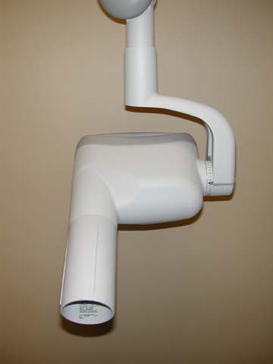
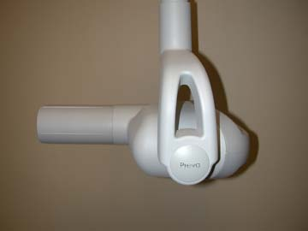
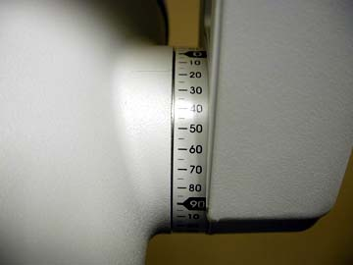
X-ray Tubehead
PID, BID
(cone)
PID = position indicating device
BID = beam indicating device
degrees

Slide 16
X-ray Tube
3
4
1
6
5
2
7
8
9
Cathode (1, 2)
Anode (3,4)
1 = filament 6 = vacuum
2 = focusing cup 7 = leaded glass
3 = target 8 = x-rays
4 = copper sleeve 9 = beryllium window
5 = electron flow

Slide 17
X-RAY TUBE
contained in a protective housing and therefore is inaccessible.
Two primary parts:
the cathode
the anode..
Any tube that has two electrodes is called a DIODE.
POWER
X-RAY TUBE
A.FILTER
A.CYLINDER
COLLIMATER
OIL
Yoke

Slide 18
LEADED-GLASS HOUSING
The leaded-glass housing is a leaded-glass vacuum that
prevents x-rays from escaping in all directions.
One central area of the leaded-glass tube has a "window”- that
permits the x-ray beam to exit the tube and directs the x-ray
beam toward the aluminum disks, lead collimator, and BID.

Slide 19
ANODE
The anode, or positive electrode, consists of a wafer-thin tungsten
plate embedded in a solid copper rod.
The purpose of anode is to convert electrons into x-ray
photons. The anode includes the following:
A TUNGSTEN TARGET, or plate of tungsten, which serves as a
focal spot and converts bombarding electrons into x-ray photons.
The copper stem, which functions to dissipate the heat away from
the tungsten target.

Slide 20
The Stationary Anode
Stationary anodes are used in dental x-ray and some portable x-ray machine where high tube current and power are not required.
side view
front view
Tungsten Target
Dental x-ray machines have stationary anode
Tungsten Target
Copper stem

Slide 21
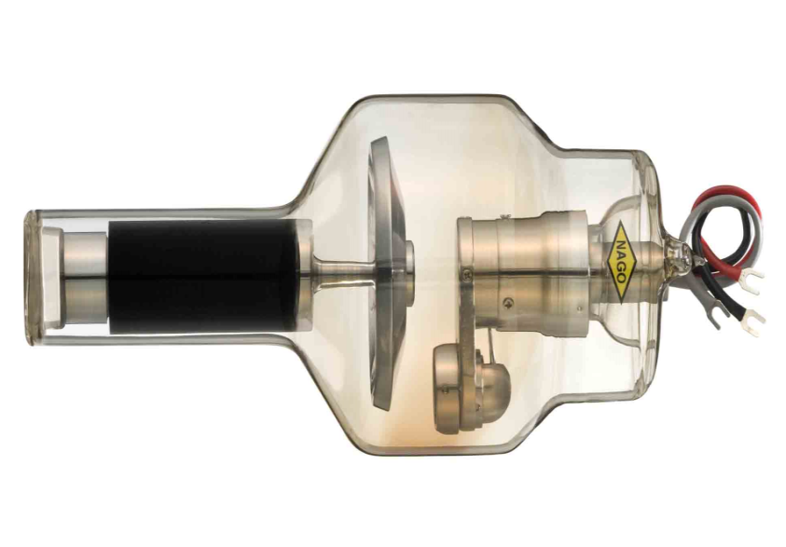
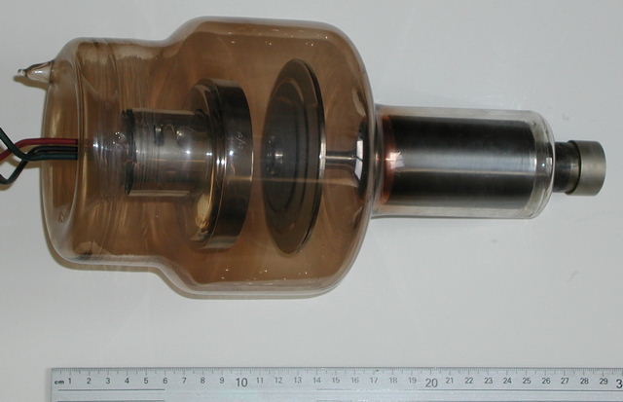
THE ROTATING ANODE
The rotating anode allows the electron beam to interact with a much larger target area.
The heat is not confined to a small area.
Its driven by electromagnetic motor
TWO MAJOR PARTS
STATOR
ROTOR

Slide 22
CATHODE
The cathode, or negative electrode, consists of a tungsten wire filament in a cup-shaped holder made of molybdenum.
The purpose of the cathode is to supply the electrons 'necessary to generate x-rays. In the x-ray tube, the electrons produced in the negative cathode are accelerated toward the positive anode
THE CATHODE INCLUDES THE FOLLOWING:
The TUNGSTEN FILAMENT, or coiled wire made of tungsten, which produces electrons when heated.
The MOLYBDENUM CUP, which focuses the electrons into a narrow beam and directs the beam across the tube toward the tungsten target of the anode

Slide 23
Cathode
Side, crosscut view
Front view
Filament
(tungsten)
Focusing
cup

Slide 24
TUNGSTEN
(FILAMENT AND TARGET)
High atomic number (target)
Transfers heat readily (target)
High melting point (target, filament)
Can be drawn into fine wire (filament)

Slide 25
THE FILAMENTS
Most tube have two filaments which provide a choice of quick exposures or high resolution.
The filaments are made of thoriated tungsten.

Slide 26
THE FILAMENTS
Tungsten is used in x-ray tube because of it’s high melting point of 3410°C.
X-rays are produced by thermionic emission when a 4 A or higher current is applied.

Slide 27
FOCUSING CUP
The focusing cup has a negative charge so that it can condense the electron beam to a small area of the anode.

Slide 28
Filament Current
When the x-ray machine is turned on, a low current flows through the the filament to warm it and prepare it for the big thermal jolt necessary for x-ray production.
X-ray tube current is adjusted by the filament current
SPACE CHARGE
When emitted by the filament, the electrons form a cloud near the filament momentarily before being accelerated to the anode. This is called a space charge.

Slide 29
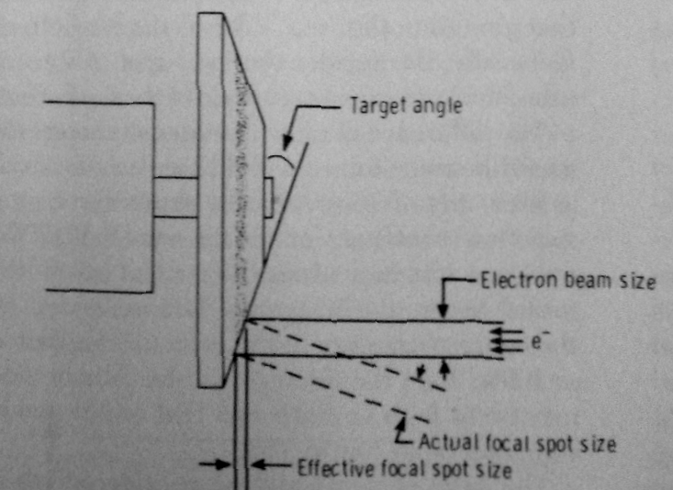
LINE-FOCUS PRINCIPLE
The focal spot is the area of the anode from which the x-rays are emitted.
smaller focal spot with greater resolution image
the effective focal spot size is the area projected on patient or flim
The angling of the target is know as the line focus principle.
lower target angle smaller effective focal spot

Slide 30
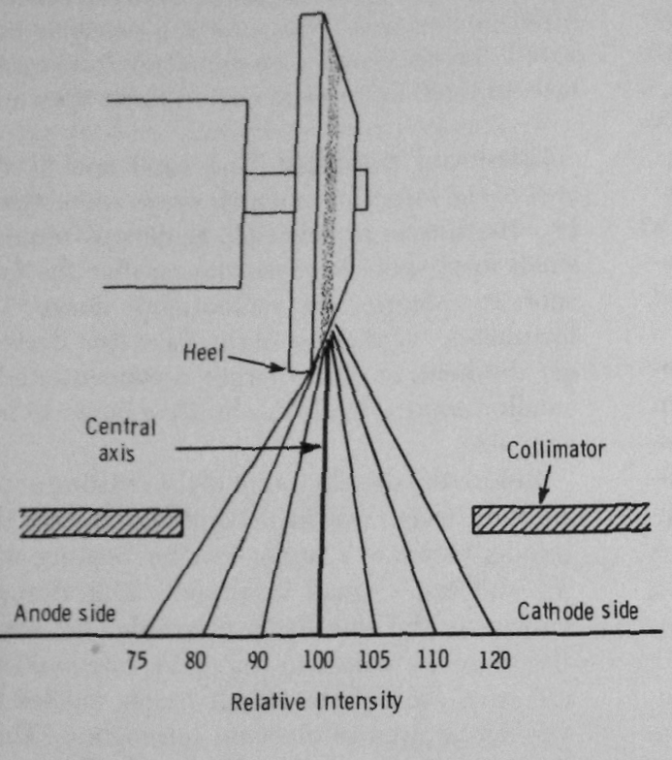
HEEL EFFECT
The radiation intensity in cathode side is higher than the
anode side
Increased absortion the
intensity of x-ray penetrate
heel of the target is Lower
than that of those that
penetrate the toe this is heel
effect.

Slide 31
CONTROL PANEL
The control panel of the dental x-ray machine contains an on-off switch and an indicator light, an exposure button and indicator light, and control devices (time, kilovoltage, and milliamperage selectors) to regulate the x-ray beam.
The control panel is plugged into an electrical outlet and appears as a panel or cabinet mounted on the wall outside the dental operatory

Slide 32
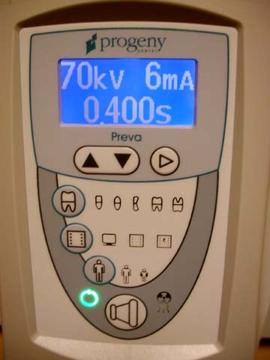
CONTROL PANEL COMPONENTS
Timer (all machines)
mA control (some machines)
kVp control (some machines)
Autotransformer(some machines)
Exposure switch (all machines)
Either on, or connected to, the
control panel
kVp
mA
(10-15)
Selects kVp, ma, or exp. time
exposure time
Adjusts kVp, ma, or exp. time up or down

Slide 33
Exposure Switch
Allows current to flow through low-voltage circuit then through high-voltage circuit
Light on control panel and audible signal indicate exposure
You cannot overexpose by holding
the exposure switch down too long!

Slide 34
High Voltage Circuit
Exp.
Switch
kVp/Auto
Step-up
65-90 volts
110 volts
65,000 to 90,000 volts

Slide 35
LINE COMPENSATION
A line compensator incorperates ameter to measures the
voltage provided to the x-ray unit & a switch to adjust that
voltage to precisely 220 v
The switsh is usually multistation and wired to the auto transformers

Slide 36
AUTO TRANSFORMERS
Power supplied to the x-ray machines is first shunted to special
transformers called auto transformers.
Auto transformers designed to supply voltage of varying magnitude
To the several different circuits of the x-ray machines.
Operates as a induction device

Slide 37
KVP ADJUSTMENT
Have labeled major KVP & minor KVP & by selecting a combination of
these controls are technologist can produce freeway to the required KVP
Selection of appropriate KVPs can be made by an as if the case on much
new euipment Can be actuated
KVP meter is placed across out put terminals of the auto transformers&
therefore reads the voltage & kilo voltage

Slide 38
mA CONTROL
The x-ray tube current no electrons crossing cathode to the
anode is measured In mili amperes
Filament current increases hotter more electrons relesed by
thermionic emmision.
Filament is a step down transfansformer Filaments normally
operates at current between 4 & 6 A
X-ray tube current controlled through separate circuit called
filament circuit

Slide 39
A circuit, is a path of electrical current. Two electrical circuits are used in the production of x-rays: a low-voltage or filament circuit and a high-voltage circuit.
The filament circuit uses 3 to 5 volts, regulates the flow of electrical current to the filament of the x-ray tube, and is controlled by the milliampere settings.
The high-voltage circuit uses 65,000 to 100,000 volts provides the high voltage required to accelerate elec­trons and to generate x-rays in the x-ray tube, and is controlled by the kilovoltage settings.

Slide 40
Thermionic Emission
Release of electrons from hot filament when current flows after depressing exposure switch
x-section
of
filament
hot
filament
electrons
The hotter the filament gets (increased current), the greater the number of electrons produced.

Slide 41
Amperage is the measurement of the number of electrons moving through a conductor. Current is measured in amperes or milliamperes (mA).
Voltage is the measurement of electrical force that causes electrons to move from a negative pole to a positive one. Voltage is measured in volts or kilovolts (kV).
In the production of x-rays, both the amperage and voltage can be adjusted. In the x-ray tube, the amperage, or number of electrons passing through the cathode filament, can be increased or decreased by the milliamperage (mA) adjustment on the control panel of the x-ray machine

Slide 42
EXPOSURE TIMERS
For any given radiographic examination the number of x rays reaching the film is directly related to the x-ray tube current and the time that the tube is energized. X-ray operating consoles provide a wide selection of beam-on times and, when used in conjunction with the appropriate mA station, an even wider selection of mAs values is possible.
Mechanical timers.
Synchronous timers.
Electronic time
mAs timers.rs.
Phototimers.

Slide 43
CHECKING TIMERS
Inaccurate or malfunctioning timers results of poor radio graph, unnecessary
patint exposure ,and retakes
Half rectification produce 60 pulses
Full wave rectification produces 120 pulses
Spinning top plate used measuure the pulses/min

Slide 44
HIGH VOLTAGE SECTION
The high voltage section of an x-ray machine is responsible
converting low supply voltage into kilovoltage in proper form.
CONTAIN THREE PARTS
High voltage step up transformer
Filament transformer
rectifier

Slide 45
HIGH VOLTAGE TRANSFORMER
Secondary volt is greater than the primary volt
No of sec.winding more than the pri.winding
Turn ratio
amplitude

Slide 46
VOLTAGE RECTIFICATION
Rectication is a process of converting alternating voltage into
direct volt
Diode:
rectification is accomplised with devices called diodes
x-ray tube like rectifiers
unspecified rectification :
This voltage waveform appears exactly as the voltage
wave form supplied to the primary coil of the high voltage
Transformers except for its amplitude

Slide 47
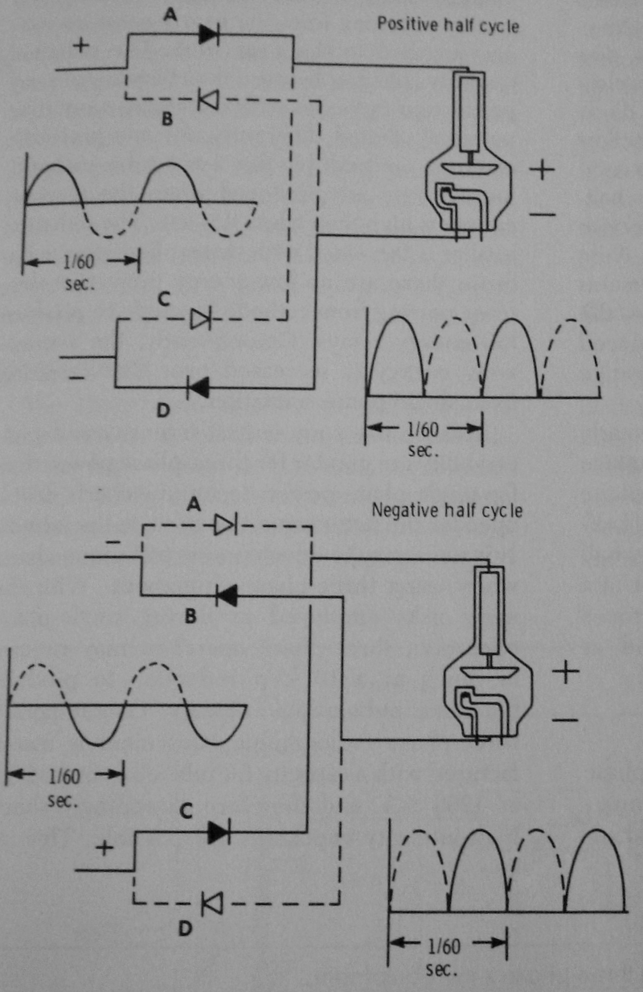
Half wave rectification
Inverse square voltage is removed by rectification
This represent the condition in which is ntot allowed to swing negative of its cycle
Full wave rectification

Slide 48
CAUSES OF X-RAY FAILURES
Surface irregularity & pitting ,over heated anode
Maintaining the anode elevated time
Bearing damage of the rotor
High heating of filament by high-mA

Slide 49
POWER SUPPLY
A brief review of some aspects of an electric circuit maybe useful in understanding the power supply in an xray machine.
An electric current is the movement of electrons in a conductor, for example, a wire. The rate of the current flow-the number of electrons moving past a point in a second-is measured in amperes
It depends on two factors: the pressure, or voltage, of the current, measured in volts , and the resistance of the
conductor to the flow of electricity, measured in ohms.
Ohm's law relates these units:
v == I x R
where is the electric potential in volts,l is the current
flow in amperes, and R is the resistance of the conductor
in ohms.

Slide 50
The secondary voltage regulated by the kilovolts peak (kVp) select or dial .The kVp dial selects a voltage from different levels on the autotransformer and applies it across the primary winding of the high-voltage transformer
. The kVp dial therefore controls the voltage between the anode and cathode of the x-ray tube When the electrons strike the focal spot of the target, some of their energy converts to x-ray photons
At these times the electrons stay in the vicinity of the filament and do not flow across the This type of power supply circuitry, in which the alternating high voltage is applied directly across the x-ray tube, limits x-ray production to half the AC cycle and is called self-rectified or half-wave rectified
These photons are produced as the voltage across the x-ray tube rises from zero to its peak and then decreases back again to zero during the voltage cycle in the half-wave rectified machine gap between the two elements of the tube. This half of the cycle is called inverse voltage or reverse bias

Slide 51
FUNCTIONS OF THE POWER SUPPLY
The primary functions of the power supply of an
x-ray machine are to
(1) provide a low-voltage current
to heat the x-ray tube filament by use of a step-down
transformer and
(2) generate a high potential difference
between the anode and cathode by use of a high voltage
transformer.
These transformers and the x-ray
tube lie within an electrically grounded metal housing
called the head of the x-ray machine. An electrical insulating
material, usually oil, surrounds the transformers

Slide 52
TUBE RATING AND DUTY CYCLE
Each x-ray machine comes with tube rating specifications that describe the maximal exposure time the tube can be energized without risk of damage to the target rom overheating.
These specifications describe in graph form the maximal safe intervals(seconds) that the tube can be used for a range of voltages (kVp) and filament current (mA) values.
These tube ratings generally do not impose any restrictions on tube use for daily intraoral radiography. If a dental x-ray unit is tobe used for extra oral exposures,.

Slide 53
Duty cycle relates to the frequency with which successive exposures can be made. The heat build up at the a node is measured in heat units defined by the following
Equation: heat units (HU) =kVp x mA x seconds. The heat storage capacity for anodes of dental diagnostic tubes is approximately 20kHU. Because of heat generated at the anode, the interval between successive exposures must be long enough for its dissipation.
This characteristic is a function of the size of the anode and the method used to cool it. The cooling characteristics of anodes are described by the maximal number of heat units it can store without damage and the heat dissipation rate, which can be determined from the cooling curves provided by the manufacturer of each tube,

Slide 54
Tube Current
The filament step-down transformer reduces the voltage of the incoming alternating current(AC) to about 10 volts .
Its operation is regulated by the filament current control (mA switch) ,which adjusts the resistance and thus the current flow through the low-voltage circuit, including the filament.
This in turn regulates the temperature of the filament and thus the number of electrons emitted.
The tube current is the flow of electrons through the tube, that is, from the filament to the anode and then back to the filament through the wiring of the power supply.
The mA setting on the filament current control refers to the tube current, which is measured by the ammeter

Slide 55
timer
filter
PID
110
220
barrier
oil
filament
collimator
exposure
button
Control panel
Tubehead

Slide 56
X-RAY GENERATING APPARATUS
To understand how the x-ray tube functions and how x-rays are produced, the dental radiographer must un­derstand electricity and electric currents, electrical cir­cuits, and transformers.

Slide 57
ELECTRICITY
Electricity is the energy that is used to make x-rays. Electrical energy consists of a flow of electrons through a conductor; this flow is known as the electric current.
The electrical current is termed direct current (DC) when the electrons flow in one direction through the conductor/ The term alternating current (AC) de­scribes a current in which the electrons flow in two opposite directions
Rectification is the conversion of alternating current to direct current; the dental x-ray tube acts as a self-rectifier in that it changes AC into DC while producing x-rays.
Generators on older machines produced an x-ray beam with a wave­like pattern,
whereas newer constant potential x-ray machines produce a homogenous beam of consistent wavelengths during radiation exposure.
Constant potential machines also reduce patient exposure to radiation by 20%, an important consideration for patient protection

Slide 58
TRANSFORMERS
A transformer is a device that is used to either increase or decrease the voltage in an electrical circuit Transformers alter the voltage of the in­coming electrical current and then route the electrical energy to the x-ray tube\/In the production of dental x-rays, three transformer; are used to adjust the elec­trical circuits: the step-down transformer, the step-up transformer, and the autotransformer.

Slide 59
A step-up transformer is used to increase the voltage from the incoming 110 or 220 line voltage to the 65,000 to 100,000 volts required.
A step-up transformer has more wire coils in the secondary coil than in the primary coil An auto-transformer serves as a voltage compensator that cor­rects for minor fluctuations in the current

Slide 60
Step-Up (High-voltage) Transformer
Primary
65-90 volts
current flow
current flow
Secondary
65,000 to 90,000 volts
(65 kVp to 90 kVp)

Slide 61
A step-down transformer is used to decrease the voltage from the incoming 110 or 220 line voltage to the 3 to 5 volts required.
A step-down transformer has more wire coils in the primary coil than in the secondary coil The coil that receives the alternating electrical current is the primary or input coil; the secondary coil is the output coil.
The electrical current that energizes the primary coil 'induces a current in the secondary coil.
The high-voltage circuit requires 65,000 to 100,000 volts and uses both a step-up transformer and an auto-transformer.

Slide 62
Step-Down Transformer
Primary
80-100
volts
current flow
8-10 volts
current flow
Secondary

Slide 63
NEW ADVANCEMENT IN DENTAL XRAYS
Portable x-ray machine
Hand held x-ray machines

Slide 64
INTRA ORAL X-RAY MACHINES
Performance
Allan
60 kV 10 mA
Med ford
60 KV 10 mA
VILLA
70 kV 7mA
GOMAX
60 kV 7mA
Rs. 28,000
Confident
60 kV 7 mA
60,000
Siemens
60 kv 10 mA
RS 1,20,000
Poor
Moderate
well

Slide 65
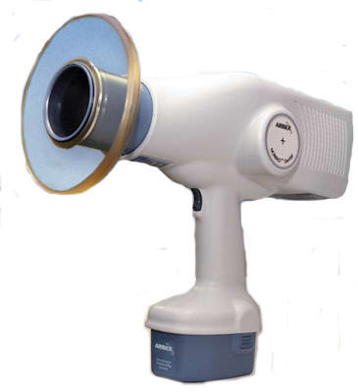
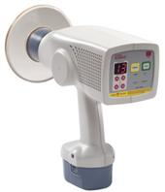
HAND HELD X-RAY MACHINES

Slide 67
REFERENCES
ESSENTIALS OF DENTAL RADIOLOGY 3RD EDITION - ERIC WHITE
PRINCIPLES OF DENTAL IMAGING 2ND EDITION – LANGALIUS
ORAL RADIOLOGY 6TH EDITION - WHITE & PHARAOH
RADIOLOGIC SCIENCE & TECHNOLOGY 3RD EDITION- STEWART BUSHING
DENTAL RADIOLOGY 3RD EDTION- HARING

Slide 68
THANK YOU

