Slide 1
Intraoral periapical radiolucencies

Slide 2
INTRODUCTION
Intraoral radiographs play an integral role in assesment of periapical and periodontal disease. Periapical views show all of a tooth surface and the surrounding bone are very useful.

Slide 3
CLASSIFICATION
Periapical radiolucency
True radiolucencies
False or anatomic radiolucencies

Slide 4
TRUE PERIAPICAL RADIOLUCENCY
Sequelea from pulpitis
periapical abscess
Periapical granuloma
Radicular cyst
Osteomyelitis
Periapical scar
Surgical defect
Residual cyst
Periodontal disease
Chronic periodontitis
Aggressive periodontitis
Periodontal abscess
Lateral periodontal cyst
Fibroosseous lesion
Periapical cementosseous dysplasia
Malignant tumours
Squamous cell carcinoma
Metastatic tumour
Leukemia
Histocytosis x

Slide 5
FALSE RADIOLUCENCIES
Maxillary sinus
Incisive foramen and canal
Greater palatine foramen
Mental foramen
Submandibular fossa
Mandibular canal
Nasolacrimal canal
Marrow spaces of the jaws.

Slide 6
FALSE OR ANATOMIC PERIAPICAL RADIOLUCENCIES

Slide 7
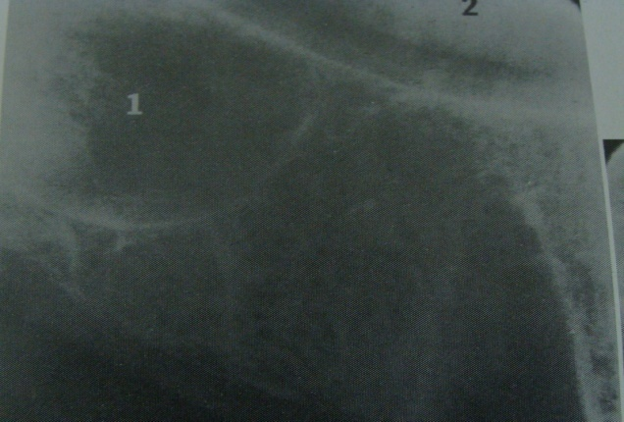
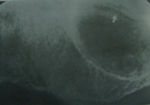
MAXILLARY SINUS
On each side – radiolucency with thin sharp radiopaque border
Bilaterally – molar and premolar
Angle of exposure – nasal fossa overlaps
Nutrient canal – seen in sinus wall helps to differentiate cyst and other pathosis

Slide 8
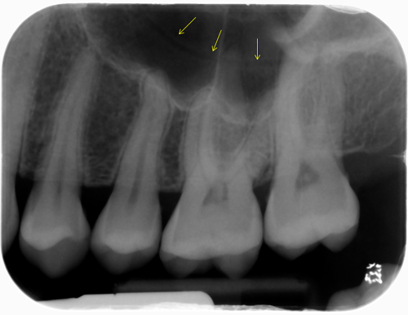

Slide 9
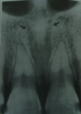
NASAL CAVITY
Inferior aspect of nasal cavities is seen on periapical radiographs
Appears as a twin radiolucencies separated by septa
Some times is projected above the incisors and canine

Slide 10
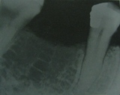
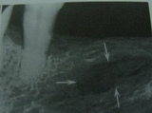
MARROW SPACES
Present between the trabaculea of the bone appears as radiolucent
In some person the trabaculea spaces above and below the root are large
Combined appearance – cyst, traumatic bone spaces or other pathosis.

Slide 11
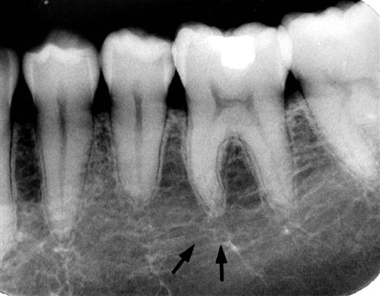

Slide 12
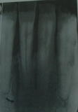
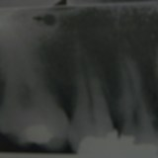
NUTRIENT CANAL
Ribbon like radiolucency – between the teeth
Large nutrient canal – max posterior region.
All the region of the canal become more marked when the teeth are missing.
Beam of x ray is placed parallell to the canal it appears - radiolucent.

Slide 13
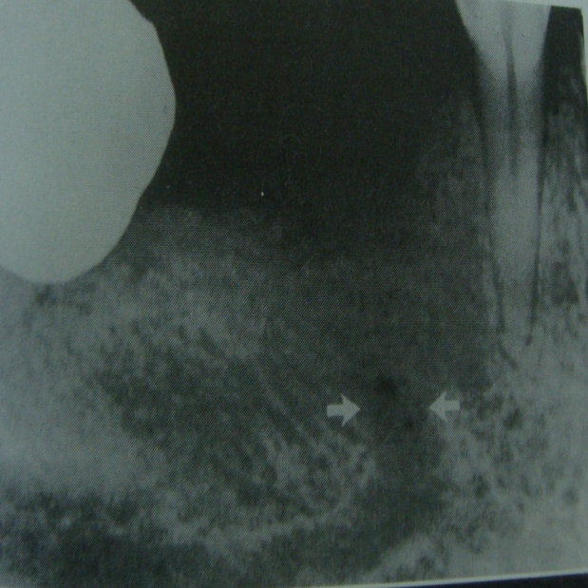
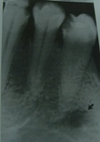
MENTAL FORAMEN
Mandibular canal sends off the mental canal in the premolar region
Smaller canal runs in superior buccal direction and terminates with mental foramen
Located in the premolar apices

Slide 14
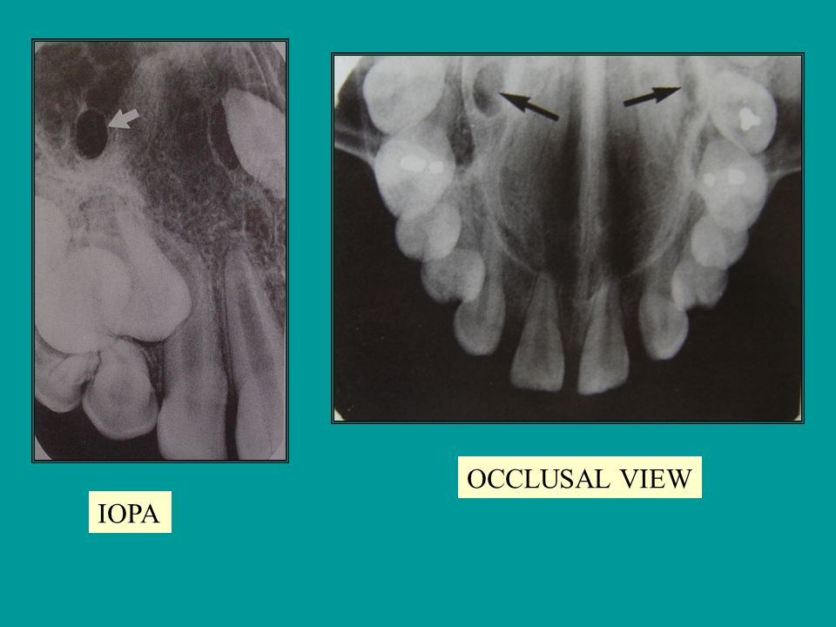
GREATER PALATINE FORAMEN
Identified as each side as a round to oval ill defined radiolucency
over or between the apices of the maxillary second and third molar.

Slide 15
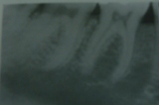
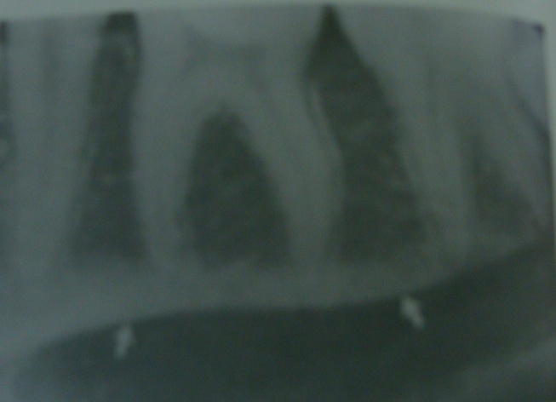
SUBMANDIBULAR FOSSA
Concave area on the lingual side of the mandible below the molar area
Appears – poorly defined radiolucent area
Contrast is increased by the prominent radiopaque mylohyoid ridge that runs across the top of the depression.

Slide 16
TRUE PERIAPICAL RADIOLUCENCIES
Sequelea of pulpitis

Slide 17
PERIAPICAL ABSCESS
Is a painful localised collection of pus in the alveolar bone at the root apex of the tooth after the death of the pulp.
Clinical features
Deep caries involving pulp or
Non vital teeth
Severe pain
Elevation of tooth

Slide 18
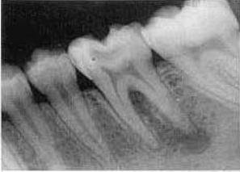
Radiological appearance
Location
Epicenter at the apex of involved tooth
Periphery
Ill defined radiolucency
Gradual transition from the normal trabecular pattern to lesion

Slide 19
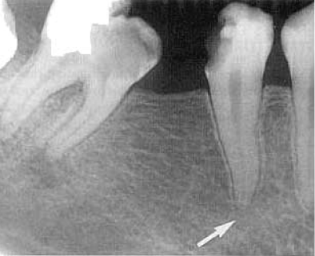
Internal structure
Widening of the periodontal ligament space
Effects on surrounding structures
Destruction of bone
Lamina dura is lost

Slide 20
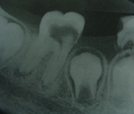
PERIAPICAL GRANULOMA
Most common pathologic radiolucency
Clinical features
Radiological features
Well defined radioluceny - apex of the root end
In long standing cases – radiopaque on the margin of the lesion.

Slide 21
Differential diagnosis
Periapical abscess – diffuse radiolucency
Periapical cyst
Radiolucency is larger than 1.6 cm its most likely an apical cyst.
Cyst may cause root of adjacent teeth due to increased pressure of fluid.

Slide 22
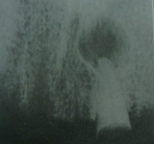
RADICULAR CYST
Is a cyst that most likely results when rests of epithelial cells in the periodontal ligament are stimulated to proliferate and undergo cystic degeneration by inflammatory products from a nonvital tooth.
Clinical features
Most common
Male prediliction
Arise from non vital tooth
asymptomatic

Slide 23
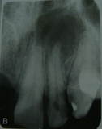
Radiographic features
Location
epicenter at the apex
mostly in maxilla – incisors and canine
Periphery
Well defined cortical border
Secondarily infected results in the
loss of cortex

Slide 24
Internal structure
Mostly radiolucent
Effect of surrounding structure
Displacement and resorption of root seen
May invaginate the antrum.

Slide 25
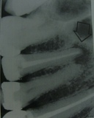
DIFFERENTIAL DIAGNOSIS
Periapical cemento osseous dysplasia
Periapical scar and surgical defects
Persistant, asymptomatic,non enlarging
Asymptomatic radiolucency that persists after root resction
Traumatic bone cyst
Intact Lamina dura is seen.
Mandibular infected buccal cyst
Usually 1st molar are involved
Lamina dura is intact.

Slide 26
OSTEOMYELITIS
Is an inflammation of bone. Inflammatory process may spread through the bone to involve the marrow, cortex, cancellous portion and periosteum.

Slide 27
ACUTE SUPPARATIVE OSTEOMYELITIS
Acute phase of osteomyelitis is caused by infection that spreads to the bone marrow.
Clinical features
Male, no age predliction
Mandible than maxilla
Rapid in onset
Pain swelling of adjacent tissues
Fever and lymphadenopathy

Slide 28
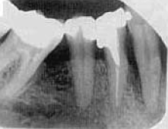
Radiological features
Location
Posterior body of the mandible
Periphery
Ill defined periphery with a gradual transition to normal trabeculea
Internal structure
Radiolucent
Sequestra may be present
Effect on the surrounding structure
Either bone resorption or formation
Portion of cortical bone may be resorbed.

Slide 29
SURGICAL DEFECTS
Defect in bone is an area that fails to fill in with osseous tissue after surgery
Seen in root resection procedures

Slide 30
Radiological features
Previous injury
Rounded, smoothly contoured and well defined radiolucency
Less than 1 cm
Edentulous region – saucerized
Post extraction surgical healing – dense radiolucent with no evidence of trabeculation.

Slide 31
PERIAPICAL SCAR
is composed of dense fibrous tissue and is situated at the periapex of a pulpless tooth in which usually the root canals have been successfully filled.
c/f
Maxilla-anterior
Asymptomatic
Endodontically treated

Slide 32
r/f
Well circumscribed radiolucency
More or less round in shape

Slide 33
Differential diagnosis
Most of the periapical pathologic lucency
Endodontically treated
Root resection,asymptomatic
r/a of well defined periapical radiolucency

Slide 34
RESIDUAL CYST
Is a cyst that remains after incomplete removal of the original cyst.
Clinical features
Asymptomatic
Discovered on radiological appearance
Pain – secondary infection

Slide 35
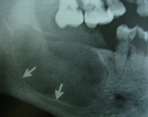
Radiological appearance
Location
Both jaws – mandible
Epicenter – former periapical region of missing tooth.
Mandible – above the mandibular canal
Periphery
Oval or circular
Has a cortical margin unless it is secondarily infected

Slide 36
Internal structure
Radiolucent
Long standing cases – dystrophic calcification is seen.
Effect on surrounding structures
Tooth displacement and resorption
May invaginate the maxillary antrum
Depress the alveolar nerve canal.

Slide 37
Periodontal disease

Slide 38
PERIONDONTAL DISEASE
When the superficial inflamation in the gingival tissues extends into the alveolar bone and there has been loss of attachment.
Chronic periodontitis
Aggressive periodontitis
Periodontal abscess
Lateral periodontal cyst

Slide 39
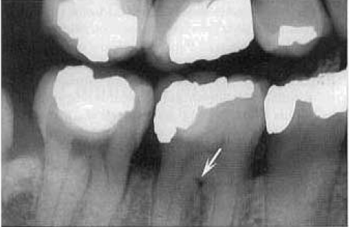
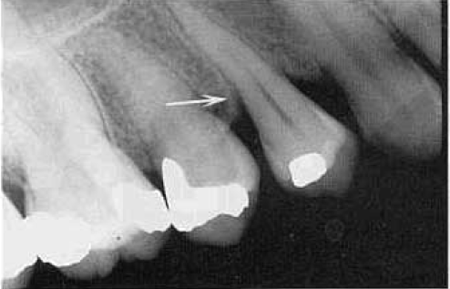
CHRONIC PERIODONTITIS
Most common and important form of periodontal tissue
Radiological features
Loss of interdental crestal margin
Widening of the periodontal ligament space
Bone angle become rounded and irregular
Localised or generalised loss of alveolar bone
Horizontal or vertical bone loss

Slide 40
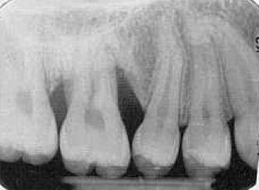
AGGRESSIVE PERIODONTITIS
Progression of the disease and subsequent bone destruction is rapid.
Radiological features
Vertical bone defect – 1st molar and incisors
Arch or saucer shaped defects
Migration – diastema formation
Rapid rate of bone loss.

Slide 41
PERIODONTAL ABSCESS
Rapidly progressing destructive lesion that usually orginates deep in a soft tissue pocket
Occurs when the coronal portion of the pulp is occluded
Radiological features
Acute – no radiological appearene
If the lesion persists
Widening of the periodontal ligament is seen

Slide 42
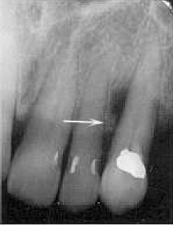
Radiolucency may be rounded area of rarefication and a bridge of bone may be present over the coronal aspect of the lesion separating from the crest of alveolar ridge

Slide 43
LATERAL PERIODONTAL CYST
Arises from epithelial rests in periodontium lateral to the tooth root. This condition usually is unicystic
It may appear as a cluster of small cyst a condition referred to as botryoid odontogenic cyst

Slide 44
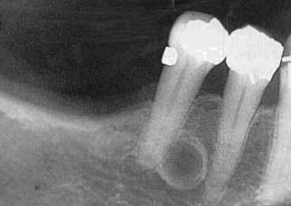
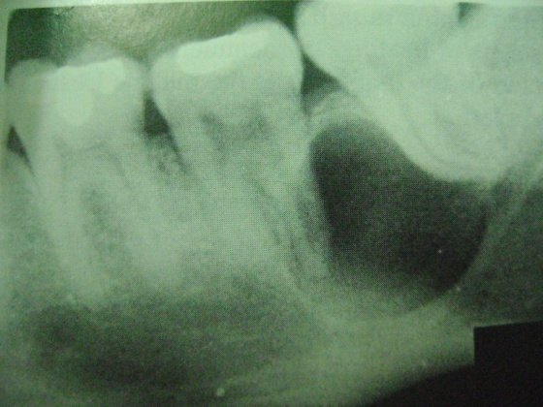
Radiogaphic features
Location
Mandible – lateral incisor to premolar
Maxilla – lateral incisors and cuspids
Periphery and shape
Well defined radiolucency with
Round or oval shape
Internal structure
Radiolucent

Slide 45
Differential diagnosis
Mental foramen
A Small KOT
Radicular cyst at the at the foramen of a lateral pulp canal.

Slide 46
Fibroosseous lesion

Slide 47
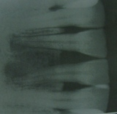
PERIAPICAL CEMENTOOSSEOUS DYSPLASIA
Periapical cementoma
Is a reactive fibro osseous lesion thought to arise elements in the periodontal ligament.
The periapical lesion have the following stages
Early stage is radiolucent
Mature stage – radiolucent area containing the radiopaque foci
Final stage – completely calcified and appears as radiopaque by thin radiolucent border.

Slide 48
Radiological features
Location
epicenter usually lies at the apex
Mandibular anterior – maxilla
Mostly- bilateral
Periphery and shape
Well defined radiolucency with sclerotic border
Round or oval shaped

Slide 49
Internal structure
Early stage – radiolucent
Effect on surrounding structures
Loss of lamina dura

Slide 50
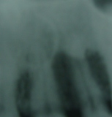
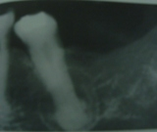
Differential diagnosis
Pulpoperiapical lesion
Traumatic bone cyst
Focal cementoosseous dysplasia
Cemento ossifying fibroma

Slide 51
Malignant tumours

Slide 52
Squamous cell carcinoma
Metastatic tumour
leukemia
Histiocytosis X

Slide 53
SQUAMOUS CELL CARCINOMA
Most common oral malignancy
Malignant tumour arising from the surface epithelium
Characterized by invasion of malignant epithelial cells into the underlying connective tissue with subsequent spread into the deeper soft tissues and occasionally into adjacent bone, lymphnodes, ultimately to lung, liver and skeleton

Slide 54
Radiological appearance
Location
Lateral border of the tongue – posterior lingual aspect of the mandible
Lesions of lip, floor of mouth – involves the anterior mandible
Lesions of gingiva and alveolar bone – mimic inflamattory disease such as periodontal disease.

Slide 55
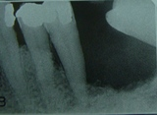
Periphery
May erode underlying bone in any direction
Radiolucency – irregular in outline
Bone involvement is extensive – appears as finger like extensions
Internal structure
Radiolucency
Small islands of normal trabucular bone are visible with in the radiolucency.

Slide 56
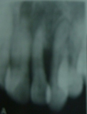
Effect on sorrounding structure
Evidence of invasion may first appear as widening of the periodontal ligament
Extensive tumour – soft tissue mass grow into the teeth and are grossly displaced.

Slide 57
Differential diagnosis
Scc is differentiate by other malignancies by its clinical and histologic features
Osteomyelitis
Usually produces some periosteal reaction
Periodontal disease
Bone loss from the squamous cell carcinoma originating in the soft tissue of the alveolar process appears as a periodontal disease.

Slide 58
METASTATIC TUMOURS
Establishment of new foci of malignant diease from a distant malignant tumour, usually by way of the blood vessels
In the jaws usually arise from the sites that are anatomically inferior to the clavicle
Usually occurs when the distant primary lesion is already known

Slide 59
Clinical features
5th to 6th decayed
Pt c/o dental pain, numbness and parasthesia
Pathologic fracture of the jaw

Slide 60
Radiological features
Location
Mandible common than maxilla
Posterior area are most commonly affected
Frequently lesions were bilateral
Also in the periodontal ligament space
Periphery
Is moderately well demarcated
No cortication or encapsulation – ill defined margins

Slide 61
Internal structure
Radiolucent normal trabecular bone is seen
Sclerotic metastasis present – normal radiolucent appears as patchy sclerosis
If the tumour is sealed in multiple region of the jaws – multifocal appearence

Slide 62
Differential diagnosis
Known primary malignancy present
Multiple myeloma
Periapical inflammatory lesion

Slide 63
LEUKEMIA
Malignant tumor of hematopoietic stem cells
Replace normal bone marrow constituents
Pallor, spontaneous hemorrhage, hepato and splenomegaly, and fever
Mobile teeth, petechiae, ulceration, boggy enlarged gingiva

Slide 64
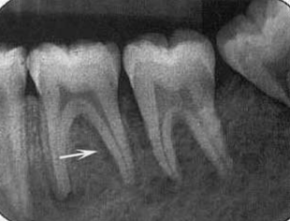
Location
Mandible
Bilateral
Areas of developing tooth
Periphery and shape
Ill defined patchy radiolucent areas
Teeth stand out of bone

Slide 65
Internal structure
Patchy radiolucent areas
Effects on surrounding structures
No expansion
Developing teeth buds displaced occlusally even with out root formation
Loss of lamina dura and cortical out lines of follicles

Slide 66
LANGERHANS CELL HISTIOCYTOSIS
Abnormalties that results from the abnormal proliferation of langerhans cells
Clinical features
Head and neck are common at initial
1o% of all pts have oral lesion
Oral signs are the first clinical signs of the disease
Soft tissue mass, bony swelling, gingivitis pain and ulceration.

Slide 67
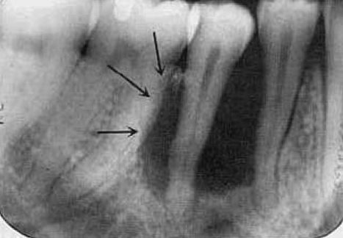
Radiological appearance
Location
Alveolar type or commonly multiple
Mandible is common – posterior regions
Periphery
Moderate to well defined without cortication
Common start at the mid root region of the teeth
Bone destruction in circular shape- scooped out

Slide 68
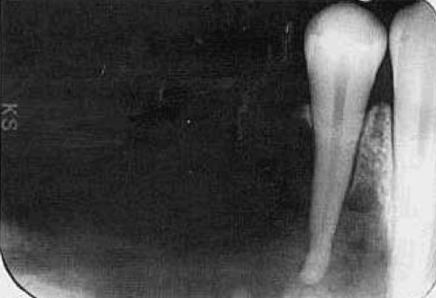
Internal structure
Totally radiolucent
Effect on sorrounding structures
Destruction of bone around the teeth and lamina dura
Teeth appears to be standing in space.

Slide 69
Differntial diagnosis
Periodontal disease – starts at the alveolar crest and apically down to the root surface
Squamous cell carcinoma
Borders of the LCH IS better defined

Slide 70
Reference
Diagnostic imaging of the jaws; Robert P.Langlais, Olaf E. Langland, Christoffel J. Nortje
Oral Radiology Principles and Interpretation; 6th edition: Stuart C. White, Michael J. Pharoah.
Differential Diagnosis;5th edition: Wood and Goaz

Slide 71
Thank you

