Slide 1
ADVANCED IMAGING

Slide 2
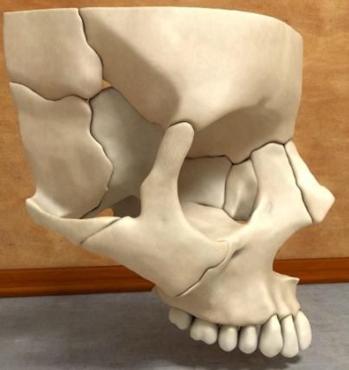
INTRODUCTION
Why we need 3D imaging???
shows 2D image of 3D structure
Superimposition of structures
Exact localization
Density of the lesion cannot be detected

Slide 3
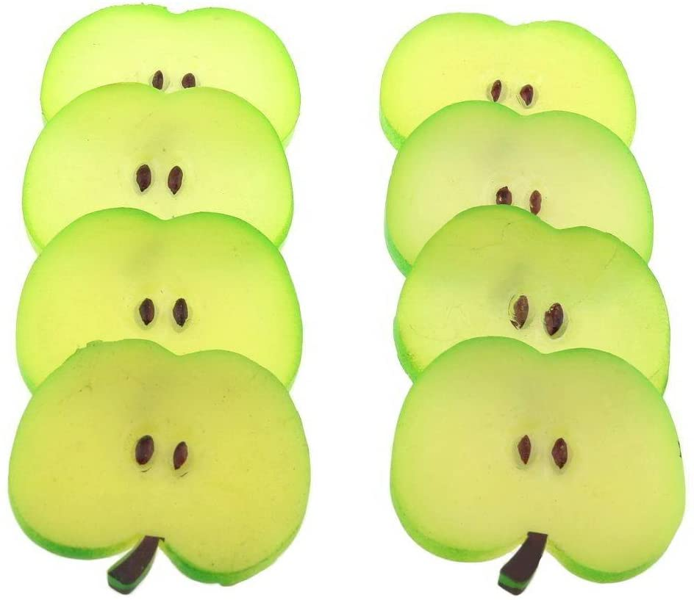
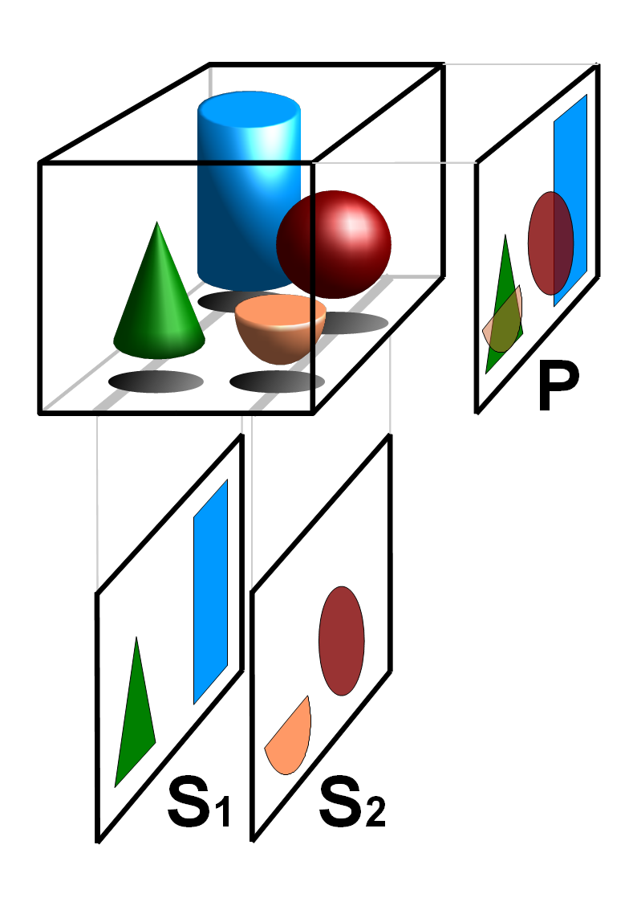

Slide 4
COMPUTED TOMOGRAPHY
CONE BEAM CT
MAGNETIC RESONANCE IMAGING
ULTRASONOGRAPHY
NUCLEAR MEDICINE
SCINTIGRAPHY
POSITRON EMISSION TOMOGRAPHY (PET)
SINGLE POSITRON EMISSION COMPUTED TOMOGRAPHY (SPECT)

Slide 5
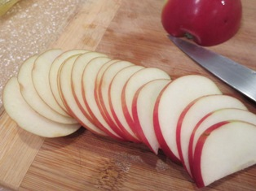
COMPUTED TOMOGRAPHY
Introduced first by Sir Godfrey Hounsfield in 1967
Is the science that creates two and three dimensional cross-sectional images of body structures
Tomos = slice/selection; Graphia = picture/ image
+ computed synthesis

Slide 6
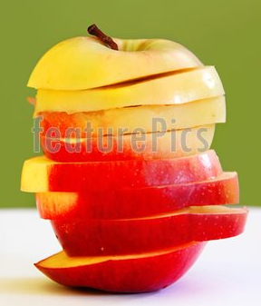
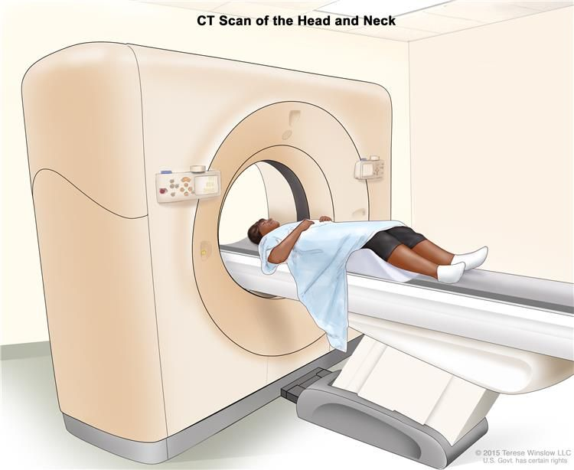

Slide 7
Principle
To be simple.....
Patient exposure
Detected by detector
Image reconstructed from multiple projections
Image is displayed

Slide 8
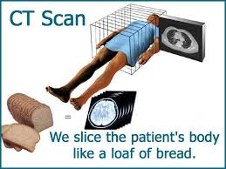
Cross sectional slices

Slide 9
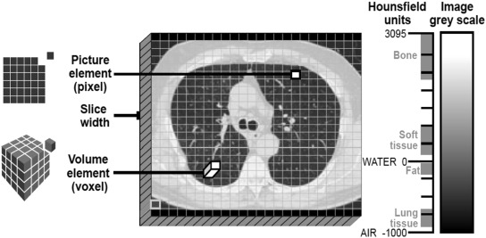
Terminologies

Slide 11
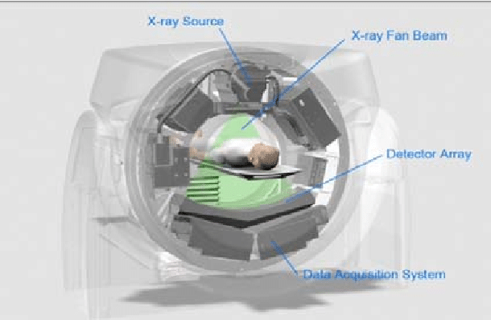

Slide 12
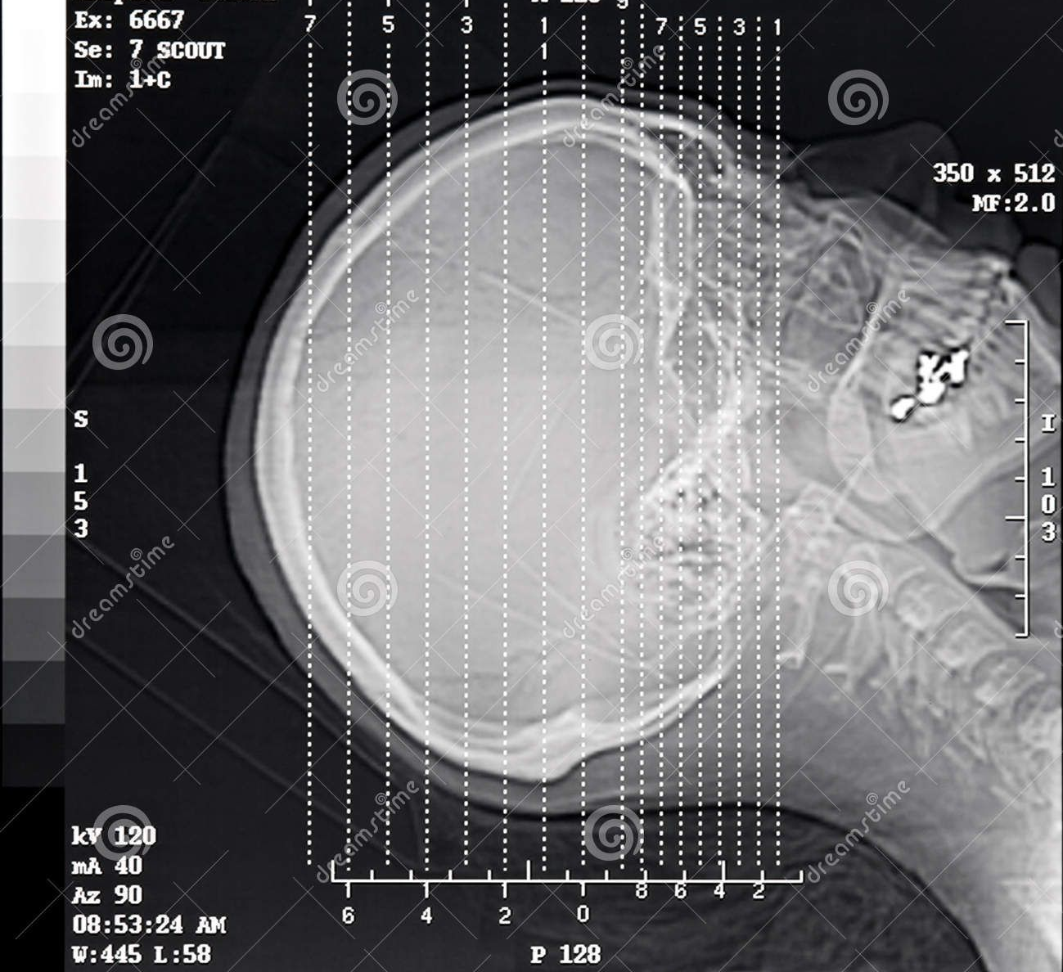

Slide 13
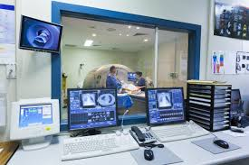
OPERATING CONSOLE

Slide 14
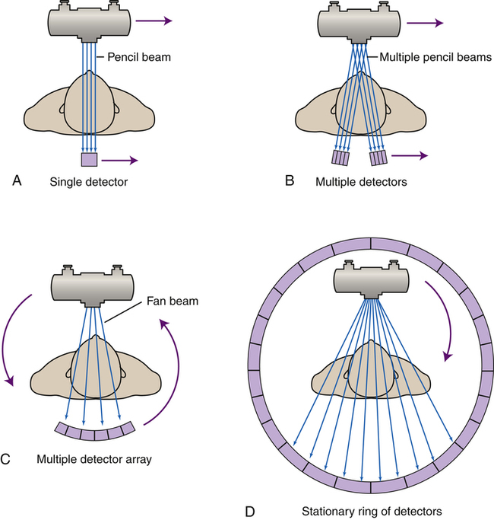

Slide 16
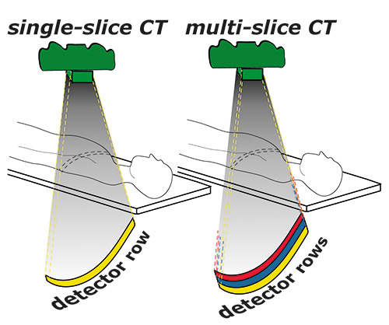

Slide 17
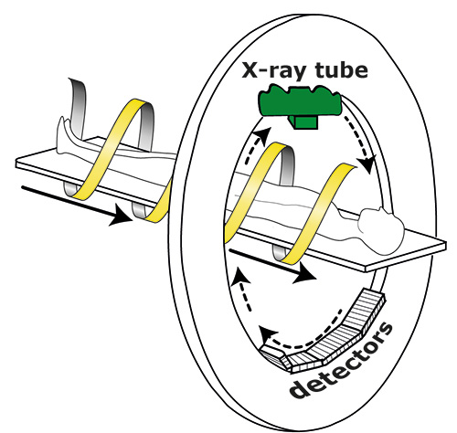
SPIRAL CT

Slide 18
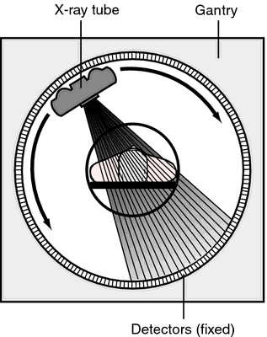
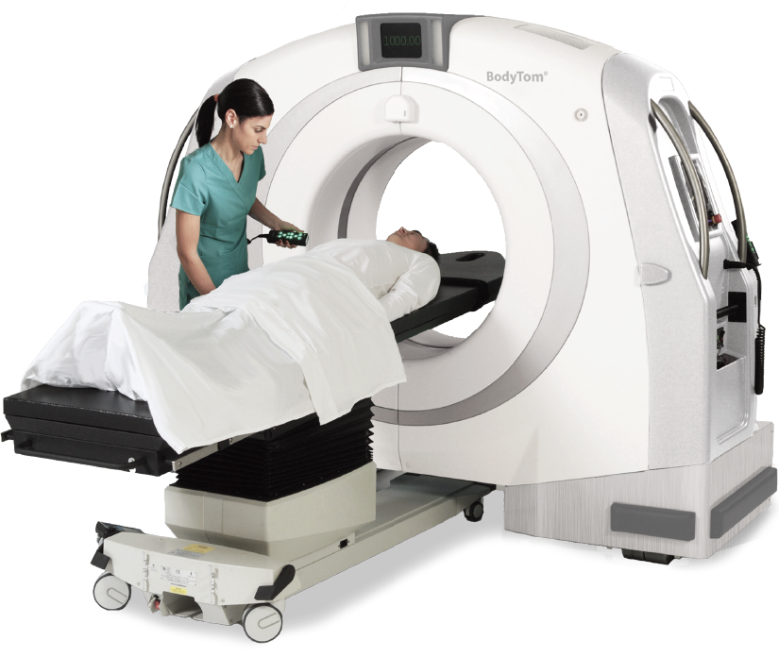
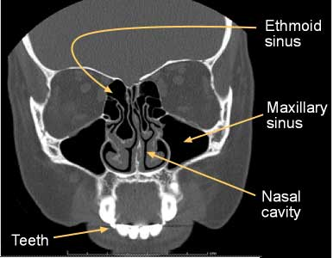
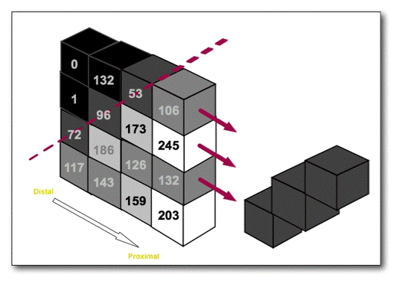

Slide 19
Indications
Mainly used to evaluate the hard tissue pathologies
Pathologies involving maxilla, mandible and facial bones.
Cysts and tumours
TMJ pathologies
Craniofacial fractures
Maxillary sinus pathologies
Bone and fibro-osseous lesion
Assessment of styloid process
Assessment of implants

Slide 20
Advantages
Axial, coronal and sagittal sections are obtained along with 3D view
Imaging of hard and soft tissues
Images can be manipulated
Images can be enhanced by use of IV contrast.
Images can be archieved and sent through electronic gadgets

Slide 21
Disadvantages
Expensive
Very thin slices may result in high dose of radiation
Metallic objects such as fillings may produce artifacts and streaks.

Slide 22
Interpretation
Hyperdense:
Tissues with high density
E.g. Bones
Isodense:
Has same density as surrounding structures
E.g. Muscles
Hypodense:
Tissues with less density
E.g. Water, air

Slide 24
CT Number
The numbers in the image matrix is called CT NUMBER.
Each pixel has a number which represents the X ray attenuation in the corresponding voxel of the object.
Represent the density of tissue.
Different tissue have different CT number range in HU.

Slide 25
TISSUE AND CT NUMBER
TISSUE | CT NUMBER
AIR | -1000
FAT | -100
PURE WATER | 0
CSF | 15
WHITE MATTER | 45
GRAY MATTER | 40
BLOOD | 20
BONE/ CALCIFICATION | +1000

Slide 26
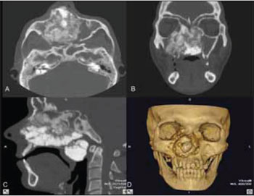

Slide 27
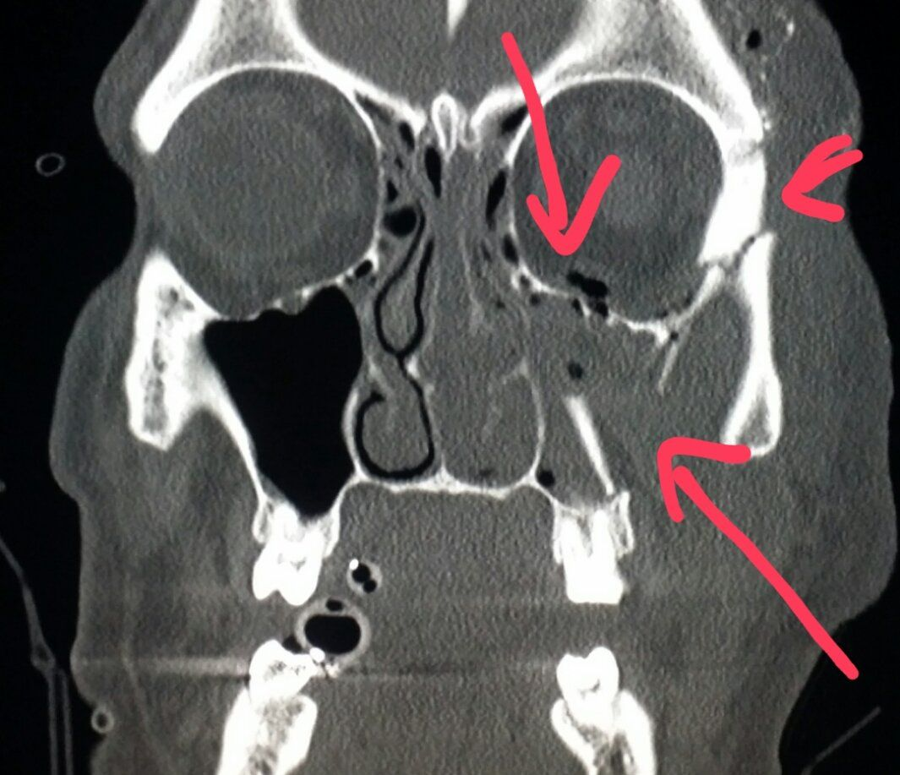
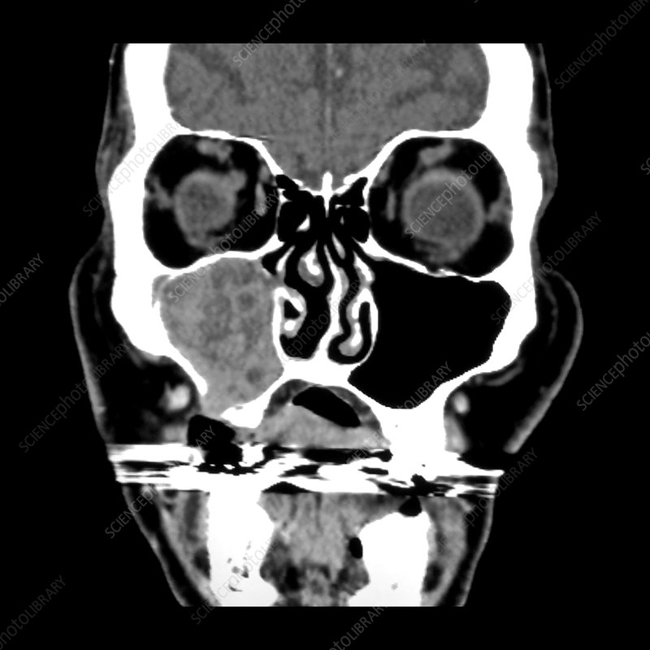

Slide 28
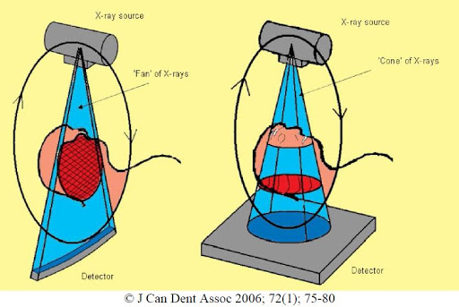
Cone Beam Computed Tomography (CBCT)

Slide 29
Cone shaped beam
Both source and detector rotate by 360 degree
Patient position: sitting or standing
FOV can be adjusted ; either maxilla or mandible can be imaged
Detector: Area detector – whole volume can be imaged with a single rotation of X-ray machine and detector
Multiplanar reformattion is possible ---i.e. Image can be in oblique, curved section along with Axial, Coronal and Sagittal sections

Slide 30
Advantages
Rapid scan time
FOV can be limited based on the area of interest
Image accuracy
Reduced patient dose
Less space occupancy of the machine
Low cost compared to CT

Slide 31
Disadvantages
Poor soft tissue contrast
Artifacts due to metal objects like restorations and implants

Slide 32
THANK YOU

