Slide 1
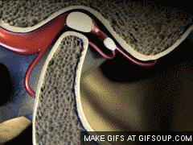
TMJ imaging

Slide 2
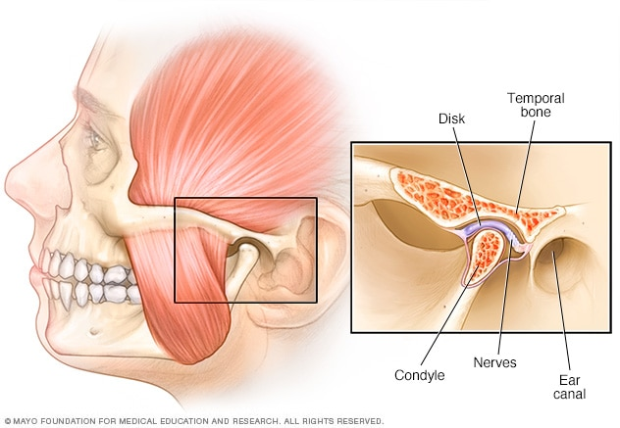
Anatomy

Slide 5
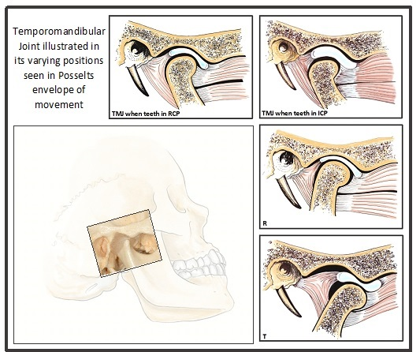
Movements

Slide 6
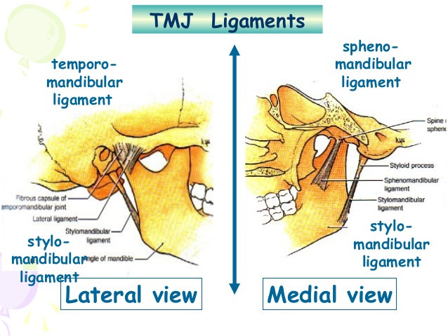

Slide 7
EXAMINATION Inspection
Facial assymmetry
Swelling
Pus discharge
Erythema
Flatness of joint

Slide 8
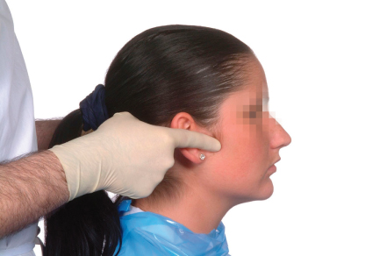
Palpation

Slide 9
Projections
To evaluate bony component | Soft tissue component
TMJ views | Arthrography
Reverse town | MRI
OPG | USG
Submentovertex view
TMJ Tomography
Computed tomography
Bone scintigraphy

Slide 10
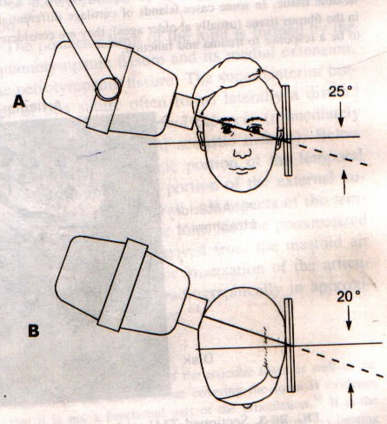
Transcranial
Film placement
Patient placement
Central ray
Passes half inch behind and 2 inch above EAM
Directed downward 25 degree and 20 degree anterior to horizontal plane centered over TMJ of interest.

Slide 11
Structures seen
Indications:
Arthritic changes on the lateral aspect of condyle.
Fracture of condylar head.
To view latero superior surface of condylar head and articular eminence.

Slide 12
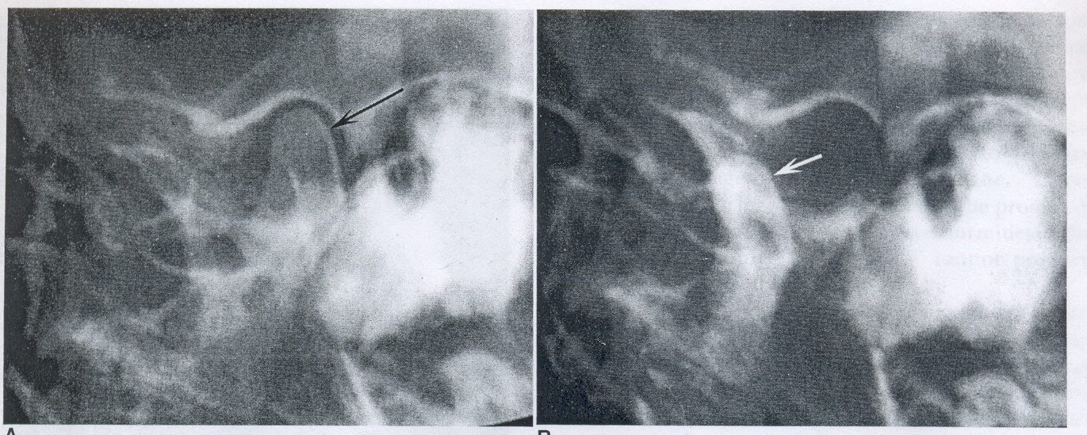
CLOSED MOUTH OPEN MOUTH

Slide 13
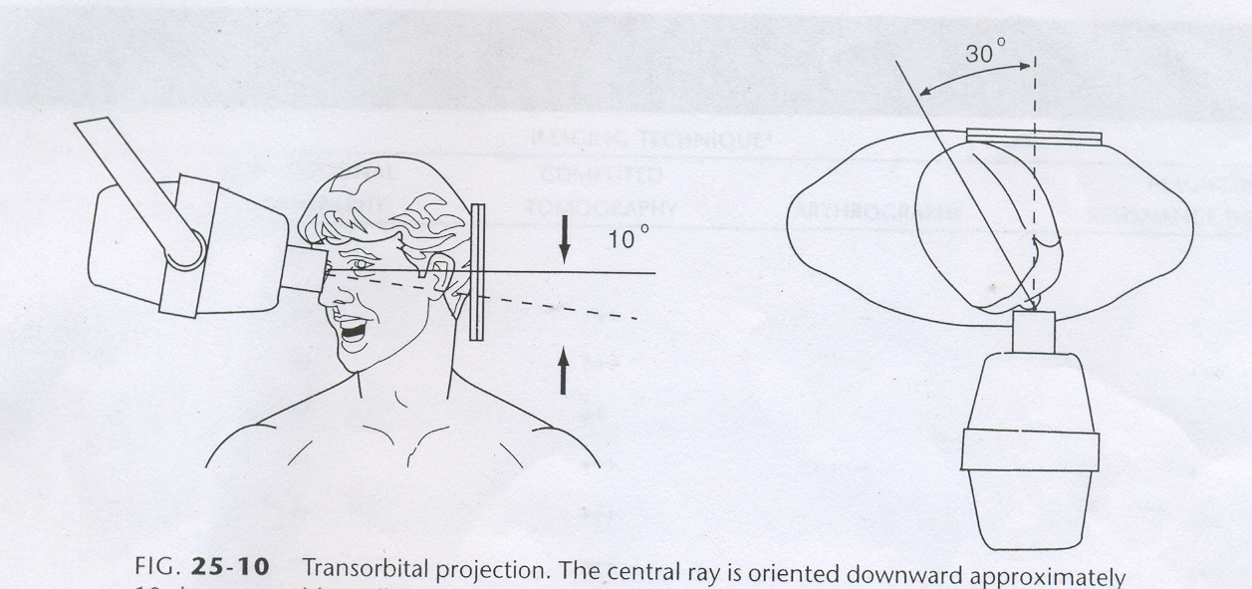
Transorbital view/ Zimmer projection
Film placement
Patient placement
Central ray:
Tube head infront of patient.
Directed toward joint of interest at angle of +2o degree.
Point of entry-medial canthus of opposite eye.

Slide 14
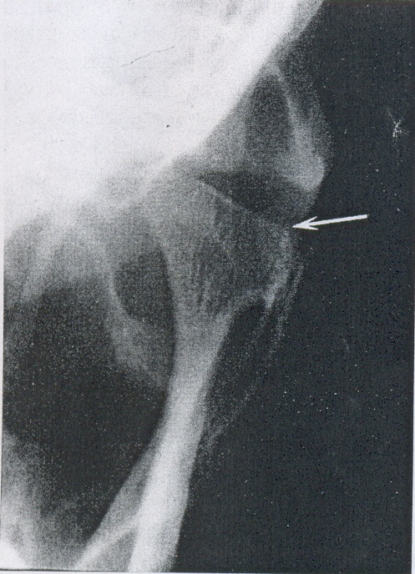
Structures seen
Indications:
Anterior view of condylar head and neck
Medial displacement of fractured condyle.
Fracture of neck
of condyle

Slide 15
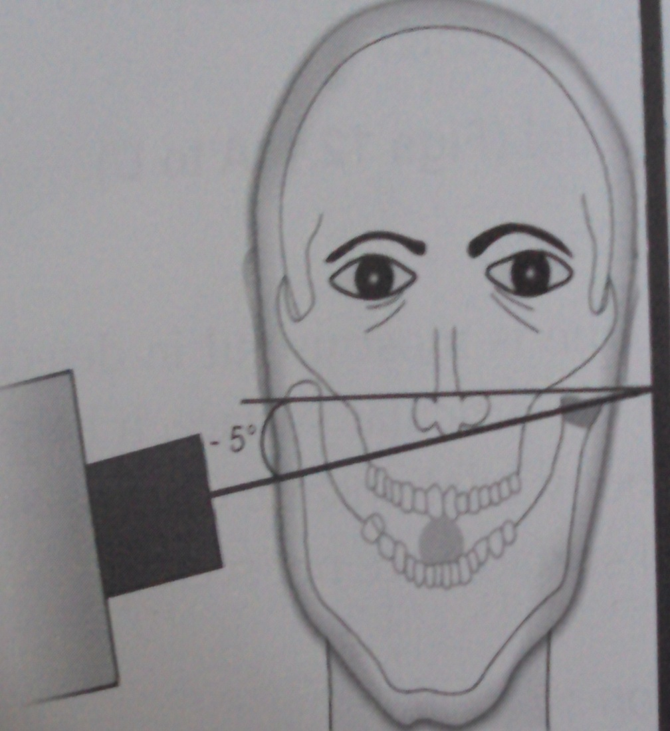
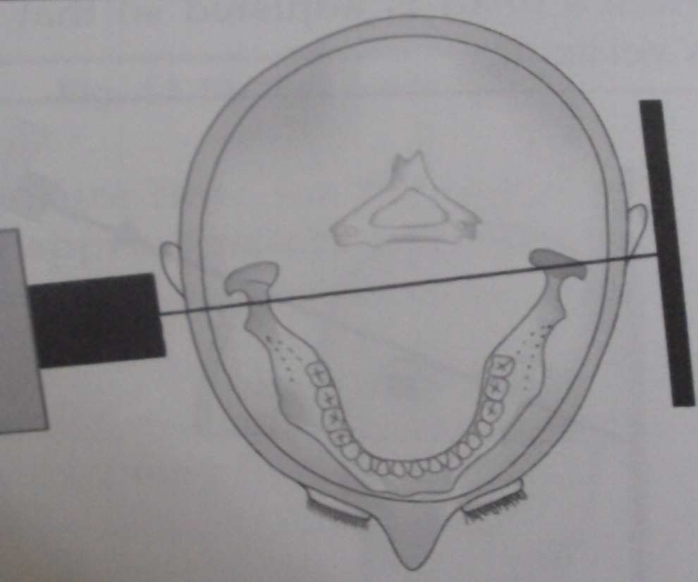
Transpharyngeal view / Infra cranial view
Film placement
Patient placement
Central ray

Slide 16
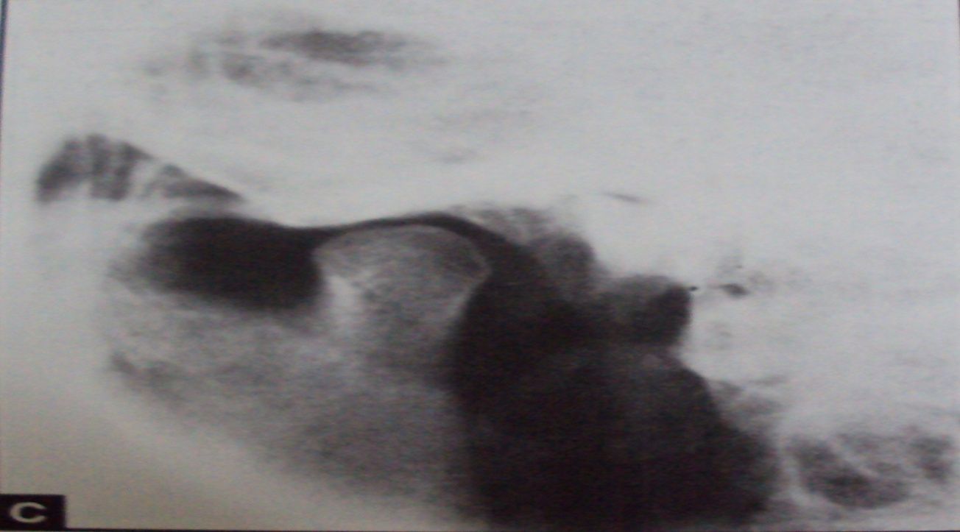
Structures seen:
Indications:
To view the medial surface of condylar head and neck.
To view fracture of condylar head and neck.

Slide 17
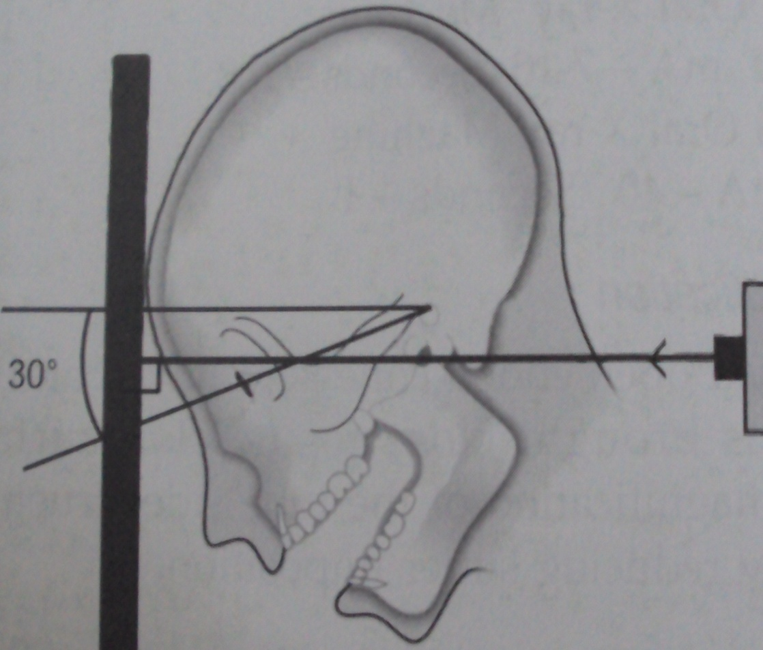
Reverse town

Slide 18
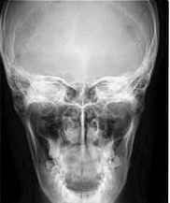
Structures seen:
Indications:
High fracture of condylar neck.
Intra-capsular fracture of TMJ
Condylar hypoplasia and hypertrophy

Slide 19
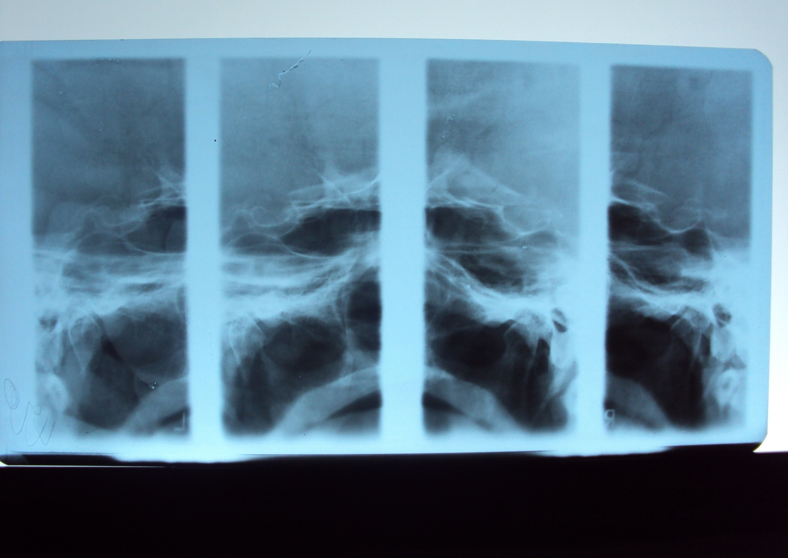
TMJ Tomography

Slide 20
CT
Axial

Slide 21
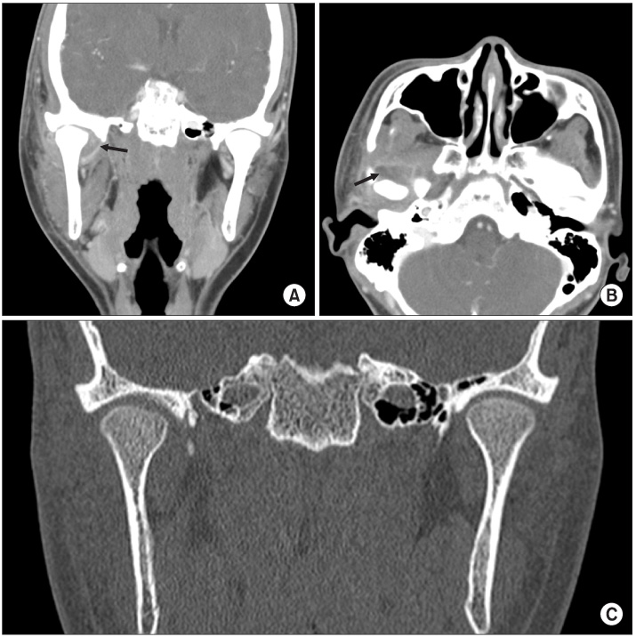
Coronal Ct

Slide 22
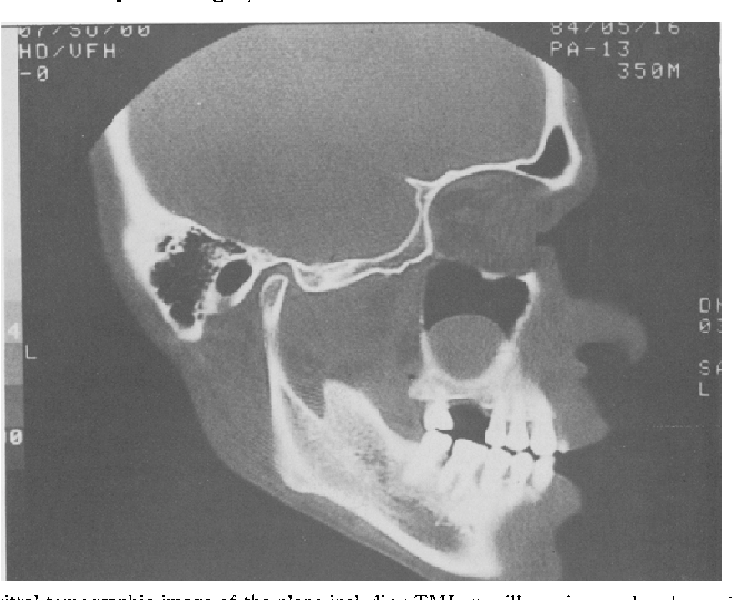
Sagittal

Slide 23
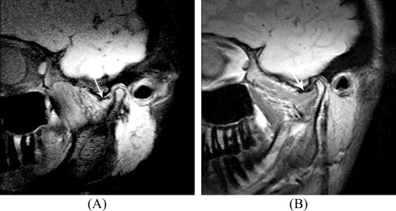
MRI

