Slide 1
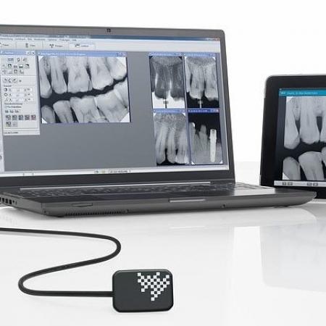
Digital radiography

Slide 2
Digital radiography is a term used to describe radiography when the images are taken in a digital form and are capable of being displayed in the computer
Digital sensors are used

Slide 3
Digital radiography refers to a method of capturing a radiographic image using a sensor, breaking it into electronic pieces and presenting and storing the image using a computer.

Slide 4
Advantages
Dose reduction upto 50 -90% compared to conventional
Image can be manipulated
Contrast of the image can be enhanced
Measurements can be done
Images are electronically transferred to other healthcare providers
It can stored for future use and study purpose
Environment friendly – avoids chemicals used in processing and lead foil

Slide 5
Disadvantage
Relatively high initial cost
Rigid sensor dimensions
Large disc space is needed to store the data

Slide 6
Methods
Direct - sensor is placed in the patient’s mouth and exposed to radiation. From the sensor the image is transmitted to computer monitor within seconds
Indirect - an existing X-ray film is digitized using a CCD camera, which scans the image, digitizes or converts the image and displays in computer.

Slide 7
Storage Phosphor Imaging – A reusable imaging plate coated with phosphors is used. The storage phosphor imaging records diagnostic data on the plates following exposure to the X-ray source and high speed scanner to convert the information to electronic files --- displayed on the computer screen

Slide 8
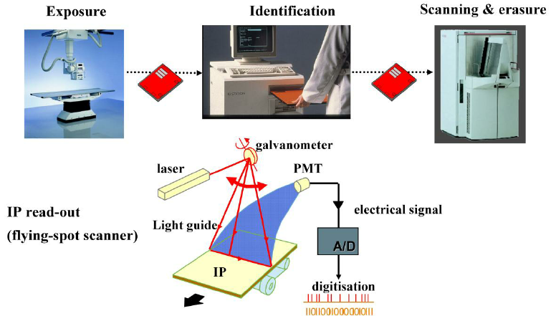

Slide 9
Components
X-ray generator
Direct digital sensors
Charge coupled device (CCD)
Complementary metal oxide semiconductors (CMOS)
Photostimulable phosphor plates (PSP)
Thin film transistors (TFT)
Analog to digital converter (ADC)
Computer
Monitor or printer for Image display

Slide 10
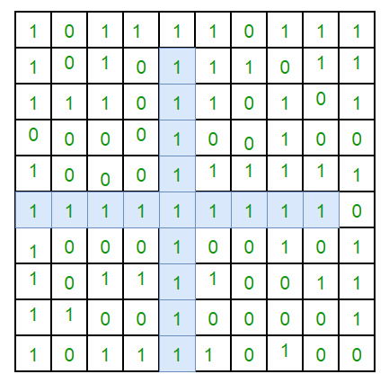
Terminologies
Matrix – the image to be taken is represented as many rows and columns
Pixel – picture element. Each pixel is assigned a value, related to signal intensity. The value stored in a binary form (0,1)
Pixel having high value represents dark gray shade, whereas low value represents white shade.
High dose – high value – dark gray shade

Slide 12
Process
Image acquisition
Image processing
Image display
Image Archiving
Image retrieving

Slide 14
Digital radiography
Digital radiography
Indirect flat panel detector
Computed Radigraphy
PSP
CCD
Direct Flat panel

Slide 15
CHARGE Coupled Device
First adapted in dentistry in 1987
It is an integrated circuit made of crystalline silicon
Forms images from a visible light
Uses the same radiographic machine as the conventional
Uses sensors instead of radiographic film to capture

Slide 16
CCD
CCD uses a thin wafer of silicon as the basis for image recording.
The silicon crystals are formed in a picture element (pixel) matrix.
When exposed to radiation, the covalent bonds between silicon atoms are broken, producing electron –hole pairs.
Electrons are the attracted toward the most positive potential in the device, where they create ‘charge packets’
Each packet corresponds to one pixel

Slide 17
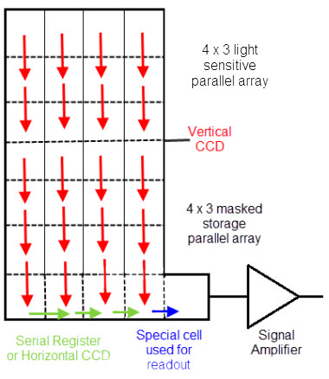
The image is read by transferring each row of pixel charges from one pixel to the next in a bucket brigade fashion

Slide 18
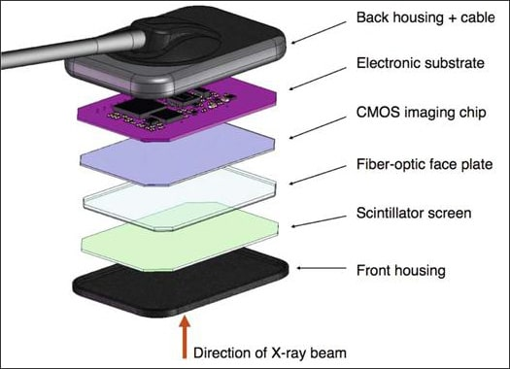
3 components
component | Function
Scintillator | Convert X-ray into visible light
Fiberoptic | Transmit visible light to chip and stop X-rays
Main CCD component | Convert light signal to electric voltage

Slide 19
scintillator
Fiberoptic
e-
CCD component
e-
e-
e-
ADC
e-
X-rays
e-
e-
e-
e-
e-
Light waves
computer

Slide 20
Principle
After passing through the patient the x-ray first strikes on the scintillator
This transmits light to CCD
CCD consists of multiple small elements called pixels (picture element)
It converts the X-rays to visible light
Visible light passes through the fiberoptic

Slide 21
Visible light is absorbed in individual pixel
With the help of small transistor element made of silicon, the electrons are released
These electrons are converted to electric voltage signal
The electrons are deposited in the electron well itself
Once CCD is exposed, charge is read out in Bucket brigade fashion i.e. The electronic charge is shifted from pixel by pixel at the boundaries and then collected

Slide 22
Analog signal is sent to the analog digital converter (ADC)
This is then passed on to computer and converted to a visible image on a monitor
Electrons stored will be proportional to the number of X-rays photon strike the element
ADC converts analog image to numeric values

Slide 23
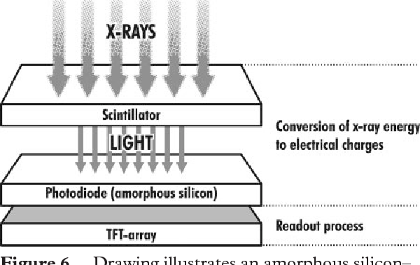
CCD

Slide 24
